Slide 1
WRF Webcast Hyperspectral Characterization of Harmful Algal Blooms
June 5, 2018

Slide 2
WRF Source Water Research
The integrated Water Research Foundation offers a stronger, broader, more interconnected research agenda with greater value and services to subscribers and funders.
WRF has a robust body of work on cyanobacteria that covers occurrence, treatment, prevention and communications.
Check out Legacy WRF (waterrf.org) and Legacy WE&RF (werf.org) websites for projects.

Slide 3
WRF Cyanotoxin Research Projects
Title | Project # | Date Published
Release of Intracellular Cyanotoxins During Oxidation of Naturally Occurring and Lab Cultured Cyanobacteria | 4692 | 2019
Development of a Risk Communication Tool Kit for Cyanotoxins | 4697 | 2018
Performance Evaluation of Methods for the Analysis of Cyanotoxins | 4647 | 2018
Cyanobacterial Blooms and Cyanotoxins: Knowledge Synthesis, Utility Workshop and Research Gaps | 4657 | 2017
Cyanotoxin Guides for Water Utility Managers | 4548 | 2015/2016 Phase 3-2017
Treatment of Algal Toxins in Rivers and River Influenced Groundwater | 4526 | 2017
Management of Treatment Sludge Impacted by Cyanobacteria | 4523 | 2016
Optimizing Conventional Treatment for Removal of Cyanobacteria and Toxins | 4315 | 2015
Release of Intracellular Metabolites from Cyanobacteria During Oxidation Processes | 4406 | 2014
Are There More Toxin Genes Than Toxic Cyanobacteria? Implications for Enumeration, Toxicity, and Bloom Formation | 4060 | 2012

Slide 4
WRF Cyanotoxin Research Projects
Title | Project # | Date Published
Criteria for Quality Control Protocols for Various Algal Toxin Methods | 2942 | 2012
Evaluation of Integrated Membranes for Taste and Odor and Toxin Control | 4016 | 2012
Rapid Detection of Cyanobacterial By-Products in Drinking Water | 4212 | 2012
International Guidance Manual for the Management of Toxic Cyanobacteria | 3418 | 2010
Treating Algal Toxins Using Oxidation, Adsorption, and Membrane Technologies | 2839 | 2010
Determination and Significance of Emerging Algal Toxins (Cyanotoxins) | 2789 | 2007
Development of Molecular Reporters for Microcystis Activity and Toxicity | 2818 | 2007
Early Detection of Cyanobacterial Toxins Using Genetic Methods | 2881 | 2007
Reservoir Management Strategies for Control and Degradation of Algal Toxins | 2976 | 2006
Control of Toxic Cyanobacterial Blooms in Water Bodies by Allelochemicals | 2904 | 2005

Slide 5
WRF Cyanotoxin Research Projects
Title | Project # | Date Published
Removal of Algal Toxins From Drinking Water Using Ozone and GAC | 446 | 2002
Assessment of Blue-Green Algal Toxins in Raw and Finished Drinking Water | 256 | 2001
Cyanobacterial (Blue-Green Algal) Toxins: A Resource Guide | 925 | 1995

Slide 6
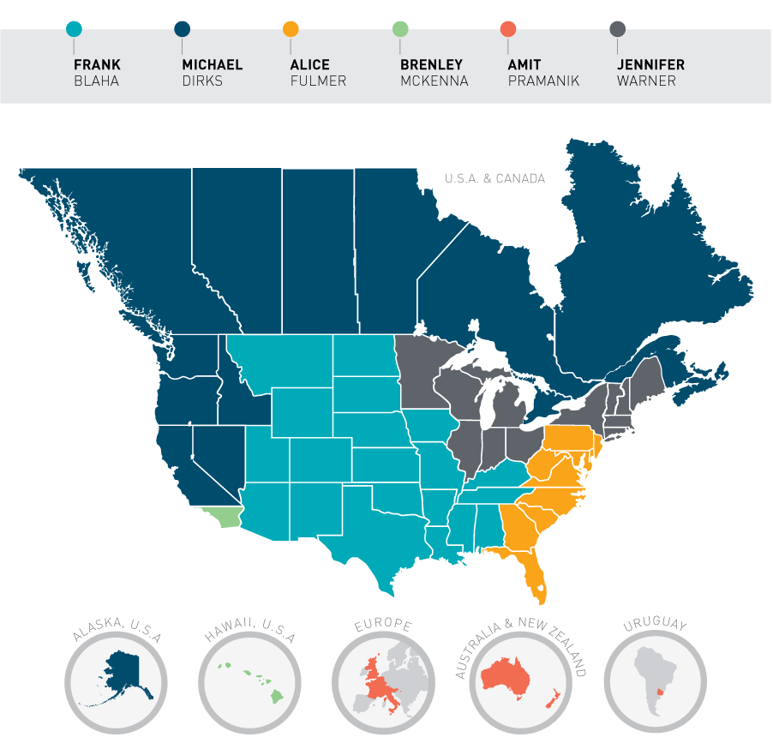
Regional Liaisons

Slide 7
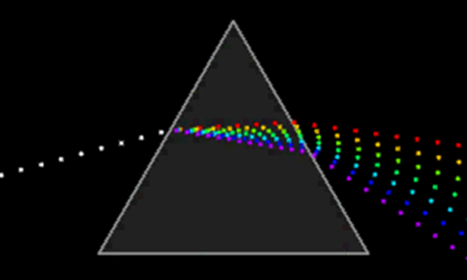
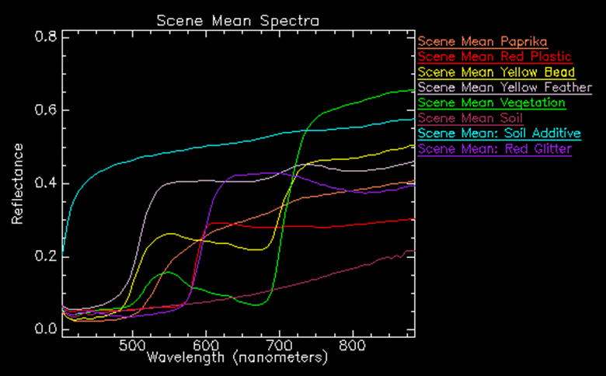
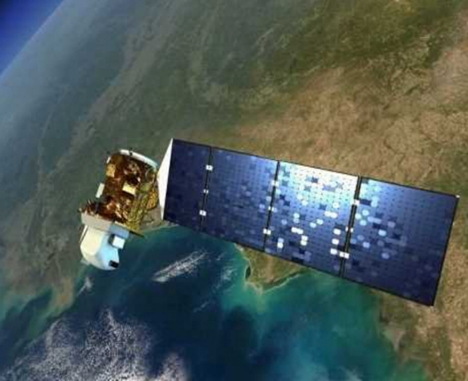
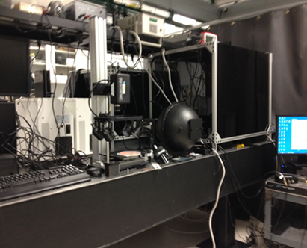
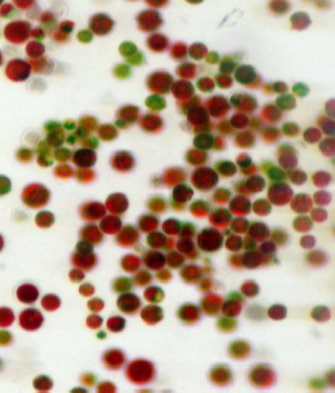
Very High Resolution and Hyperspectral Analysis of Harmful Algal Blooms
E. Terrence Slonecker
Nancy Simon
Natalie Hall
U.S. Geological Survey
June 5, 2018
Notes:
+-Good afternoon. And thank you for your attention. Our goal todayis to briefly present a new technology and research collaboration between the science agencies of the U.S. Geological Survey and the National Institute of Science and Technology. The technology is known as HYPERSPECTRAL MICROSCOPY and involves imaging spectroscopy of harmful algal blooms and related phenomenon at the petri dish scale of observation.

Slide 8
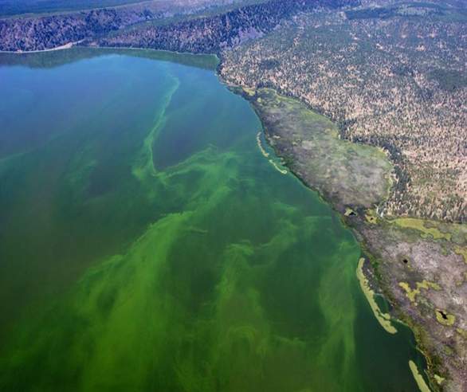
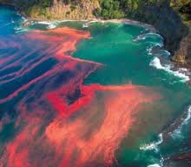
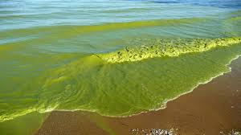
Harmful Algal Blooms
Growing water quality problem worldwide
Aquatic and human health consequences
Water quality
Economic effects
Notes:
Harmful Algal Blooms are of course a growing water quality problem worldwide and are likely to increase as a result of a growing population and changing climate

Slide 9
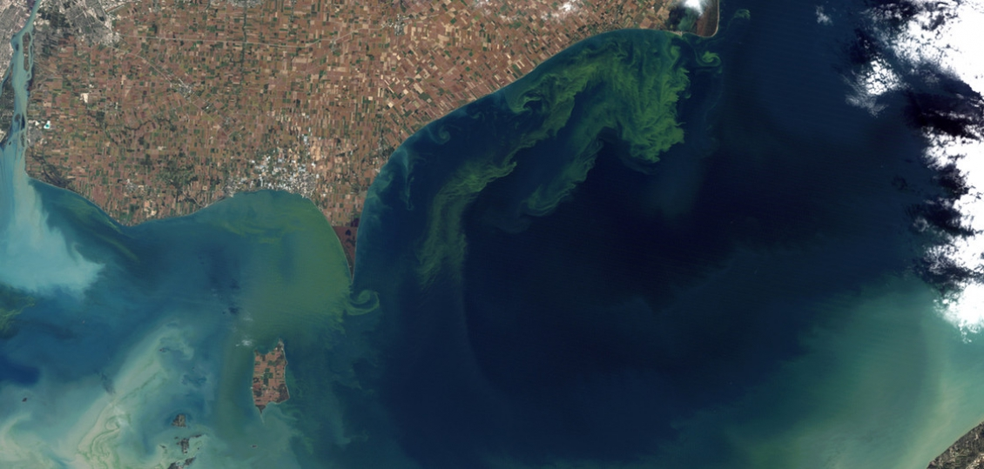
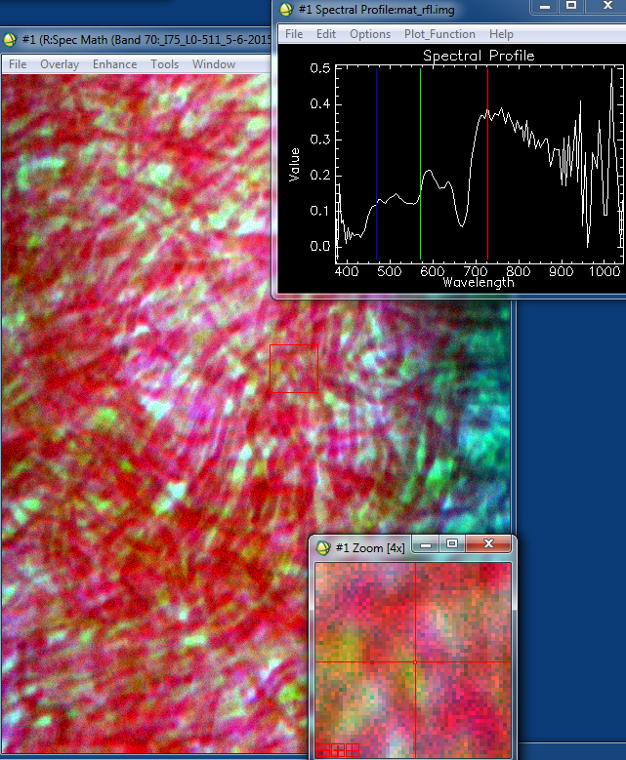
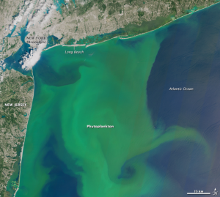
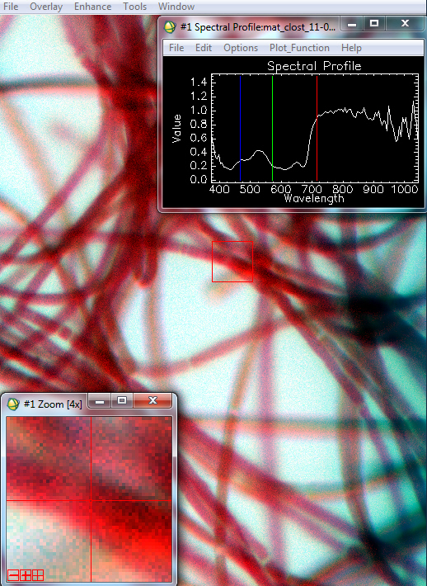
Algae undergoes rapid and uncontrolled growth due to environmental conditions

Slide 10
Finding HABs and measuring their toxins is a complex task
In addition to being a nuisance to recreation, HABs can also be toxic to human and marine life
Toxic species and toxicity conditions are largely misunderstood and represent a major scientific monitoring need
A methodology to remotely identify and monitor HAB conditions would be of great value to a number of water quality managers
Especially important would be the ability to predict toxic transitions and growth potential

Slide 11
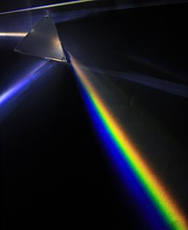
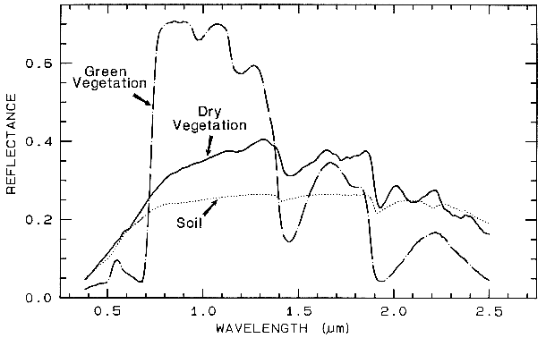
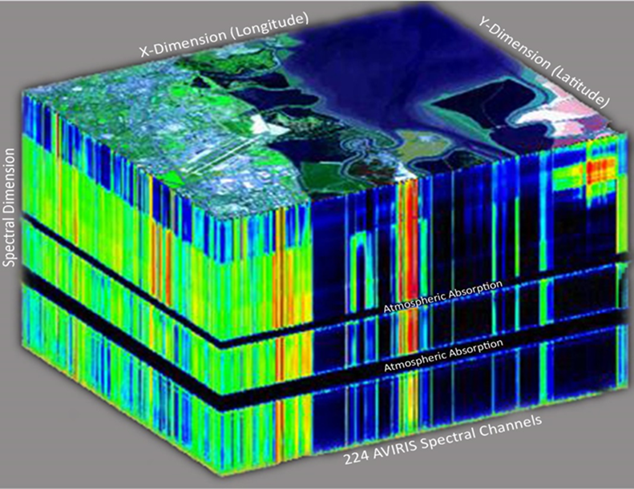
Technology Advances 1
Spectroscopy - Imaging Spectroscopy
Spectroscopy the study of the interaction between matter and electromagnetic radiation. Historically, spectroscopy originated through the study of visible light dispersed according to its wavelength, by a prism.
Imaging Spectroscopy is the simultaneous acquisition of spatially co-registered images in many spectrally contiguous bands.

Slide 12
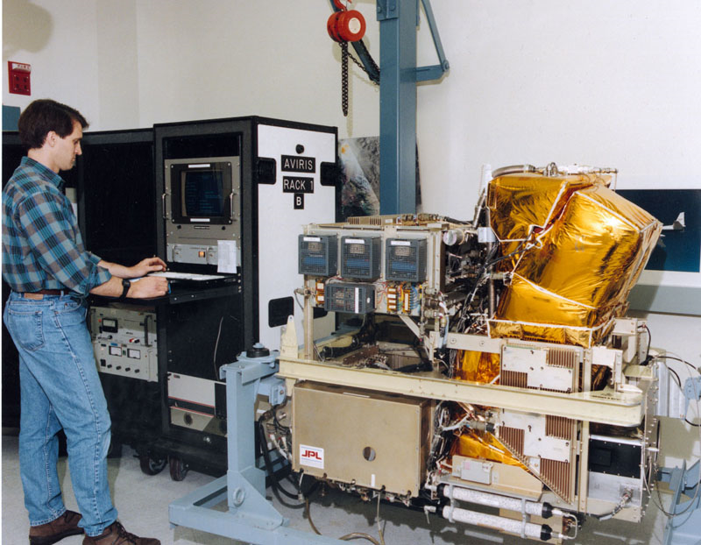

Slide 13
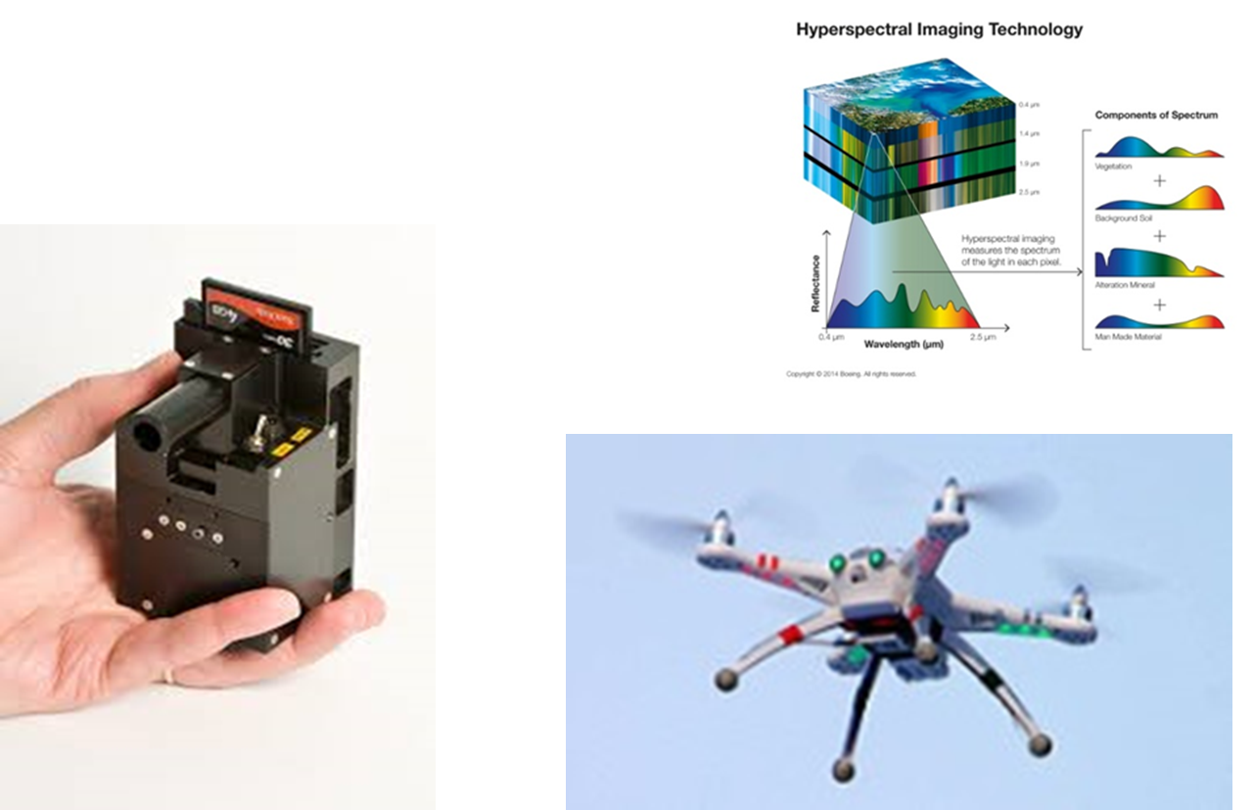
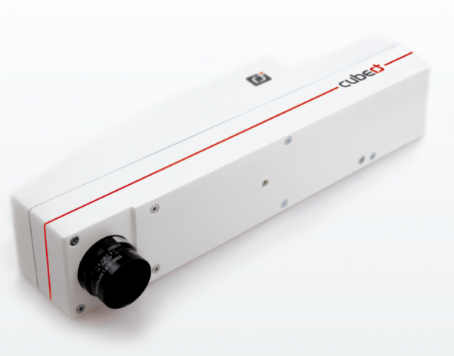
Technology Advances 2
Compact Imaging Spectrometers

Slide 14
Video 1

Slide 15
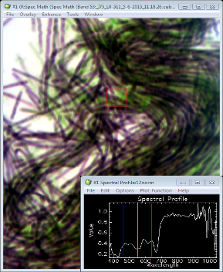
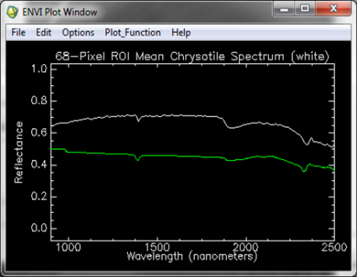
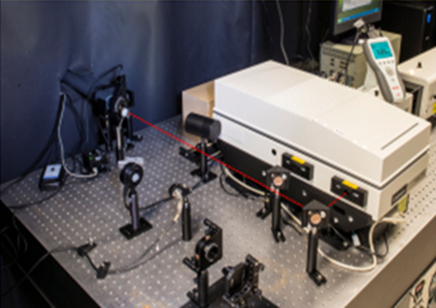
Hyperspectral Microscopy
Tunable laser microscope, developed with NIST and Mitre, designed to better characterize earth and medical materials, and microscopic organisms
Hyperspectral imaging spectroscopy at the microscope scale
Designed to complement and understand spectral response at different remote sensing scales

Slide 16
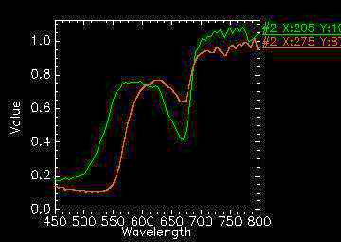
Hyperspectral Microscopy
Details from Harmful Algal Blooms

Slide 17
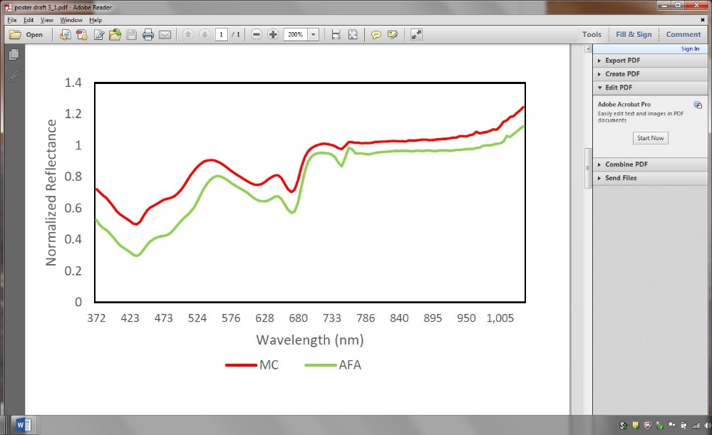
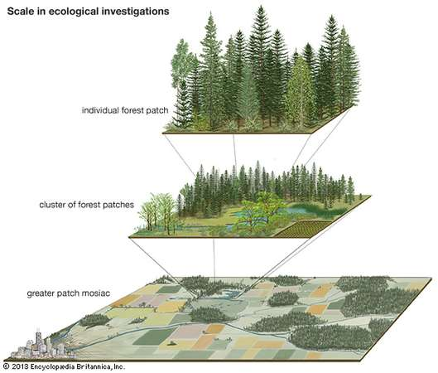
Technology Advances 3
Advantages of Imaging Spectroscopy
Non-contact, stand-off-detection (microscopy to astronomy)
Repeatable patterns, quantitative results
Image scale can be user defined

Slide 18
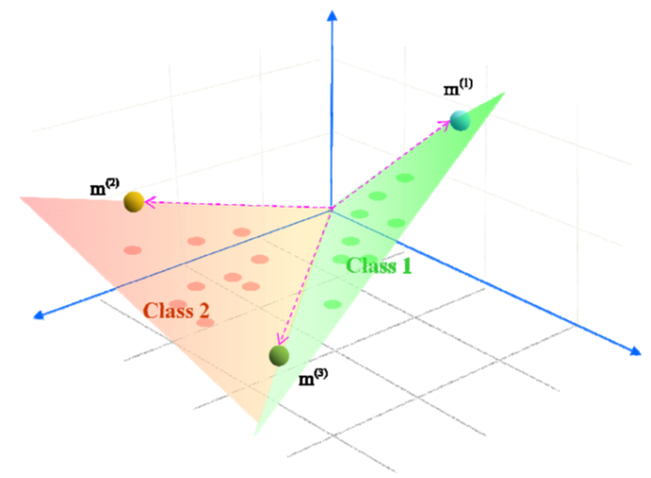
Hyperspectral Data Transformations
Data transformations
Parallelpiped
Derivative functions
Classification algorithms
Fourier Transforms
Spectral Angle Mapper
Minimum Noise Fraction
Principal Components Analysis

Slide 19
Notes:
+-

Slide 20
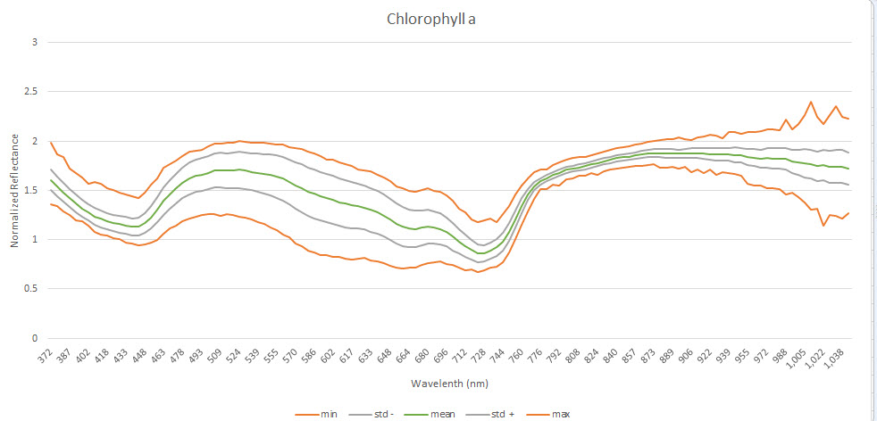
Chlorophyll A
Notes:
Chlorophyll A

Slide 21
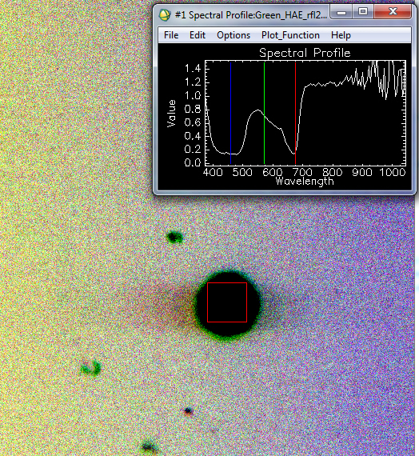
Notes:
Phorum / Green HAE

Slide 22
Video 2

Slide 23
Molecular methods - DNA
After morphological assessment and identification:
Phylogenetic analysis (evolutionary relationships and identification) based on the 16S rRNA gene - a widely used tool for bacterial taxonomy
The 16S rRNA gene is genetically stable as it is essential for cell functionality
Notes:
Elongation. DNA polymerase has 5′–3′ activity. All known DNA replication systems require a free 3' hydroxyl group before synthesis can be initiated (note: the DNA template is read in 3′ to 5′ direction whereas a new strand is synthesized in the 5′ to 3′ direction—this is often confused); This gene represents a part of the rrn
operon, situated at the 5’ end, being
followed by the 23S rRNA and 5S rRNA
gene, all of them being separated by
intergenic regions

Slide 24
Molecular methods - DNA
Extract cyanobacterial DNA using a cyanobacterial-specific protocol
Perform amplification reactions using PCR with primers specific for the 16S rRNA gene in cyanobacteria
Amplified fragments are visualized in agarose gels and photographed
Automated DNA sequencing to confirm PCR results

Slide 25
This project includes ground proofing of spectral data and water quality analyses of water column samples collected with cyanobacteria samples.
The added value of water quality analyses is related to recognition that chromophores (pigments) can be:
polar molecules , or –
pigment molecules associated with large proteins .
Both (i) and (ii) respond to changes in water quality conditions by
modifying distribution of charge within the pigment, or
changing the structure of the associated protein attached to the pigment molecule
This leads to changes in absorption (spectrum) characteristics
Our work addresses
What happens when spectra appear not to have identifiable peaks or to have extraneous peaks?
(b) What water quality conditions can we identify from the spectra of algal and cyanobacteria pigments?

Slide 27
Phycocyanin – the major pigment of cyanobacteria - changes major absorption wavelength and decreases adsorption in response to changes from a neutral to alkaline water column.

Slide 28
Opportunities in the Remote Sensing of HABs and Water Quality
Build HSI Microscopic Library of HABs and related conditions
Establish species-specific identification algorithms
Develop research and development agenda for HSIM, CIS and UAV
Controlled lab and field experiments
Develop profile for other landscape species of interest
Notes:
+-

Slide 29
Thank you for your time and attention!
Questions?

Slide 30
Thank you
Comments or questions, please contact:
jalbert@waterrf.org
nssimon@usgs.gov
nhall@usgs.gov
tslonecker@usgs.gov
For more information visit:
www.waterrf.org

