Slide 1
Advances in In-Plant Treatment of Taste-and-Odor Compounds
Djanette Khiari, PhD
Water Research Foundation, USA
Chao Chen, PhD
Tsinghua University, China
10th IWA Symposium on Off-Flavours in the Aquatic Environment, Oct.27 – Nov 1, 2013
NCKU – Tainan, Taiwan

Slide 2
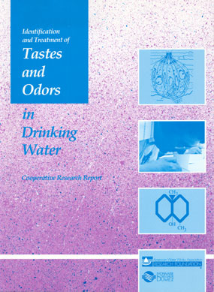
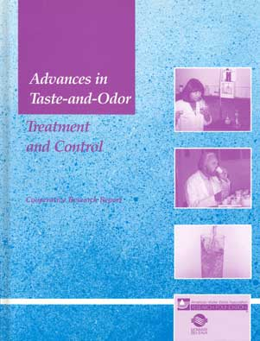
Important References
Advances in Taste-and-Odor Treatment and Control (AwwaRF, 1995)
Identification and Treatment of Tastes and Odors in Drinking Water (AwwaRF, 1987)

Slide 3
Treatment Options
Oxidation
  Conventional Cl2, ClO2, KMnO4
  Advanced – O3, O3/H2O2, UV/H2O2
Adsorption
  Powdered Activated Carbon (PAC)
  Granular Activated Carbon (GAC)
Biological Treatment
  Conventional Filter Media
  Biological Activated Carbon (BAC)
Others
  Membranes
  Mixed

Slide 4
What, Why, When?
Regulations
Consumer perception
Severity, duration, and frequency of the problem
Risk/risk trade-offs
Site and treatment specificity
Performance
Cost (capital and operations)

Slide 5
Overview of Treatment Technologies
Geosmin and MIB
Treatment | Approx. Max Conc. (ng/L) | Episode Duration | Capital Cost | O&M Cost | Usage for T&O (%)
Cl₂/ClO₂/KMnO₄ | < 20 | Short/Long | $ | $ | 18
PAC | < 50 | Short | $ | $$ | 69
Biotreatment | < 50 | Long | $-$$ | $
Ozone/H₂O₂ | 25 - 75 | Short/Long | $$-$$$ | $-$$$
UV/H₂O₂ | 25 - 75 | Short | $$-$$$ | $$-$$$
GAC | 25 - 100 | Long | $$-$$$ | $-$$$ | 5
GAC / Multiple Barrier | > 100 | Short | $$$ | $-$$
Multiple Barrier | > 100 | Long | $$$ | $$$
Corwin & Summers, 2011

Slide 6
Adsorption
Source
Flash Mix
Clarifiers
Filters
Storage
Good removal of TCA, geosmin, MIB, IPMP
Competition (TOC, DOC, NOM, BOM, organics)
Other treatment chem (oxidants, coagulants, pH)
Dose
Contact time
PAC
Low
Flexible (when, where,
type, how much)
Messy
$/unit removal - jar test
Impacts
Form
Capital
Application
Handling
Selection
GAC
Moderate
Fixed barrier (can support biological activity)
Easier
$/unit removal - RSSCT
Notes:
But adsorption capacity is affected by:
Presence of other chemicals that compete for adsorption sites
Presence of chemicals that coat carbon
Water quality changes that alter the carbon’s surface characteristics
No DBPs are formed
Water quality changes that alter the odorant’s characteristics
Concentration and characteristics of NOM (Natural Organic Matter)
Presence of CL₂, ozone, KMnO₄, and chloramines (chlorine and ozone produce surface oxides on carbon)
More evident at lower odorant levels
More evident at lower carbon dosages

Slide 7
Powdered Activated Carbon (PAC)
 | Dose (mg/L) | Contact Time (min) | Removal (%) | Limitations
PAC | 5 - 30 | 15 - 90 | 40 - > 95 | Feed Rate Oxidant compatibility
Performance Drivers for PAC
  Influent TOC concentration
  Influent concentration and treatment objective
  PAC dose
  PAC type (base material)
  Contact time and mixing

Slide 8
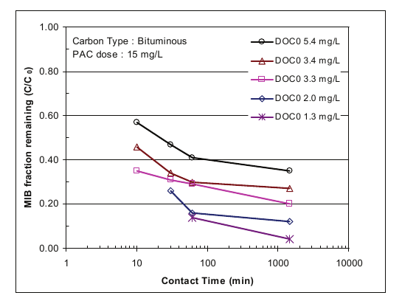
Powdered Activated Carbon (PAC)
Influent TOC Concentration and Contact Time
Cho and Summers, 2007

Slide 9
Powdered Activated Carbon (PAC)
PAC Dose and Type

Slide 10
Powdered Activated Carbon (PAC)
Influent Concentration and Treatment Objective

Slide 11
Superfine Powdered Activated Carbon (SPAC)
Submicron-sized activated carbon: obtained by wet-milling commercially available activated carbon

Slide 12
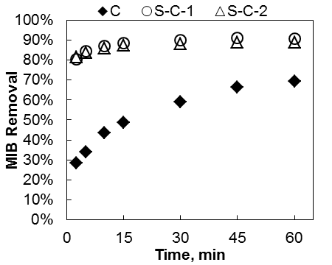
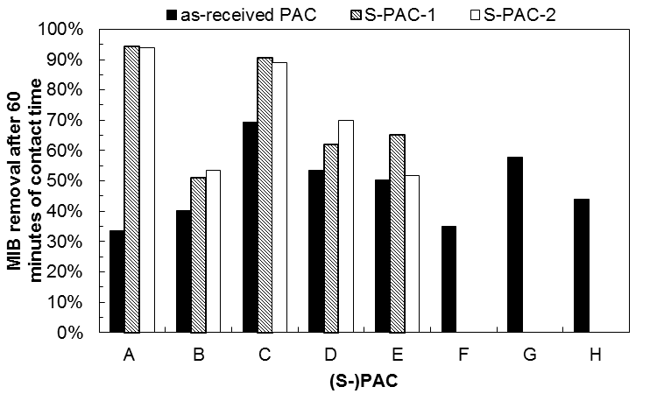
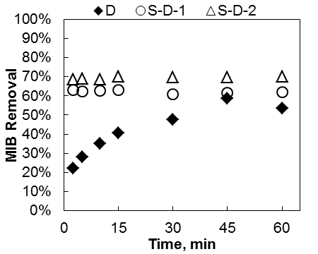
MIB Removal
(S-)PAC Dose = 15 mg/L Initial MIB Conc. = 100 ng/L
Overall, smaller as-received PACs did not perform better than traditional PACs
Superfine forms of PAC A and C achieved >89% MIB removal
Dunn et al, 2010

Slide 13
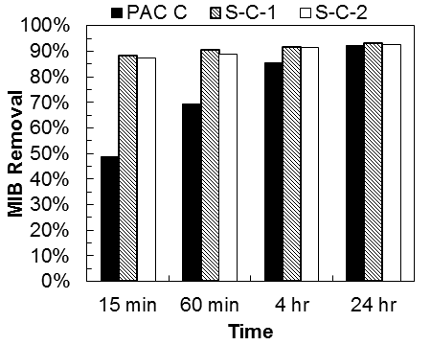
MIB Removal – equilibrium conditions
(S-)PAC Dose = 15 mg/L Initial MIB Conc. = 100 ng/L
  Grinding as-received PAC to a finer particle size
    enhanced adsorption kinetics
    did not increase equilibrium uptake capacity for MIB
  S-PACs would be beneficial for MIB removal at short contact times
Dunn et al, 2010

Slide 14
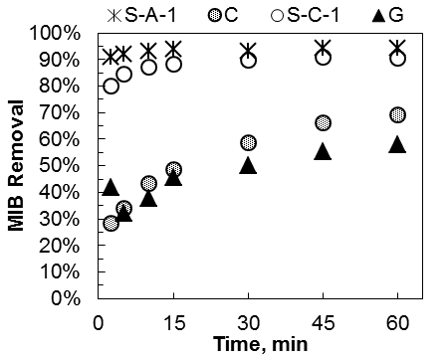
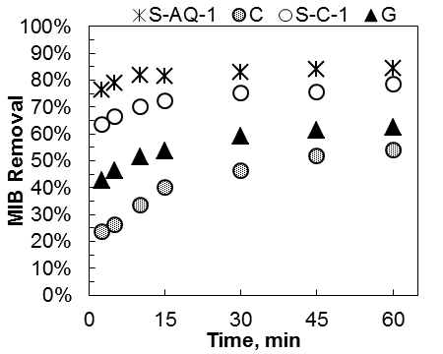
MIB Removal
(S-)PAC Dose = 15 mg/L Initial MIB Conc. = 100 ng/L
Similar MIB removal trends in CCR and LM waters with S-PAC achieving higher MIB removal than PACs
Decreased MIB removal in LM water possibly due to higher adsorption competition between NOM and MIB (higher NOM concentration in LM water)
LM
CCR
Dunn et al, 2010

Slide 15
Granular Activated Carbon (GAC)
Application | EBCT (min) | Removal (%) | Use Rate (lb/1,000 gal) | Media size | Limitations
Filter Adsorber | 2 - 10 | > 95 | 0.4 – 1.1 | 8x30 ES= 0.90 mm | Oxidant compatibility Media replacements are more difficult May need sand layer Backwashed
Post-Filter Adsorber | 5 - 30 | > 95 | 0.25 – 1.0 | 12x40 ES= 0.65 mm | Cost/space/hydraulic head Oxidant compatibility

Slide 16
Granular Activated Carbon (GAC)
Performance Drivers
  Influent TOC concentration
  Influent concentration & treatment objective
  Design and operation strategy
  GAC type

Slide 17
Granular Activated Carbon (GAC)
Operation Strategy
Operation | Advantages | Disadvantages
Continuous | DBP formation control Lower Cl₂ demand 0.5 log Crypto credit (PFA only) | Reduced TO adsorption capacity* * can be offset by GAC change-out prior to episode
Intermittent | Maximum TO adsorption capacity | Large capital investment for intermittent use
Biological | Possible removal by both adsorption and biodegradation? Possible bio-regeneration of adsorption capacity?? | More frequent backwashes Underdrain clogging? Possibility of higher HPC counts in finished water?
Corwin and Summers, 2011

Slide 18
Oxidation
Source
Flash Mix
Clarifiers
Filters
Storage
Distribution
Permanganate
Chlorine
Chloramines
Chlorine dioxide
Ozone
UV
Advanced oxidation (O₃/H₂O₂, UV/H₂O₂)

Slide 19
Permanganate (MnO₄⁻)
Source
Flash Mix
Clarifiers
Filters
Storage
Distribution
Fishy, grassy, cucumber
Reduces Chlorine demand
Reduces AC demand
THMs
Colored water
Adsorption (???)_

Slide 20
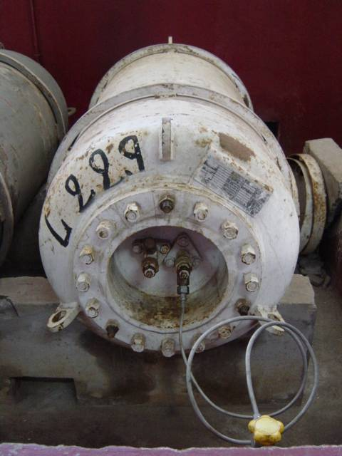
Chlorine
Source
Flash Mix
Clarifiers
Filters
Storage
Distribution
Marshy/Swampy/Septic/Sulfurous/Fishy
Disinfection
Algae control
Chlorinous
Medicinal
Biofilm control
DBP formation

Slide 21
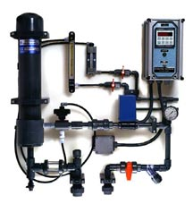
Chlorine Dioxide (ClO₂)
Source
Flash Mix
Clarifiers
Filters
Storage
Distribution
Marshy/Swampy/Septic/Sulfurous/Medicinal
Disinfection and algae control
Fe and Mn control
Kerosene
Cat urine
ClO₂⁻/ClO₃⁻ formation

Slide 22
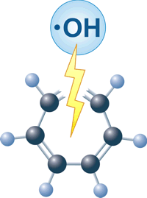
Advanced Oxidation Processes (AOPs)
An effective process for disinfection and chemical oxidation
AOPs work by creating hydroxyl radicals (•OH)
Complex chemistry
Several Technologies
  UV/H₂O₂, UV/O₃, UV/HOCl, etc.
  Ozone/H₂O₂, Ozone/NOM, Ozone/pH

Slide 23
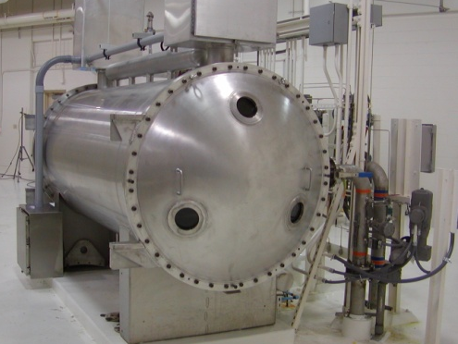
Ozone/AOPs
Pre-Ozone
Basin
Flash
Mix
Clarifiers
Inter-Ozone
Basin
Filters
Post-Ozone
Basin
Storage
Higher
Dose
Unstable
Residual
Easier
Hydraulics
Lower
Dose
Stable
Residual
Difficult
Hydraulics
Lowest
Dose
Stable
Residual
Fragrant/Sweet
Medicinal
AOC
BrO₃⁻ formation

Slide 24
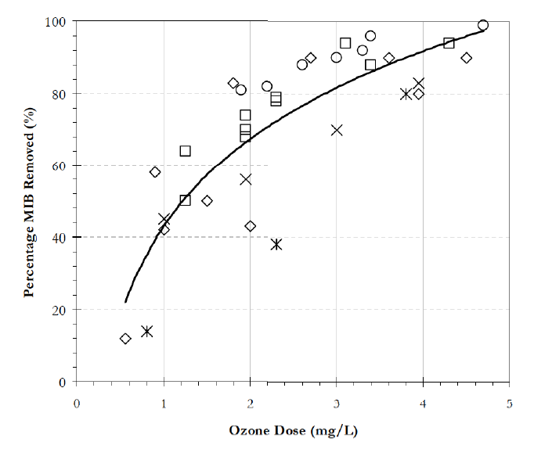
Ozone Oxidation of MIB and Geosmin
Ozone is effective for MIB and geosmin Direct ozonation is very slow for oxidizing MIB and geosmin
But OH radical is quite effective
Direct ozonation better for toxins
Compound | k_{O3} (M⁻¹s⁻¹) | k_{OH} (M⁻¹s⁻¹)
MIB | N/A | 8.2x10⁹
Geosmin | N/A | 1.4x10¹⁰
Observed MIB and Geosmin ozone oxidation a result of Advanced Oxidation (AOP)

Slide 25
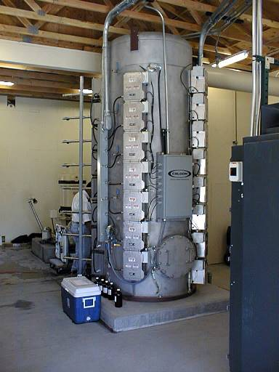
Ultraviolet (UV)
Source
Flash
Mix
Clarifiers
Filters
Storage
Distribution
MTBE (90%)
Geosmin/MIB (90%)
NDMA (90%)
Virus (2-log)
Crypto. (>2-log)
1
10
100
1,000
10,000
Applied UV Dose (mJ/cm²)

Slide 26
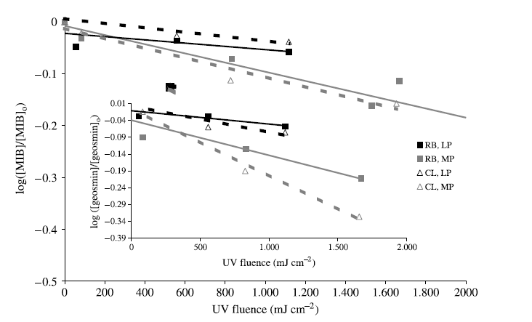
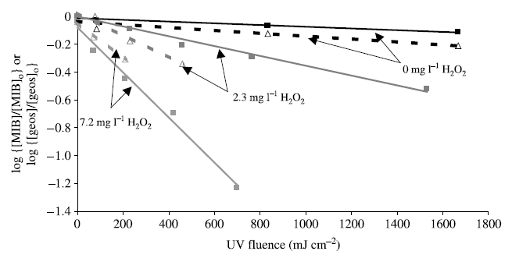
UV AOP for Taste and Odor
UV Photolysis
UV Advanced Oxidation
Rosenfeldt and Linden, 2005

Slide 27
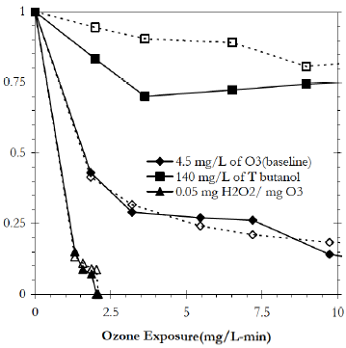
AOP performance
Ozone + Peroxide AOP
UV + Peroxide AOP
Extra 30% oxidation
AWWARF, 2005
Rosenfeldt and Linden, 2004

Slide 28
Biological Filtration
Principle: Odorants at low concentrations are utilized by microorganisms as secondary substrates when the biodegradable organic matter is
sufficient to serve as the primary substrate.
Biotreatment | Contact Time (min) | Acclimation Period | Removal (%) | Limitations
Conventional Media | 5 – 10 | > 4 months | 30 - > 95 | Temperature Substrate availability Influent concentration fluctuations
Biological Activated Carbon (BAC) in FA | 5 – 10 | > 4 months | 60 - > 95 | Temperature Substrate availability
Corwin and Summers, 2011

Slide 29
Pilot Testing
(AWWARF, 2005 –Westerhoff)

Slide 30
Pilot Testing
Biofilters receiving 4 different feed waters, biologically active carbon (GAC) removed more MIB and geosmin) than GAC/sand or anthracite/sand biofilter
The control anthracite/sand (A/S) biofilter received chlorinated water and achieved minimal MIB degradation.
Longer EBCCT improved removal
Finding #2: Pilot tests required at least 2 months of constant MIB exposure to become acclimated and biologically stable. Longer EBCTs and higher temperatures improved MIB degradation. MIB & geosmin biodegradation was modeled as
secondary substrates.
Finding #3: Filter biomass density was a good
indicator for MIB removal in some pilot tests.
More biomass equated to improved removal.
Backwashing practices affected biomass density, with more benefit of using non-chlorinated water

Slide 31
Pilot Testing
Pilot tests required at least 2 months of constant MIB exposure to become acclimated and biologically stable.
Longer EBCTs and higher temperatures improved MIB degradation
Filter biomass density was a good indicator for MIB removal in some pilot tests. More biomass equated to improved removal.
Backwashing practices affected biomass density, with more benefit of using non-chlorinated water

Slide 32
Membrane Treatment
Removal by Size and Charge
    Membrane effective pore size
    Membrane surface charge (Zeta potential)
    Compound charge (pKa)
    Charges depend on water pH
Microfiltration and Ultrafiltration
  Particle removal membranes
  Limited removal by charge repulsion
Reverse osmosis may remove minerals and organics producing unpalatable water
Highly corrosive to metal plumbing

Slide 33
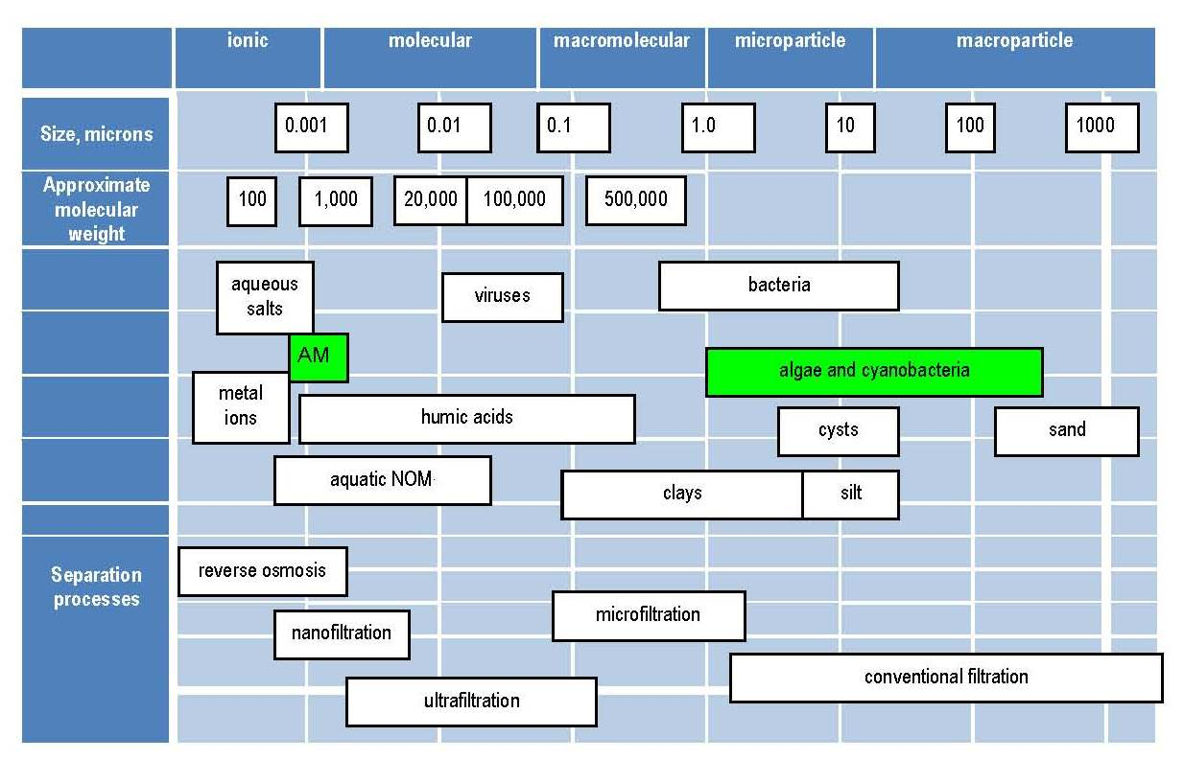
Courtesy of Gayle Newcombe

Slide 34
Caution!!!
Algae vs. Algal Metabolites
Algal metabolites can be:
  Intracellular: Contained within the cell
  Extracellular : Dissolved (extracellular)
Cells can be removed by physical processes (relatively easy)
Extracellular, dissolved metabolites can be removed by physical, chemical or biological processes (not so easy)

Slide 35
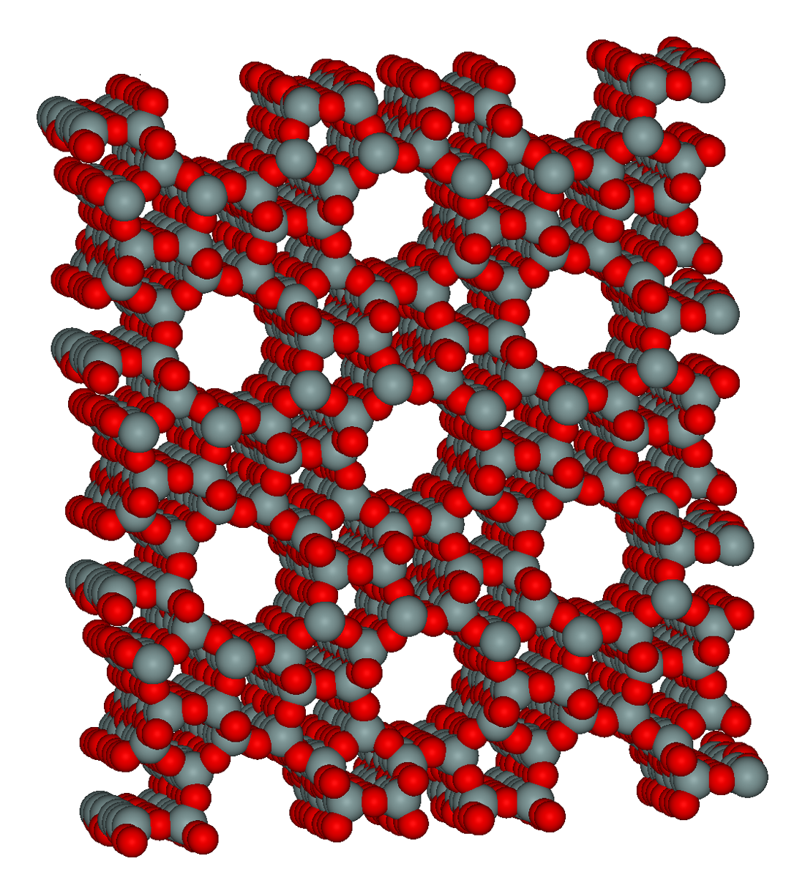
Zeolites
Primary building blocks are TO₄ tetrahedra (T is Si⁴⁺ or Al³⁺) linked via their oxygen atoms to other tetrahedra
↓
↓
Structural subunits form crystalline framework
Pore dimensions defined by the ring size of the aperture
“10 ring" is a closed loop built from 10 tetrahedrally coordinated Si⁴⁺(or Al³⁺) atoms and 10 oxygen atoms
: Si⁴⁺ or Al³⁺
:Oxygen

Slide 36
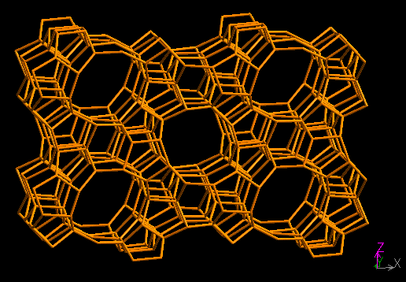
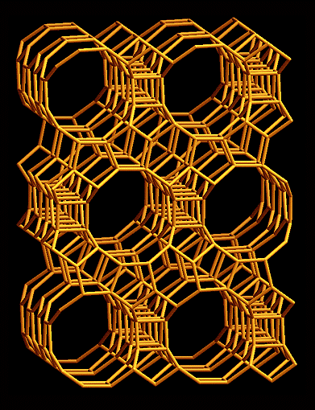
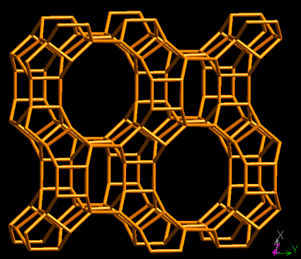
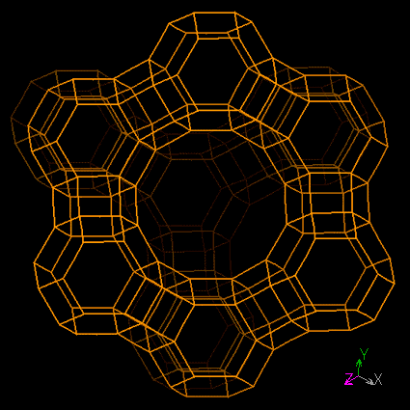
Zeolite framework types
Beta framework type:
0.76 x 0.64 nm
Silicalite framework type:
Pore dimensions:
0.53 x 0.56 nm and 0.51 x 0.55 nm
Mordenite framework type:
0.65 x 0.70 nm
Y framework type:
0.74 nm diameter windows
1.3 nm supercages
Source: http://topaz.ethz.ch/IZA-SC/StdAtlas.htm

Slide 37
Zeolites
SiO₂/Al₂O₃ ratio the determines hydrophobicity and acidity
of the zeolite
low SiO₂/Al₂O₃ → negative framework charge
  hydrophilic character → not effective for the adsorption of organic contaminants but suitable for cation exchange
  more acidity → suitable for surface reactions
high SiO₂/Al₂O₃ → low negative or neutral framework charge
  hydrophobic character → suitable for the adsorption of organic contaminants
  less acidity → not very reactive

Slide 38
Experiments with ¹⁴C-MIB assess overall removal of ¹⁴C from solution but do not provide information about the reactive removal of MIB
Experiments with ¹²C-MIB were conducted to specifically track MIB removal

Slide 39
Clearly, ¹²C data differed from the ¹⁴C data when testing mordenite zeolites!!
Yuncu and Knappe, WaterRF 2005

Slide 40
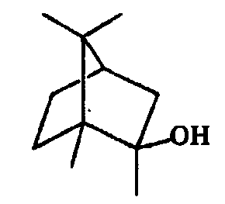
Discrepancies between ¹⁴C-MIB and ¹²C-MIB data may suggest that a reaction removal mechanism other than adsorption contributes to MIB removal
2-methyl-2-bornene (2M2B)
MIB
2-methylenebornane (2MB)
H⁺
H⁺
H⁺
H⁺
Acidic zeolite surface
1-methylcamphene (1MC)
Yuncu and Knappe, WaterRF 2005
Non-odorous products

Slide 41
www.WaterRF.org
dkhiari@WaterRF.org

