Slide 2
Sustainable Water Management Conference
Denver, Colorado
March 31, 2014
Presentation by Karen Raucher

Slide 3
Effective Climate Change Communication for Water Utilities
WRF Project #4381
Karen Raucher
Stratus Consulting, Inc.

Slide 4
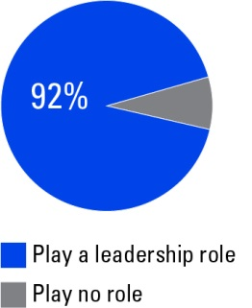
Effective Climate Change Communication for Water Utilities
How large of a leadership role should your community water utility play in helping your community prepare for the impacts of climate change?

Slide 5
Co-Authors
Bob Raucher, Eric Horsch, Stratus Consulting, Inc.
Anthony Leiserowitz, Yale Project on Climate Change Communication
Mark Millan & Barry Dugan, Data Instincts
GfK Corporation

Slide 6
Our Great Participating Utilities
Organization | City/state/country
American Water | Voorhees, NJ
Austin Water | Austin, TX
Denver Water | Denver, CO
Inland Empire Utilities Agency | Chino, CA
Los Angeles Department of Water and Power | Los Angeles, CA
Miami-Dade Water and Sewer Department | Miami, FL
New York City Department of Environmental Protection | New York, NY
City of Phoenix Water Services Department | Phoenix, AZ
San Francisco Public Utilities Commission | San Francisco, CA
Southern Nevada Water Authority | Las Vegas, NV
United Utilities | Great Sankey, Warrington, UK
Western Municipal Water District | Riverside, CA
City of Wilmington Department of Public Works | Wilmington, DE

Slide 7
Project Goals
Help utilities overcome climate change communication barriers

Slide 8
Today’s Objectives
  Share the findings from the national survey
  Share the project tools

Slide 9
What Do Americans Think about Community Water and
Climate Change ?

Slide 10
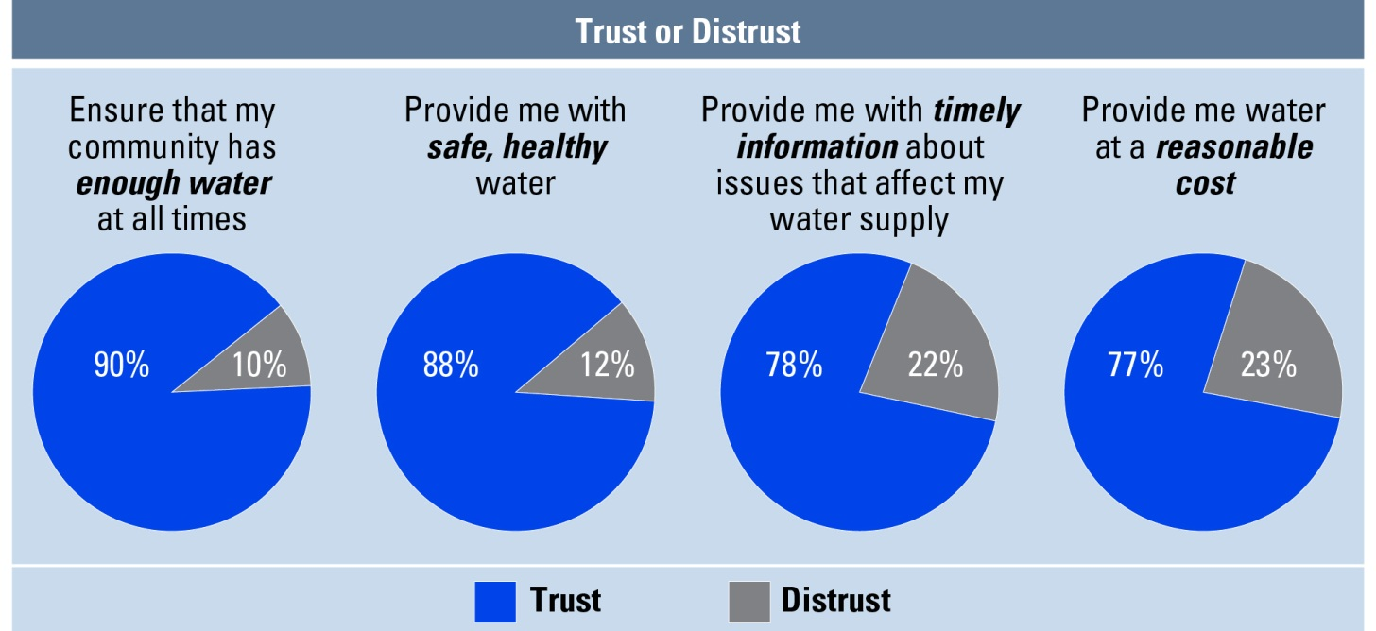
What Do Americans Think about Community Water and Climate Change ?
How much do you trust your water utility to do the following things:

Slide 11
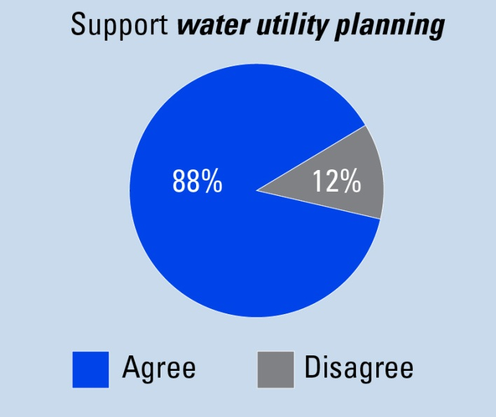
What Do Americans Think about Community Water and Climate Change ?
A large majority of Americans support their water provider planning for the future (10–40 years).

Slide 12
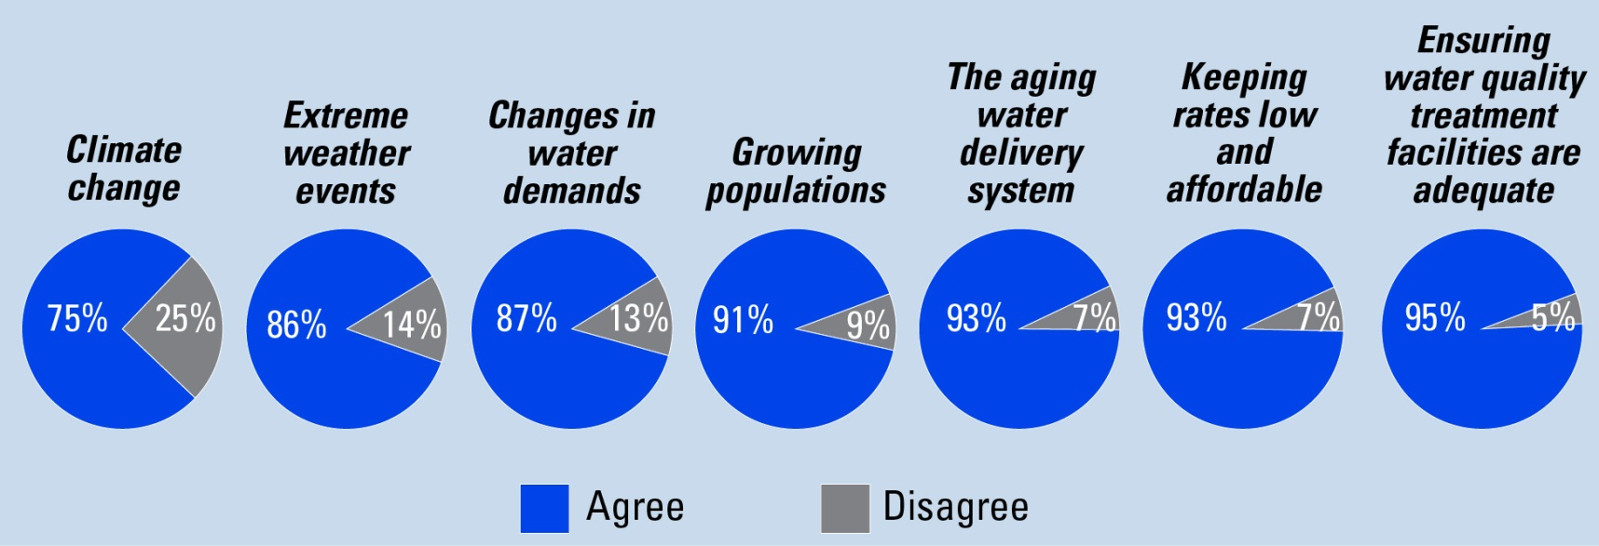
What Do Americans Think about Community Water and Climate Change ?
When planning for the future, how much attention do you think your water utility should give to the following issues?

Slide 13
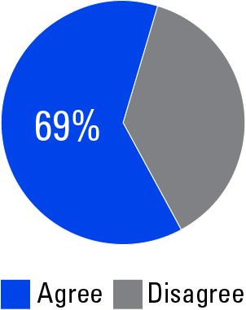
What Do Americans Think about Community Water and Climate Change ?
Assuming the money is needed, and would be spent wisely and efficiently, would you be willing to pay extra each month to ensure that your community has access to abundant, safe water for the next 10–40 years?

Slide 14
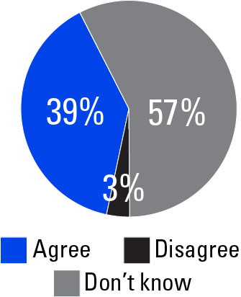
What Do Americans Think about Community Water and Climate Change ?
My water utility has a plan, has taken the necessary actions, and is adequately prepared for extreme weather.

Slide 15
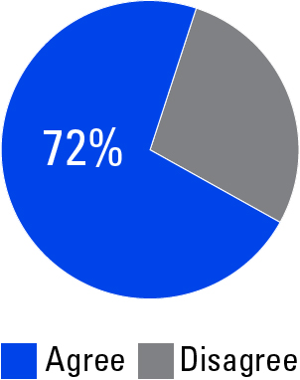
What Do Americans Think about Community Water and Climate Change ?
How concerned are you that future extreme weather events will negatively impact your community water provider’s ability to provide safe, healthy drinking water?

Slide 16
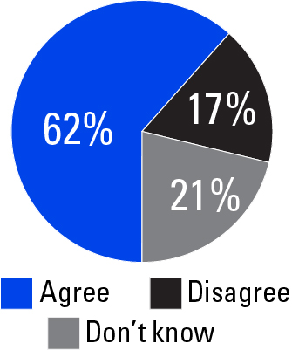
What Do Americans Think about Community Water and Climate Change ?
The impact of climate change on extreme events will make it more difficult for water utilities to meet community water needs during and immediately after extreme weather events.

Slide 17
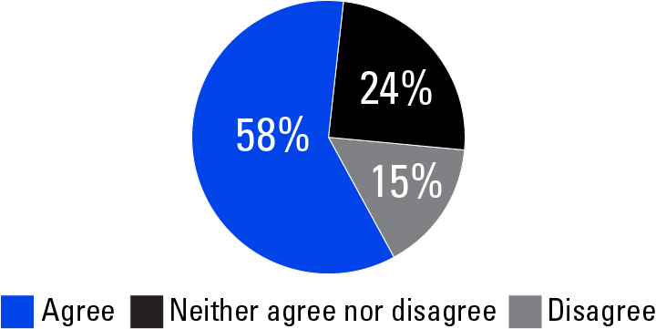
What Do Americans Think about Community Water and Climate Change ?
Assuming the money is needed, and would be spent wisely and efficiently, I am willing to pay more to ensure that my water utility is prepared for future extreme weather events.

Slide 18
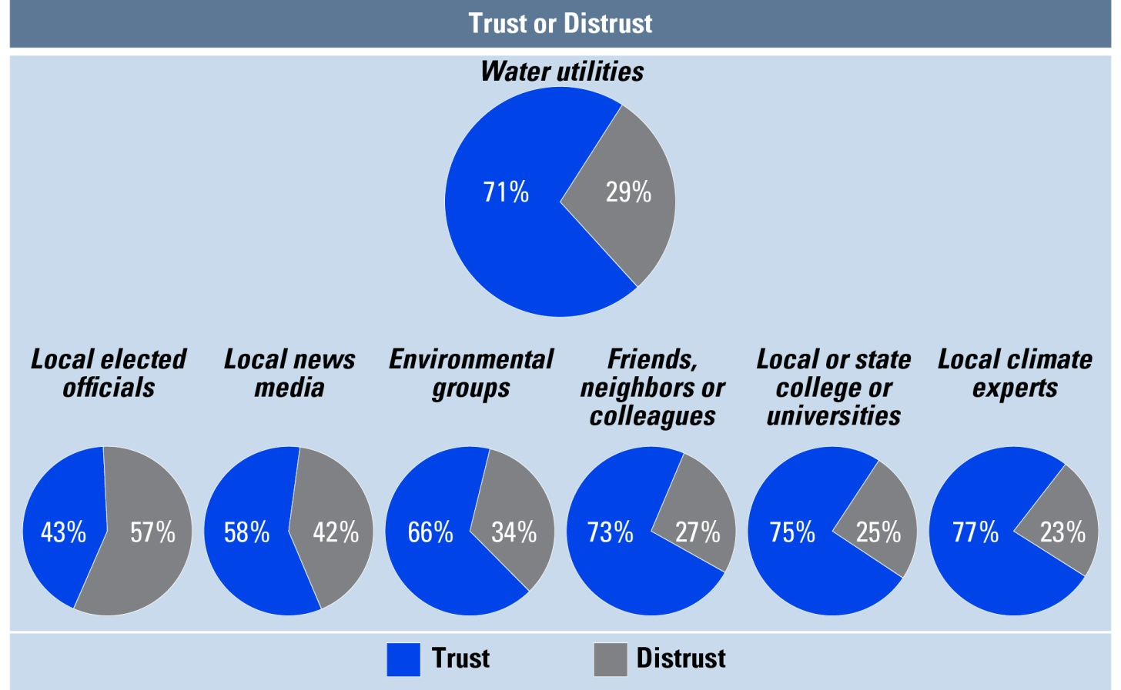
What Do Americans Think about Community Water and Climate Change ?
How much do you trust or distrust the following as a source of information about climate change impacts for your local water system?

Slide 19
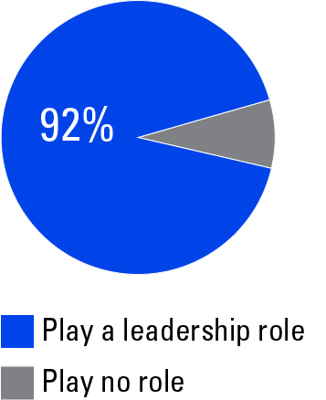
What Do Americans Think about Community Water and Climate Change ?
How large of a leadership role should your community water utility play in helping your community prepare for the impacts of climate change?

Slide 20
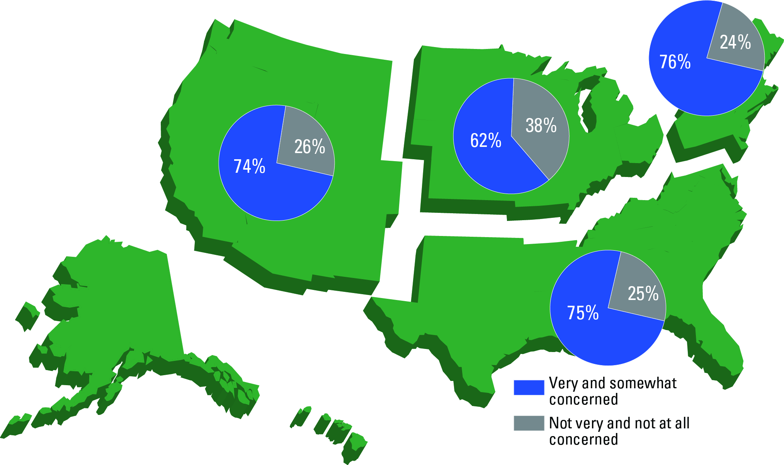
How concerned are you that future extreme weather events will negatively impact your community water provider’s ability to provide safe, healthy drinking water?

Slide 21
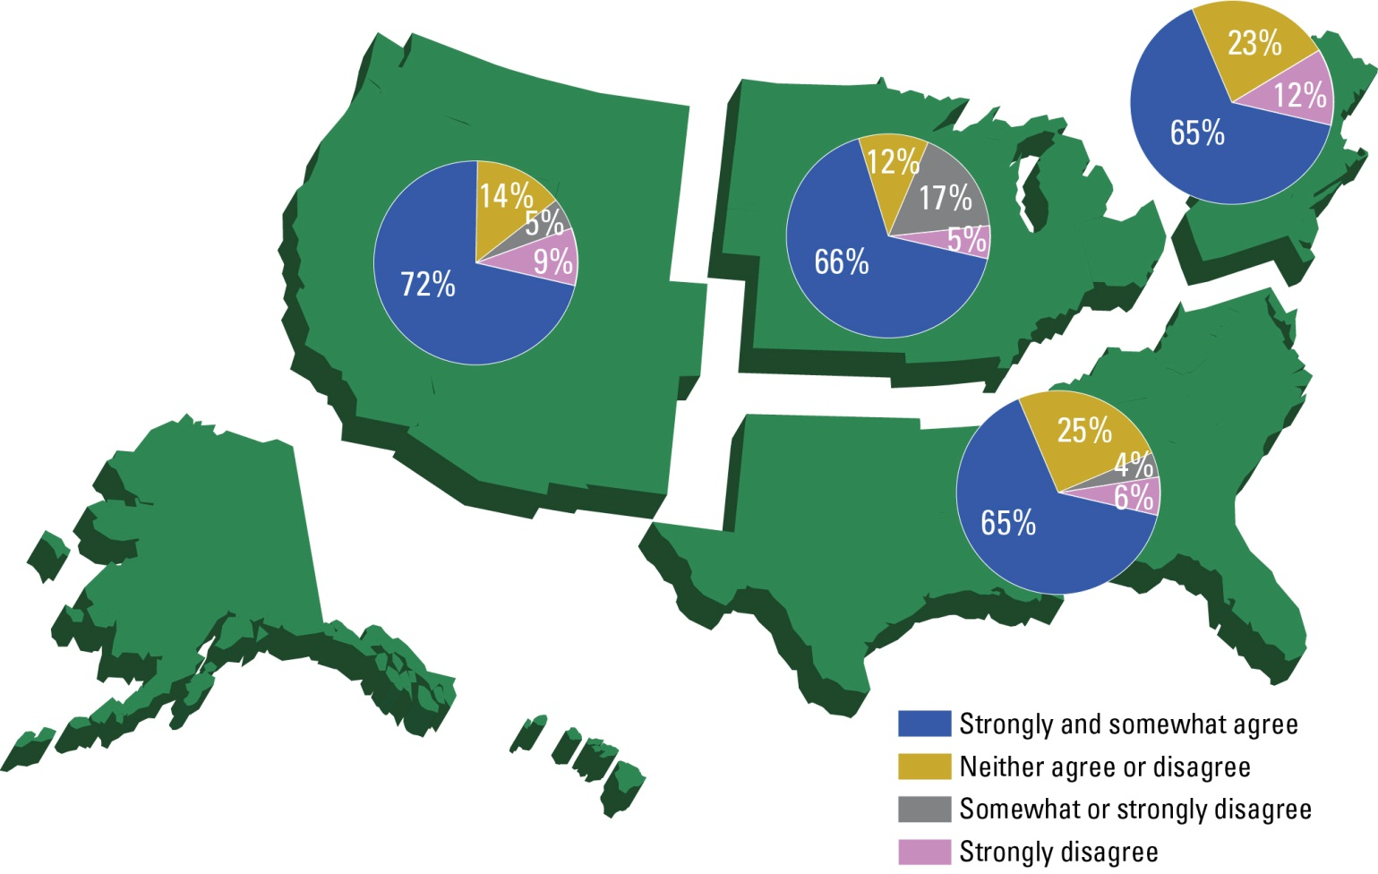
Climate change will have a significant impact on extreme weather events, causing changes in the severity of droughts, hurricanes, rainstorms, and heat waves.

Slide 22
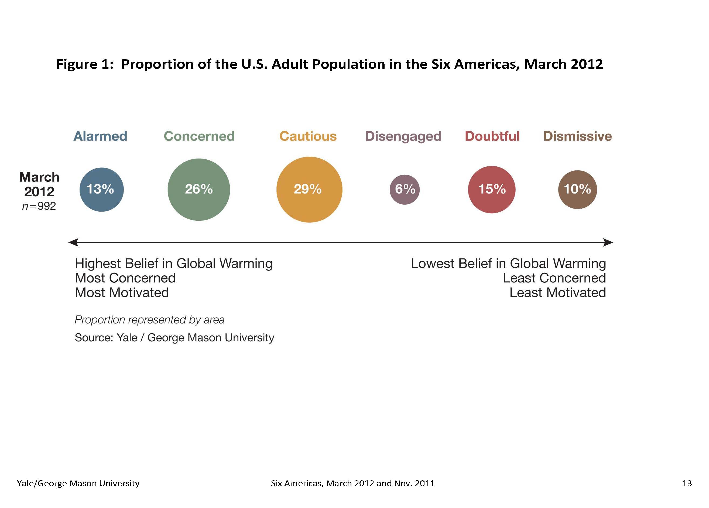
Global Warming’s “Six Americas”
Leiserowitz et al. (2011)

Slide 23
Five Americas for “Community Water and Climate Change”

Slide 24
Closed Wallets (15%)
One Who is Not Willing to Pay
93% of this group is not willing to pay extra
  19%: My utility has enough
  10%: My utility needs to do more with less
  19%: I should not have to pay
  49%: I do not have enough money

Slide 25
Closed Wallets (15%)
This is the group most likely to buy bottled water (48%)

Slide 26
Pessimist (8%)
41% are willing to pay up to $3 more per month to ensure there is abundant safe water in the future
31% do not think there is much a water provider can do to protect the local water supply from extreme weather
Most likely to show up at a utility meeting

Slide 27
Message Testing
Water cycle
Extreme events
Separation

Slide 28
Net Change in Support as a Response to Climate Change by Message Group

Slide 29
Net Change in Support as a Response to Climate Change by Audience Segment and Message Test

Slide 30
Net Change in Willingness to Pay From No to Yes (water message)

Slide 31
Research Conclusions
Water utilities are a trusted source for information about climate change
  71% of Americans perceive their water utility as a trusted source of information concerning climate change and community water

Slide 32
Research Conclusions (cont.)
Americans support your thinking about climate change as part of your planning and extreme event preparation actions
And they are willing to pay more today

Slide 33
Research Conclusions (cont.)
A well-designed message increases support
  The water cycle message increased support by 19%
  The extreme events message increased support by 40%
  The separation message increased support by 43%

Slide 34
Research Conclusions (cont.)
Americans trust you to have their back…
but they are not sure you have a plan
  Only 39% of Americans know if you have a plan, have taken the necessary actions, and are adequately prepared for extreme weather

Slide 35
Research Conclusions (cont.)
Data support using communication as a tool today
  92% of Americans want their water utility to be a leader in preparing the community for the impacts of climate change

Slide 36
Applying the Strategies…
A way to take action today to build the support you will need tomorrow, regardless of the uncertainties and surprises
  Customize the data
  Identify your unique message
  Use joint areas of expertise to build strong united messages

Slide 37
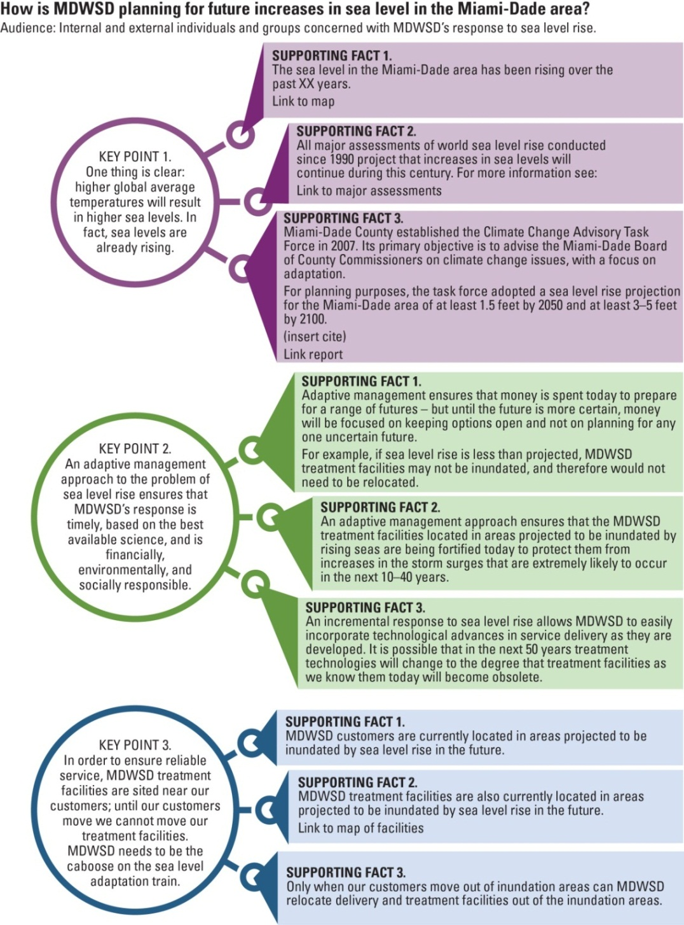
Message Mapping:
A 12 Step Program
27/9/3
3 supporting facts for each of the 3
Lays it out – don’t assume anything

Slide 38
The single biggest problem in
communication is the illusion
that it has taken place.
George Bernard Shaw

Slide 39
92% of Americans want their community water supplier to play a leadership role in preparing their community for climate change.
Thank You!
Karen Raucher
kraucher@stratusconsulting.com
303-381-8000

