Slide 2
Sustainable Water Management Conference
Denver, Colorado
March 31, 2014
Presentation by William DeOreo, P.E.

Slide 3
Some Key Findings of the 2014 REUWS Update Study WRF Project #4309
William DeOreo, P.E.

Slide 4
Project Advisory Committee
Mr. David Bracciano, Demand Management Coordinator, Tampa Bay Water
Mr. Doug Bennett, Water Conservation Manager Southern Nevada Water Authority
Mr. Robert Day, Director of Customer Service, San Jose Water Company
Ms. Mary Ann Dickenson, Executive Director, Alliance for Water Efficiency
Mr. Warren Liebold, Director of Conservation, New York City, and
Ms. Maureen Hodgins, Water Research Foundation Research Manager

Slide 5
Participating Level 1 Water Agencies
The Denver, Colorado Water Department
The City of Fort Collins, Colorado, Water Department
The City of Scottsdale, Arizona Water Department
The San Antonio, Texas, Water System
The Clayton County, Georgia, Water Authority
The Toho, Florida Water Authority
The Region of Peel, Ontario, Canada
The Region of Waterloo, Ontario, Canada
The City of Tacoma, Washington, Water Department

Slide 6
Participating Level 2 Agencies
City of Aurora Colorado Water, Department
City of Austin, Texas
City of Chicago, Illinois
City of Henderson, Nevada
City of Mountain View, California
City of San Diego, California
City of Santa Barbara, California
City of Santa Fe, New Mexico
Cobb County Water System, Georgia
Colorado Springs Utilities, Colorado
Town of Cary, N.C.
EPCOR, Edmonton, Alberta, Canada
Miami-Dade Water & Sewer, Florida
Otay Water District, California
Philadelphia, Pennsylvania Water Department
Portland Water Bureau, Oregon
Regional Water Authority, Connecticut

Slide 7
Our Research Partners
National Research Center
Dr. Thomas Miller, President
Erin Caldwell
Hazen and Sawyer
Dr. Jack Kiefer
Mr. William Gauley, P.E. President Gauley Associates
Dr. Benedykt Dziegielewski, University of Southern Illinois
Peter Mayer, P.E., Principal, Water Demand Management

Slide 8
Objectives of Study
Obtain new flow trace data on a national sample of single family homes
Disaggregate flow trace data into end uses of water
Compile water use data into a database
Link water use to survey data
Prepare statistical analyses and models
Compare results to previous studies
Explore conservation potential and benchmarks

Slide 9
Some Key Findings
Reduction in Domestic Use has occurred
Big improvements in toilets and clothes washers
Only categories which show statistically significant reductions.
Skewed Uses need special attention
Leakage (still number 5 category, just below CW)
Irrigation (small number of big users raise the mean)
At least 20% potential for indoor conservation remains.
Landscape use is quite varied, but follows similar patterns among groups.

Slide 10
Drop in Domestic Use Box Plot of Indoor GPD
Median Use levels have dropped from 160 gpd in REUWS1 to 125 gpd in REUWS2
That is a 21% reduction in indoor use
The number of persons per home has not changed significantly
These reductions are due mainly to use of better efficiency toilets and clothes washers

Slide 11
Significant Changes in Toilets and Clothes Washer use

Slide 12
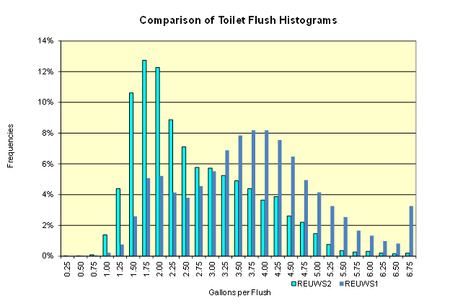
Shift in flush volumes
Toilet flush distributions
This graph shows distributions of individual toilet flushes logged during REUWS1 and REUWS2
1999 Data are in dark blue; show bulk of flush volumes around 4.5 gallon, with a second peak at 1.75 gallon.
2013 Data are in light blue, show major peak at 1.75 gallon and greatly diminished percentages at the 4 gallon level.
In 10 years the flushes will probably be normally distributed around the 1.75 gallon bin.

Slide 13
Fewer Homes with mixtures of toilets
Toilet Heterogeneity
More homes are showing higher percentages of low volume flushes
~30% of homes have over 90% of flushes < 2.2 gal
~ 30% have less than 10% flushes < 2.2 gal
~40% have mixtures
So, up to 70% of homes are still candidates for toilet retrofits.

Slide 14
Skewed Nature of Leakage
Leakage is highly skewed by a few homes.
Average leakage rate was 17 gpd, but median was 4 gpd.
Top 21 homes, 3%, accounted for 30% of total leakage in group of 762
10% of the homes were leaking at ~105 gpd; 90% were leaking at 8 gpd.
Keeping leakage at the median (~5 gpd) would save 12 gpd on average, or 4 kgal per year.

Slide 15
Hot Water by end use
Hot Water Use
Average homes used ~42 gpd of hot water
This was ~30% of total use
On average the homes use 753,000 BTU/Mo for heating water
Maximum was 1.06 MBTU in Tacoma
Minimum was 321,000 BTU in Scottsdale
Showers are the #1 hot water user, followed by faucet use.
Clothes washing is a relatively small hot water user.

Slide 16
Application ratios are biased by high users
Skewed Irrigation Applications
Most homeowners are UNDER irrigating.
Nearly 80% of homes in the study were applying less than the theoretical irrigation requirement.
Irrigation is a lot like leakage in that a few large users are accounting for the bulk of the excess irrigation.
Analysis is based on aerial photos using a consistent set of procedures for estimating irrigated areas and plant types plus Local Net ET with allowanced for irrigation system efficiencies.

Slide 17
Order of Peaking:
Diurnal Patterns
Morning Peaks
Toilets
Showers
Faucets
Clothes Washers
Evening Peaks
Faucets
Toilets
Showers
Bath tubs
Clothes washers
Dish washers
Continuous
Leaks
Humidifiers

Slide 18
Current Use vs Benchmarks
Savings Potential
Average Savings Potential = 31 gphd from switching to Water Sense devices
Equates to 11 kgal per year indoor
This is approximately 20% of current indoor use
Does not include savings from leakage control.
Leakage control would add another 4 kgal per year.
Total savings are estimated at 15 kgal per year for indoor + leakage, or ~25% of current use.

Slide 19
By Extracting from Historical Database:
Benchmarks
Class 1 homes: meet WaterSense standards. Current best available efficiency with off-the-shelf equipment
Class 2 homes: Intermediate efficiency based on most homes meeting NEPA standards.
Class 3 homes: older homes, pre-NEPA

Slide 20
Household use v residents
Non-linear Relationship
Not correct to scale up per-capita use on a linear basis
Household use relationship follows a power curve
Exponent is normally less than one
Curve shown is for high efficiency homes (Class 1)
Class 2 and 3 homes would have a different curve, but similar form.

Slide 21
Conclusions
Keep up with the high efficiency toilets and clothes washers
Consider things like upgrade-on-sale ordinances to accelerate adoption
Focus on high users for conservation
Consider water budgets to put a premium price on high consumption
Attach a capital value to the water over and above the cost of service
Deal with leakage in the 10%’ers: either install sensors, or use AMR to send alerts
Use the high efficiency benchmark values for planning purposes, not the historical values, which are obsolete.

Slide 22
Thank you
Contact:
William DeOreo, P.E.
Aquacraft, Inc.
2709 Pine Street, Boulder CO, 80302
303-786-9691
bill@aquacraft.com
www.aquacraft.com

