Slide 1
Effective Utility Management (EUM) Benchmarking
Recommended Process for Self-Assessment Benchmarking & Demonstration of Tool
Fair Yeager, CH2M
23 April 2015

Slide 2
Agenda
Recommended Approach for Conducting a Self-Assessment
Overview of the EUM Tool
Brief Tool Demo

Slide 3
Recommendations for Conducting Self-Assessments

Slide 4
Recommended approach for conducting self-assessments
Form a benchmarking team and develop an initial action plan
Select EUM attributes to assess
Select associated practice areas and performance measures to assess.
Revise plan of action (if needed)
Conduct self-assessment benchmarking for selected attributes, practice areas and performance areas
Evaluate results and identify methods to narrow priority gaps
Develop follow-up plans
These can…and in most cases should…be customized for each utility.
Notes:
Customization includes combining some steps, this is especially helpful for smaller utilities that have limited resources.

Slide 5
Step 1 - Form benchmarking team and develop initial action plan
Include representatives of key utility groups and functions in the team
Get executive sponsorship for the program to have clout in the organization
Identify team leader
Develop schedule for conducting self-assessment (on the average about 3 months)
Establish resource needs (staff time + expenses) (on the average about 32 person-hours)
Charter core team

Slide 6
Step 2 - Select EUM attributes to assess
Review the Ten Attributes
Prioritize the attributes
Knowledge of EUM/EUM Primer helps
If unfamiliar, try the EUM website http://www.watereum.org/resources/interactive-primer/getting-started/
Review practice areas and performance measures within each selected attribute
Full EUM core team should assign weights to selected attributes
Notes:
First address attributes that are most important to stakeholders, not the ones that you are most familiar with
Familiarity or experience with EUM and the EUM Primer helps identifying priority attributes
If not familiar, go to the interactive primer at the EUM website http://www.watereum.org/resources/interactive-primer/getting-started/. A downloadable file at this website can be used to help decide an organization’s most important attributes.

Slide 7
Step 3 - Select practice areas and performance measures to assess
Attribute
Practice Area 1
Performance Measure 1
Performance Measure 2
Practice Area 2
Performance Measure 1
Performance Measure 2
Practice Area 3
Performance Measure 1
Performance Measure 2
Performance Measure 3

Slide 8
Step 4 - Revise action plan (if needed)
Once the benchmarking framework has been developed, reevaluate:
Benchmarking team composition
Benchmarking resource requirements
Schedule considerations
Notes:
Benchmarking team composition – do you need a different mix of utility staff for benchmarking?
Benchmarking resource requirements - do you need more or less resources for benchmarking?
Schedule considerations – do you need more or less time to complete benchmarking?

Slide 9
Step 5 - Conduct benchmarking
Identify current and target levels for all performance measures that have been selected
Options:
A small core team conducting the initial scoring and then the full team providing input
Specialists scoring attributes they know best and then the full team providing input
The full team scoring together in a workshop setting
Validation check is part of the tool to ensure all selected performance measures have been scored

Slide 10
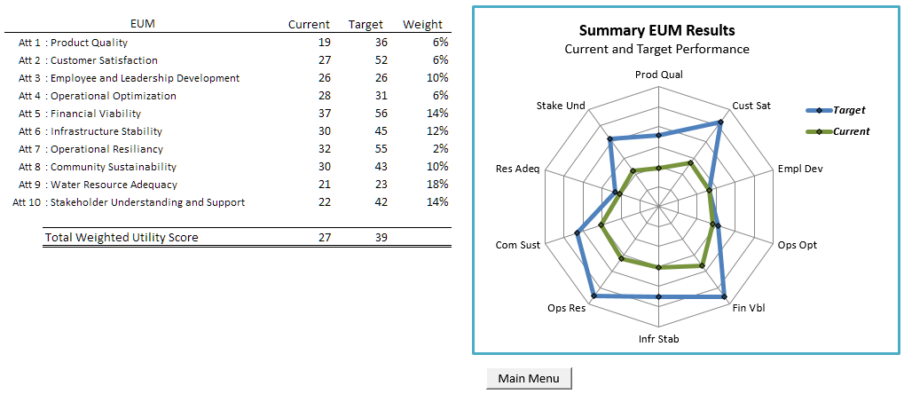
Step 6 - Evaluate results and identify methods to narrow priority gaps
Review self-assessment both at high and detailed levels
Notes:
Conduct a staff workshop to review self-assessment
Review should include:
High level analysis - e.g. how close are you to meeting performance goals for the highest priority attributes?
Detailed level analysis – e.g. why are you failing to achieve target performance for specific performance measures?

Slide 11
Step 6 - Evaluate results and identify methods to narrow priority gaps
Financial Viability: Balance in Capital Spending between Debt and Equity (Cash) Sources
Level of Performance
Level of performance
Degree of implementation
Reallocation of budgets & resources
100% debt
At least 5% equity
At least 10% equity
10-20% equity
At least 20% equity
Degree of Implementation
No target established
Target established but not achieved
Current
Target achieved < 3 years
Target achieved 3-5 years
Target
Target achieved > 5 years
Notes:
Actions to address level of performance:
Devoting additional budget to the issue
Consulting with appropriate internal and external stakeholders
Assigning specific staff members or groups with the utility to be responsible for improving performance in this area
Identifying and securing additional data or other improvements required to achieve or track performance in this area
Actions to address the degree of implementation:
Revising policies to extend performance achieved by some utility divisions to additional utility divisions
Embedding performance goals into individual employee or division objectives to achieve improvements in this area
Encouraging supportive resource allocation decisions
Reallocating budgets/resources

Slide 12
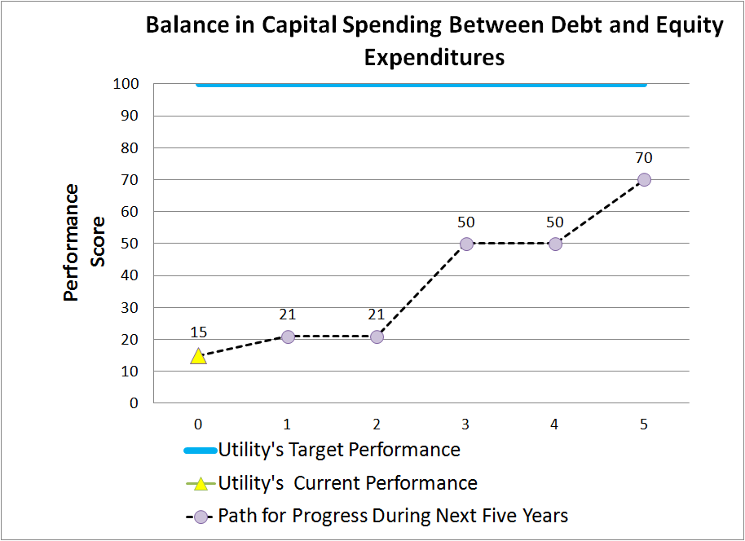
Step 6 - Evaluate results and identify methods to narrow priority gaps
Notes:
In this example, for a utility that has a significant gap in debt to equity spending, after 5 years of concerted effort, the utility might still fall short of its target, although it has made significant progress to meet target levels.

Slide 13
Step 7 - Develop follow-up plans to:
Narrow priority gaps
Track progress in the implementation of plans
Update self-assessments

Slide 14
Tour/Demonstration of the Benchmarking Tool

Slide 15
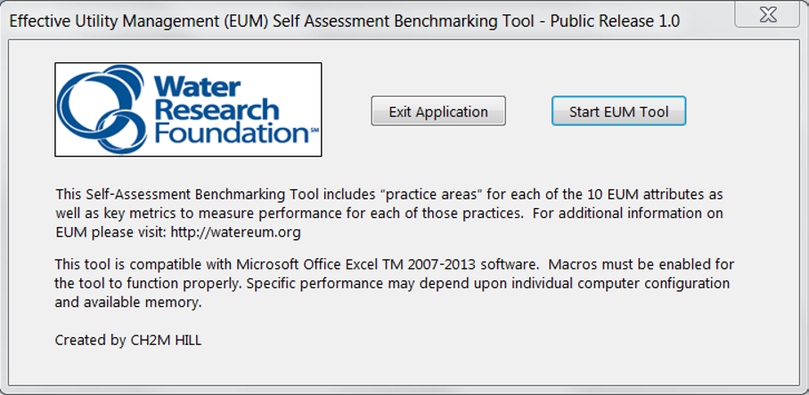
Opening the tool
Notes:
When the Tool is opened, a simple disclosure “splash screen” is presented. Exit the application or start the EUM Tool by clicking the associated button.

Slide 16
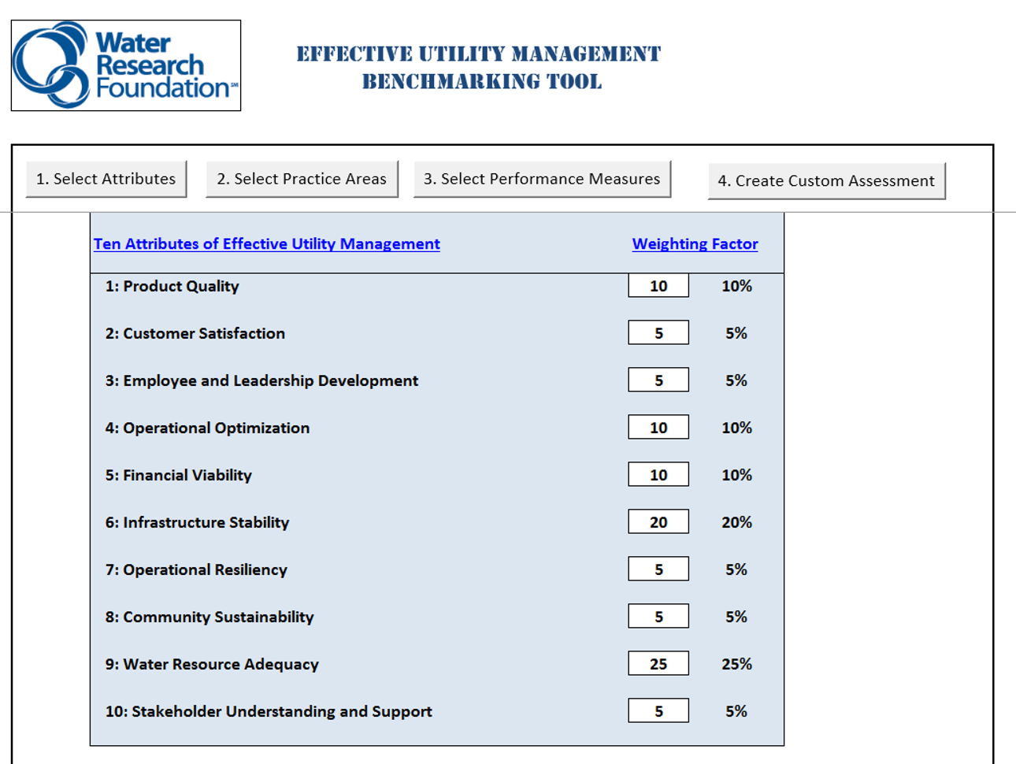
Selecting and weighing attributes
Notes:
Weigh each Attribute in terms of relative importance to the utility compared with the other selected Attributes. If a weight of 0 is selected, the Attribute will not be included in the assessment; otherwise scales of 1-10 or 1-100 are examples of weighting options that will work.
After weighting, click “select practice areas” to navigate to the next screen.

Slide 17
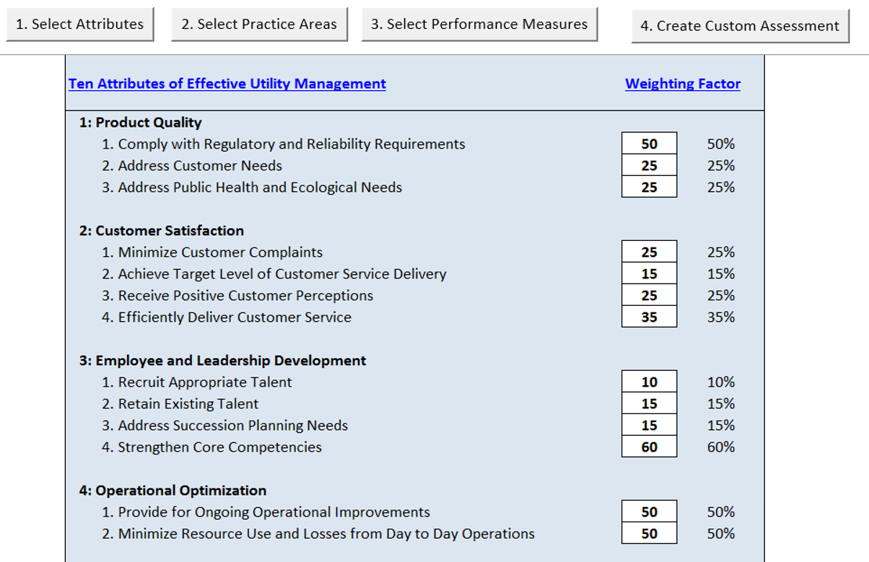
Selecting and weighing practice areas
Notes:
Only Attributes that have been weighed appear on this screen. Next, weigh the relative importance of each Practice Area that should be included in the assessment. As with the Attributes, if a weight of 0 is selected, the Practice Area will not be included in the assessment; otherwise a scales of 1-10 or 1-100 are examples of weighting options that will work. After weighting, click this button to navigate to the next screen.

Slide 18
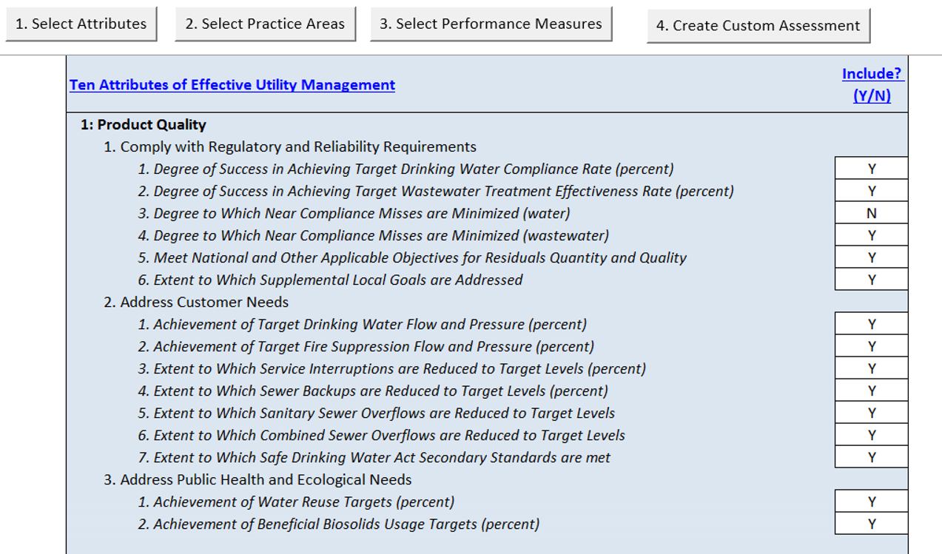
Selecting performance measures
Notes:
Enter “Y” or “N” to select Performance Measures that should be included in the assessment.
After choosing the Performance Measures, click “Create Custom Assessment” to create the customized self-assessment.

Slide 19
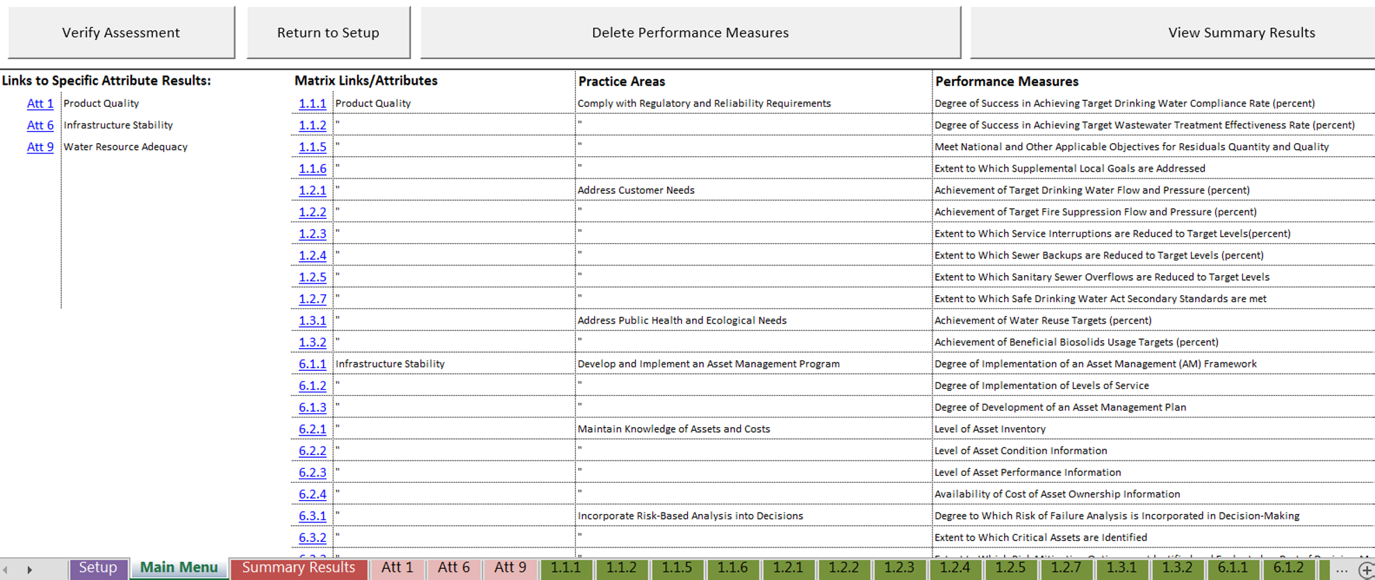
Overview of the customized Main Menu
Notes:
The Tool creates a scoring matrix for each of the Performance Measures under each Attribute. The worksheet names are coded using the Attribute #, Practice Area #, and Performance Measure #.
The Tool also creates summary sheets for each of the selected Attributes containing the current and target scores along with the weighted totals.
The next step is to select these links or navigate through the Performance Measure tabs to assess each Performance Measure.

Slide 20
Performance measure assessment matrix
 | Level of Performance
Degree of Implementation
 |  |  | Current
 |  |  |  | Target

Slide 21
Performance measure assessment matrix
 | Level of Performance
Degree of Implementation
 |  |  | Current / Target

Slide 22
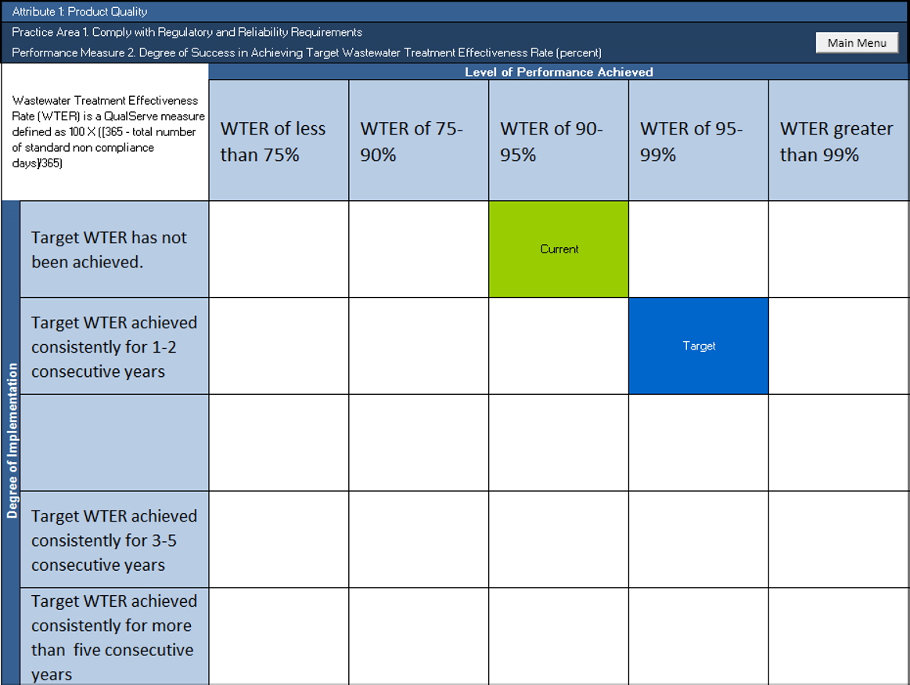
Performing the assessment
Notes:
The column and row headings can be edited by double-clicking the appropriate cell if you’d like to modify the pre-defined criteria descriptions.
Find the intersection between the correct level of performance with degree of implementation for your utility. Click to enter your current performance and repeat the process to enter the target.
In defining the performance measures, some rows and columns were intentionally left blank. Please use caution to avoid selecting the blank rows/columns.
Clicking the squares within the matrix will turn on/off “Current,” “Target,”

Slide 23
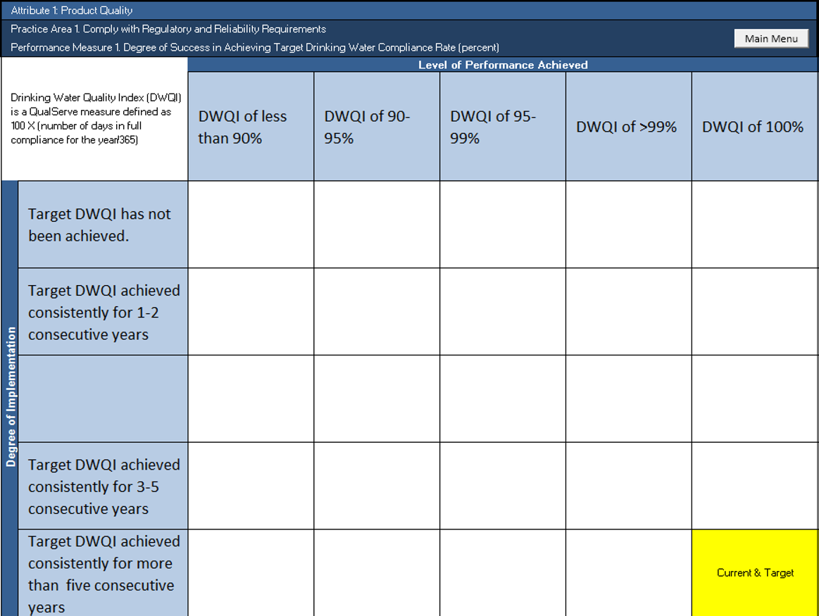
Performing the assessment
Notes:
Clicking the squares within the matrix will turn on/off “Current,” “Target,” or “Current & Target.”
Select current performance before selecting a target. Clicking activated squares will reset them for re-scoring.
After completing all of the performance measure assessments, click on the “Main Menu” button in the upper right of the matrix.

Slide 24
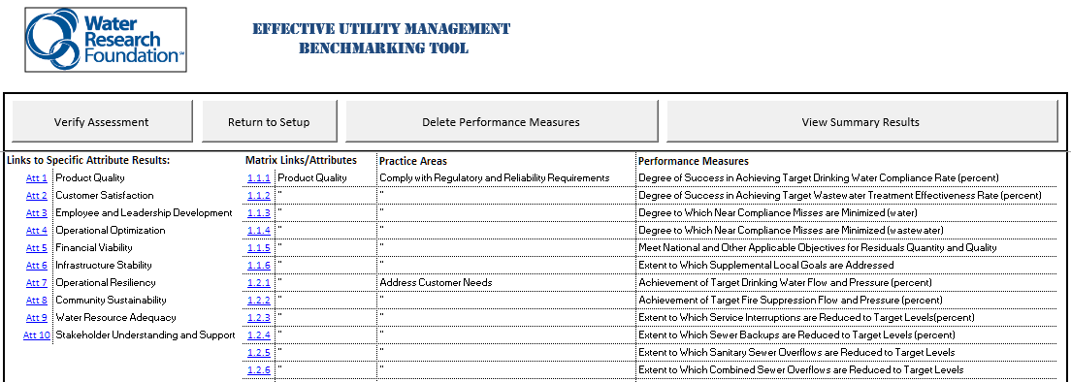
Verifying the assessment
Notes:
Clicking this button will test to see if there are missing data that must be entered before continuing.
Use the attribute links to navigate to specific Attribute(s) for the next step.

Slide 25
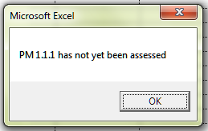
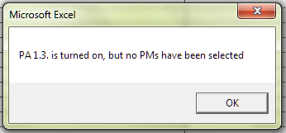
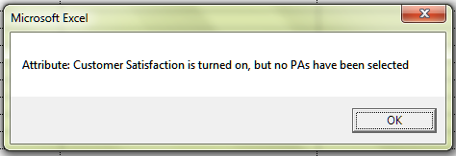
Potential errors
Performance Measure assessment missing.
Practice Area weighted, but no Performance Measures have been selected.
Attribute has been weighted, but no Practice Areas have been selected.
Notes:
The first potential error is that a Performance Measure has not yet been assessed. This is resolved by navigating to the appropriate Performance Measure(s) and recording the current and target performance.
The second potential error is that a Practice Area has been weighted, but no Performance Measures have been selected. This is resolved by either setting the Practice Area weight to zero or entering “Y” in one or more Performance Measures related to that Practice Area.
The third potential scoring error is that an Attribute has been weighted, but no Practice Areas have been selected. This is resolved by either setting the Attribute weight to zero, or entering a numerical weight for one or more Practices Areas related to that Attribute, and then entering “Y” in one or more Performance measures related to each selected Practice Area.

Slide 26
Modifying the assessment: removing or deleting elements
The following two slides illustrate the process that can be used to add/remove assessment elements and to delete Performance Measures, respectively.
Removing assessment elements takes them out of the assessment summaries but does not delete the underlying Performance Measure sheets and scoring from the tool;
Deleting Performance Measures deletes the underlying Performance Measure sheets and scoring from the tool.

Slide 27
Removing assessment elements
Notes:
If you determine that it is appropriate to add or remove elements from what is shown in the assessment, you can add or remove Attributes, Practice Areas, and Performance Measures, even after scoring, by selecting the element and making appropriate adjustments.
(Select items 1, 2 and/or 3, then re-create your assessment in step 4.)

Slide 28
Deleting performance measures
Notes:
If it is determined that certain Performance Measures are no longer needed, click “delete performance measures” to remove them.
This pop-up window will appear with each of the Performance Measures listed. Click the check boxes for the Performance Measures you’d like to remove and then click OK.
This process does not affect the settings on the setup menu; therefore , in order to prevent the deleted Performance Measure(s) from reappearing, they should be switched from “Y” to “N” in the setup menu.

Slide 29
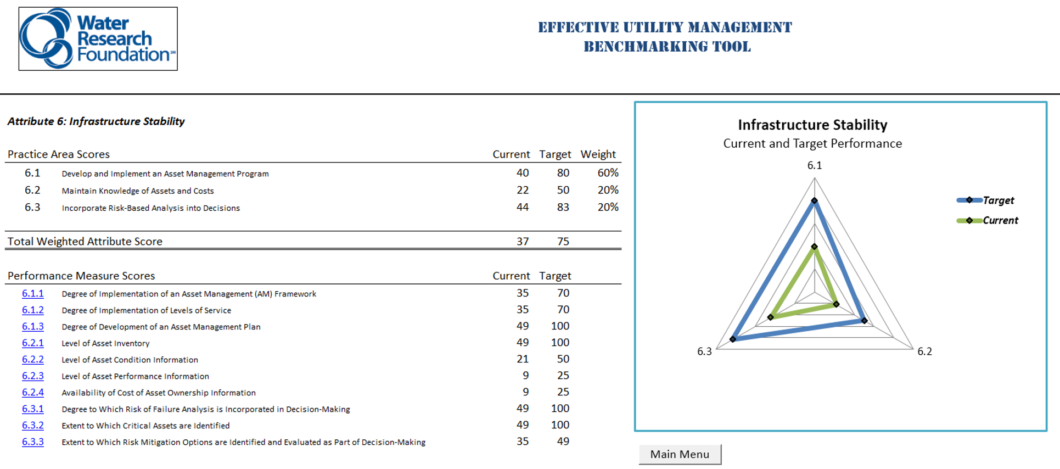
Review the results: attribute summary
Notes:
Practice Area scores (arithmetic mean of Performance Measure scores) are listed in the table and illustrated in the graph.
The individual Performance Measures are listed, with links to their sheets. If necessary, click the links to revise assessments.
Current and target performance scores are listed based on the matrix selections.

Slide 30
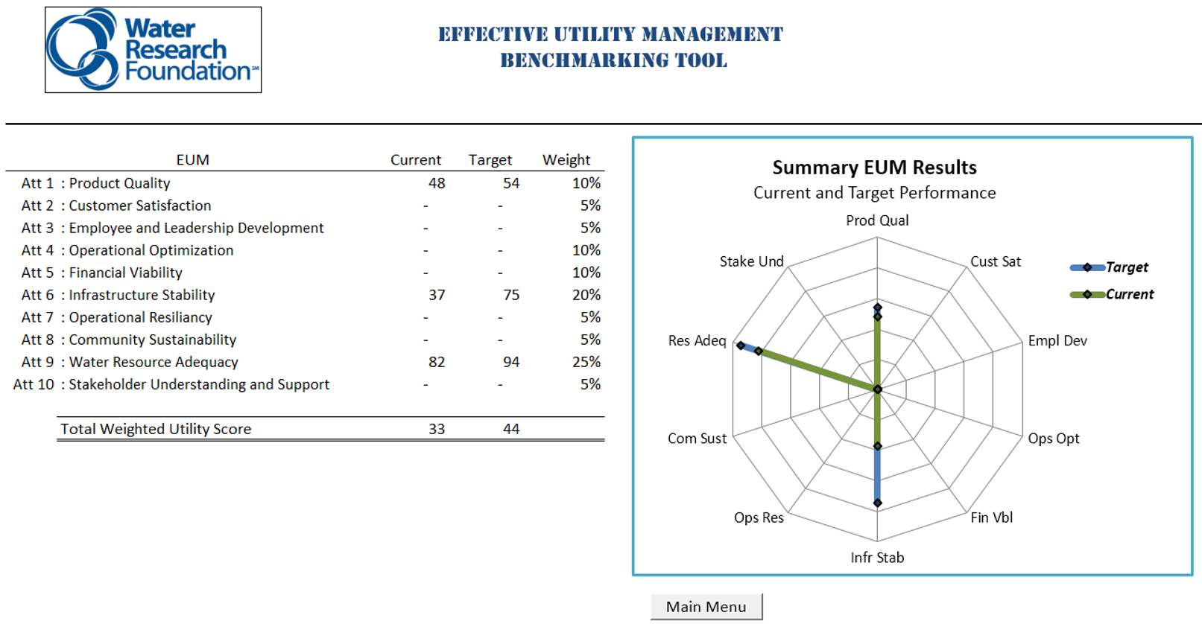
Review the results: assessment summary
Notes:
After the assessment has been completed, the summary results for each Attribute (based on the Practice Area weights) are listed and illustrated on the graph. The total weighted utility score is also provided, based on the specific Attribute weights.

Slide 31
Closing thoughts
All project materials available as freeware from WRF
http://www.waterrf.org
Search “4313”
Utilities have embraced a variety of applications of the tool
Embed directly for tracking/planning
Inform balanced score cards
Inform strategic plan updates

Slide 32
Thank You
Comments or questions, please contact:
Fair.Yeager@ch2m.com
For more information visit:
www.waterrf.org, search “4313”
www.watereum.org

