Slide 1
WaterRF Workshop on EUM Benchmarking
Toho’s Continuous Improvement Journey
April 23, 2015

Slide 2
Toho’s Continuous Improvement Journey
Michael Sweeney, Ph.D.
Deputy Executive Director
Toho Water Authority

Slide 3
Agenda
About Toho Water Authority
Qualserve
Strategic Planning and EUM
Asset Management Program Benchmarking
WaterRF 4313: EUM Benchmarking Tool
TWA’s KPI “Portfolio”

Slide 4
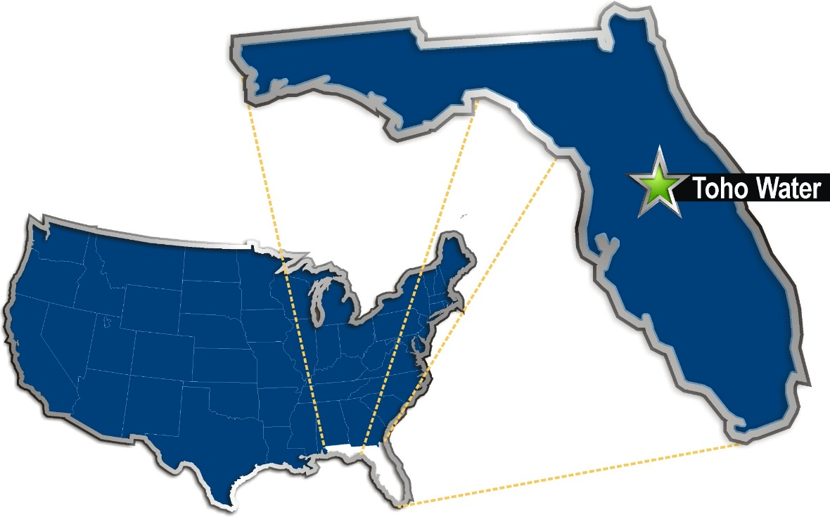
About: Toho Water Authority
A special independent district
6 member Board of Supervisors
A provider of water, wastewater, and reclaimed water services
Service population of about 250,000
290 employees
Notes:
Toho is located in central Florida in Kissimmee. Orlando is a suburb of Kissimmee.

Slide 5
Qualserve

Slide 6
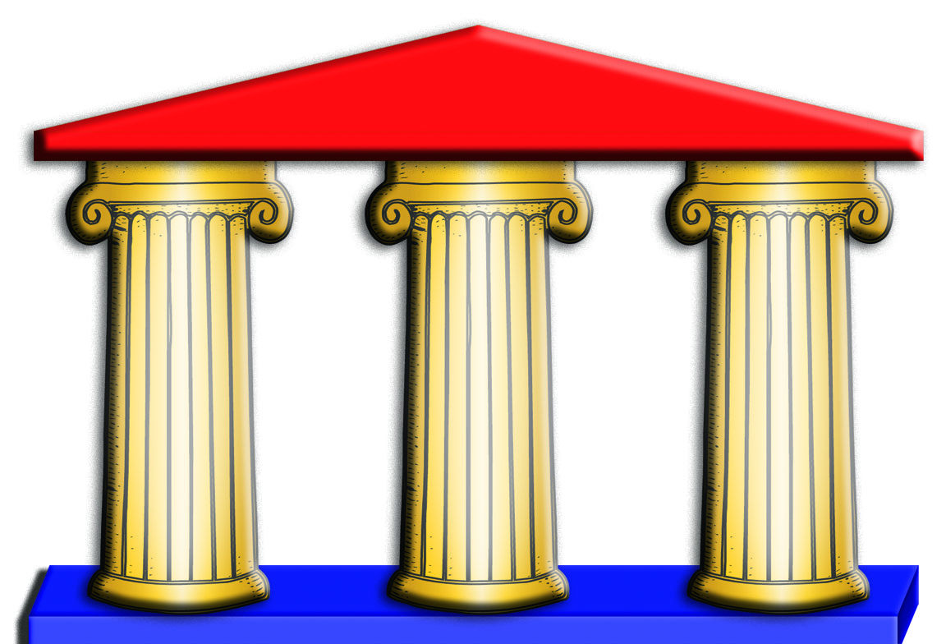
QualServe Programs
Self-assessment
Peer Review
Benchmarking
Common framework: - Business systems
- Business categories
- Best practices

Slide 7
QualServe’s Benchmarking Inititative
Started in 2000-2001 and produced:
22 indicators
Common definitions of performance indicators
Performance Indicators Reports

Slide 8
Qualserve → Florida Benchmarking Consortium
Seven Qualserve peer reviewers
Qualserve survey participants
Many utilities themselves have previously undergone peer reviews
Concentrates on 11 performance indicators

Slide 9
Strategic Planning

Slide 10
Customer Service
Water Supply
Workforce
Infrastructure
Financial Health
TWA’s
Five Primary Strategies

Slide 11
How 5 Strategic Goals Map to the 10 EUM Attributes
Employee and Leadership Development
Water Resource Adequacy
Stakeholder Understanding and Support
Operational Optimization
Infrastructure Stability
Community Sustainability
Customer Satisfaction
Financial Viability
Operational Resiliency
Product Quality
Customer Service
Employer of Choice
Water Supply
Infrastructure Financial Health
Notes:
We need to develop a figure that illustrates this concept.

Slide 12
Asset Management Program Benchmarking

Slide 13
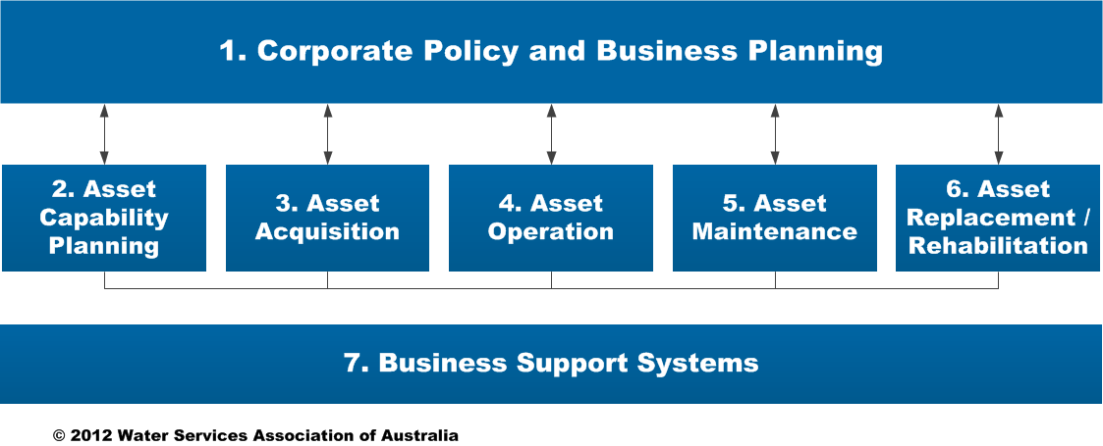
The Aquamark Framework
The asset management aspects of the utility are subdivided into seven functions:

Slide 16
WaterRF 4313: EUM Benchmarking Tool

Slide 17
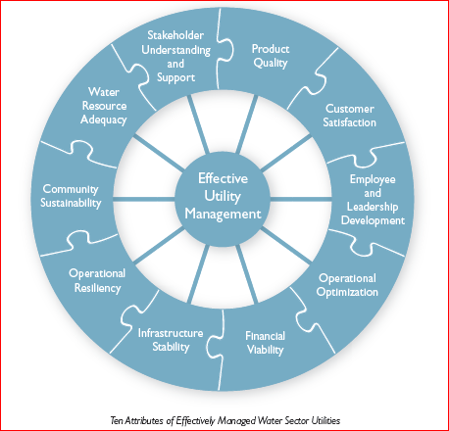
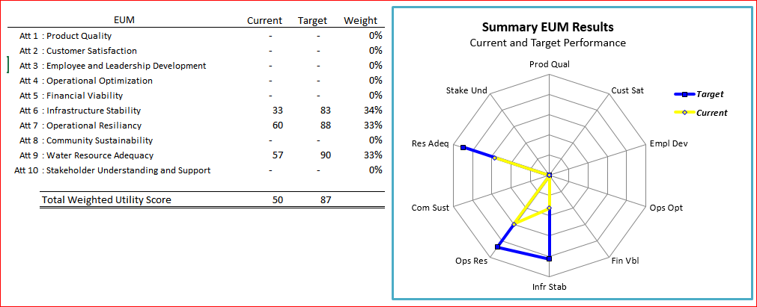
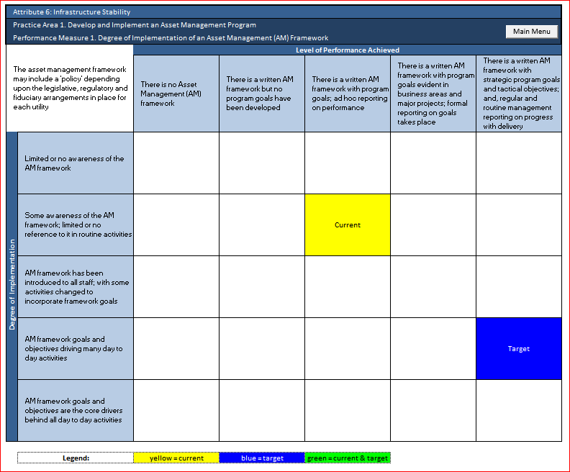
Performance Benchmarking for
Effectively Managed Water Utility Management
WaterRF Project # 4313
Effective Utility Management

Slide 18
TWA’s use of the Effective Utility Management Benchmarking Tool
Our use was primarily driven by our participation in the project
TWA selected 3 of the 10 attributes to benchmark
Infrastructure Stability
Operating Resiliency
Water Resource Adequacy
Review matrices for practice areas for the selected attributes
Identify current and targeted performance level for each practice area
Provide feedback to WaterRF

Slide 19
Benchmark tool used to identify current and target levels
for each performance measure
Level of Performance Achieved - Low to High
Degree of Implementation – Low to High

Slide 20
Benefits Realized from Using the Tool
Facilitated a discussion on how “good” TWA needed to become.
Caused TWA to identify were condition assessment activities could be performed by Staff on a scheduled basis. Lift Station rehab program fully implemented.
Re-enforced the effort to obtain consistency and completeness of work order information.
Highest score on implementation and performance may not be applicable or desirable within TWA’s financial, social or environmental space
Validated Tactical and Strategic Plans
Aided in the development of a high-level plan to close the gap between current and target process performance

Slide 21
KPI Portfolio
Or measuring the tread depth of the rubber that is meeting the road…

Slide 22
KPI Categories Roll-up to the Strategic Plan
Key Performance Indicators – Governance View
1Q14 | 2Q14 | 3Q14
67% | 67% | 75%
77% | 82% | 100%
79% | 79% | 79%
67% | 67% | 60%
100% | 100% | 100%
n/a | n/a | n/a
Infrastructure Reliability
73%
Improved response times sewer collection system failures.
Organizational Responsiveness
91%
Regulatory Compliance
79%
Customer Service Performance
60%
Financial Performance
100%
Workforce Initiatives
50%
22

Slide 23
Level of Service – 4FQ14
Key Performance Indicators – Governance View
1Q14 | 2Q14 | 3Q14
67% | 67% | 75%
77% | 82% | 100%
79% | 79% | 79%
67% | 67% | 60%
100% | 100% | 100%
n/a | n/a | n/a
Infrastructure Reliability
73%
Organizational Responsiveness
91%
Regulatory Compliance
79%
Staff available for phone coverage decreased while average call volume increased.
Customer Service Performance
60%
Financial Performance
100%
Workforce Initiatives
50%
23

Slide 24
Infrastructure Reliability - 4FQ14 Quarterly Report
WORST
73%
BEST
Level of Service: Provide reliable service to TWA Customers | POTABLE WATER |  | WASTE WATER |  | RECLAIMED WATER
 | QTR | YR | QTR | YR | QTR | YR
Provide minimum pressure (at point of service) of 40 psi during average demand
Repair out-of-service fire hydrants within 14 days of notification
Restoration of service Potable Service Lines – 4 hours Potable Distribution Lines and Reclaimed Service – 8 hours Sewer Service – 8 hrs
Number of breaks per 100 miles (pipe) per year Potable and Reclaimed Water – 100 breaks Waste Water – 30 breaks
Unaccounted for water loss 10% or less
Fewer than 11 SSO’s per 100 miles (pipe) per year
Reduce # of SSO’s by 1% over previous year Wet weather SSO’s Dry weather SSO’s
Provide service on scheduled days
LEGEND
Target met/exceeded - GOOD
Target not met – IMPROVEMENT REQ’D
Low Bound not met – IMPROVEMENT REQ’D
Trend Improving
Trending Worse

Slide 25
Infrastructure Reliability - 4FQ14 Quarterly Report
WORST
73%
BEST
Level of Service: Provide reliable service to TWA Customers | POTABLE WATER |  | WASTE WATER |  | RECLAIMED WATER
 | QTR | YR | QTR | YR | QTR | YR
Provide minimum pressure (at point of service) of 40 psi during average demand
Repair out-of-service fire hydrants within 14 days of notification
Restoration of service Potable Service Lines – 4 hours Potable Distribution Lines and Reclaimed Service – 8 hours Sewer Service – 8 hrs
Number of breaks per 100 miles (pipe) per year Potable and Reclaimed Water – 100 breaks Waste Water – 30 breaks
Unaccounted for water loss 10% or less
Fewer than 11 SSO’s per 100 miles (pipe) per year
Reduce # of SSO’s by 1% over previous year Wet weather SSO’s Dry weather SSO’s
Provide service on scheduled days
Hydrant repair averaged 22.6 days for the quarter.
LEGEND
Target met/exceeded - GOOD
Target not met – IMPROVEMENT REQ’D
Low Bound not met – IMPROVEMENT REQ’D
Trend Improving
Trending Worse

Slide 26
Infrastructure Reliability - 4FQ14 Quarterly Report
WORST
73%
BEST
Level of Service: Provide reliable service to TWA Customers | POTABLE WATER |  | WASTE WATER |  | RECLAIMED WATER
 | QTR | YR | QTR | YR | QTR | YR
Provide minimum pressure (at point of service) of 40 psi during average demand
Repair out-of-service fire hydrants within 14 days of notification
Restoration of service Potable Service Lines – 4 hours Potable Distribution Lines and Reclaimed Service – 8 hours Sewer Service – 8 hrs
Number of breaks per 100 miles (pipe) per year Potable and Reclaimed Water – 100 breaks Waste Water – 30 breaks
Unaccounted for water loss 10% or less
Fewer than 11 SSO’s per 100 miles (pipe) per year
Reduce # of SSO’s by 1% over previous year Wet weather SSO’s Dry weather SSO’s
Provide service on scheduled days
1.5% of breaks for this quarter were associated with main distribution lines.
LEGEND
Target met/exceeded - GOOD
Target not met – IMPROVEMENT REQ’D
Low Bound not met – IMPROVEMENT REQ’D
Trend Improving
Trending Worse

Slide 27
Infrastructure Reliability - 4FQ14 Quarterly Report
WORST
73%
BEST
Level of Service: Provide reliable service to TWA Customers | POTABLE WATER |  | WASTE WATER |  | RECLAIMED WATER
 | QTR | YR | QTR | YR | QTR | YR
Provide minimum pressure (at point of service) of 40 psi during average demand
Repair out-of-service fire hydrants within 14 days of notification
Restoration of service Potable Service Lines – 4 hours Potable Distribution Lines and Reclaimed Service – 8 hours Sewer Service – 8 hrs
Number of breaks per 100 miles (pipe) per year Potable and Reclaimed Water – 100 breaks Waste Water – 30 breaks
Unaccounted for water loss 10% or less
Fewer than 11 SSO’s per 100 miles (pipe) per year.
Reduce # of SSO’s by 1% over previous year Wet weather SSO’s Dry weather SSO’s
Provide service on scheduled days
74% of failures for the quarter occurred in the sewer lateral lines or at the cleanout
LEGEND
Target met/exceeded - GOOD
Target not met – IMPROVEMENT REQ’D
Low Bound not met – IMPROVEMENT REQ’D
Trend Improving
Trending Worse

Slide 28
Sample Detail
KPI: Restoration of Service – potable service lines (4 hours) and distribution lines (8 hours)
Since it is not possible to consistently differentiate between service and distribution lines an average of 8 hours is used.
Description: The following information pertains to any service interruptions (line breaks, meter or valve replacements, etc.) that cause customers to experience the complete cessation of water service or water delivered at a pressure lower than 20psi.
Data includes potable water work orders with LEAKING as the problem code and/or work orders with the word WATER and LEAK, BREAK, CUT, or HIT in the description and a SERVICE INTERRUPTION indicated.
Data shown uses the recorded service interruption time.
Detail Data:
Observations / Actions Taken: The target has been consistently achieved for the quarter.

Slide 29
Overarching Considerations
Do you currently have defined performance measures and targets in place?
How are they used and integrated to monitor trends and support operations, maintenance, asset management and/or financial decisions?
How well are they aligned with your strategic or operating plans?
How effectively is performance information shared with your external stakeholders?

Slide 30
Thank You
Comments or questions, please contact:
msweeney@tohowater.com
For more information visit:
www.tohowater.com

