Slide 1
Water Services Association of Australia
Asset Management Improvement Project (Aquamark)

Slide 2
Who is WSAA?

Slide 3
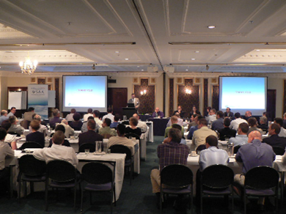
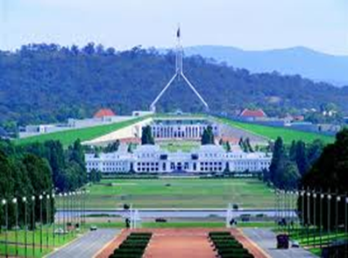
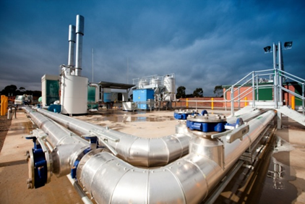
WSAA’s central functions
1. Collaboration
Information sharing and problem solving
Benchmarking
Leveraging expertise and funding
2. Advocacy
Representing industry interests in nationally
Influencing policy
International representation
3. Innovation
A filtering point for latest technology
Introducing new ideas from Australia and overseas
Notes:
1. Collaboration
Projects, research, benchmarking, tools publications, codes/standards, networks
2. Advocacy
PC Inquiry, energy and carbon policy, water quality, guidelines, other submissions i.e. third party access
3. Innovation
TAG, Cities of the Future, WERF Waste to energy, AM with ARC grant including WaterRF and UKWIR

Slide 4
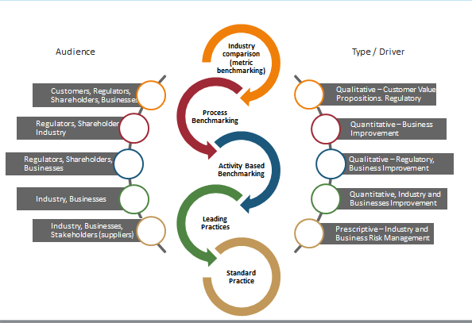
Australian Context
National Performance Report (80 Utilities) ~ EUM
Aquamark
Pump Energy Efficiency
Best practice asset operations for WWTP
Water Supply Code of Practice

Slide 5
What could be possible through collaboration?
High Level Metrics (EUM/AWWA)
Asset Mgt System Cluster
Operations Cluster
Human Resources Cluster
Customer Service Cluster
Process benchmarking/ assessment against clusters or groups of clusters
Understand individual utility gaps and garner leading practices
Enhanced industry outcomes

Slide 6
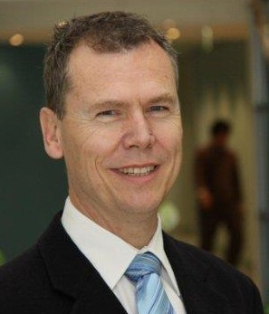
Contact details
Greg Ryan
Manager Utility Excellence
greg.ryan@wsaa.asn.au
P: +61 (3) 8605 7611
M: +61 (4) 1832 1632
LinkedIn Water Services Association of Australia Web
www.wsaa.asn.au

