Slide 1
WRF Utility Benchmarking Workshop
Integrating the EUM Benchmarking Tool into Albuquerque’s Strategic Planning Process
April 23, 2015

Slide 2
Integrating the EUM Benchmarking Tool into Albuquerque’s Strategic Planning Process April 23, 2015
2015 IWA Water Efficiency &
Performance Assessment Conference
Frank Roth, Senior Policy Manager
Albuquerque Bernalillo County Water Utility Authority
New Mexico

Slide 3
Background Albuquerque Water Authority
Budget: $202 million operating $59 million capital
205,000 customer accounts
630 employees
31 billion gallons of drinking water produced and delivered annually
3,130 miles of water supply pipeline
20 billion gallons of wastewater processed and returned to river annually
2,700 miles of collection pipeline

Slide 4
Presentation Outline
Background on Albuquerque
Overview Strategic Planning Process
Benchmarking Tool Test Phase
EUM Primer Assessment Results
Benchmarking Tool Integration into Strategic Planning Process

Slide 5
Strategic Planning, Budgeting & Improvement Process
Five-Year Goals &
One-Year Objectives
Budget (Annually)
Customer Opinion Survey (Biennial)
Benchmarking Performance Indicators Survey (Biennially)
Effective Utility Management (Quarterly)
Performance Plan (Annually)
Customer Advisory Committee (Monthly)
Customer Conversations (Quarterly)
MISSION
Assure responsive Customer Service
Provide reliable, high quality, affordable and sustainable water supply, wastewater collection treatment, and reuse systems
Support healthy, environmentally-sustainable, and economically-viable community
Notes:
Long Range Goals – Short Term Objectives
Objectives – Policy Directives from governing board to address performance issues or development/implementation of plans or projects to be more effective
SA/PR no longer active programs in QualServe
Now using Tool for Continuous Performance Improvement

Slide 6
EUM Quarterly Metrics
EUM | Metric/Indicator
PQ-1 | Discharge Permit Violations
PQ-2 | Collection System Failures
PQ-3 | Sewer Overflow Rate
PQ-4 | Biosolids Beneficial Use
PQ-5 | Sewer Use Ordinance Compliance
CS-1 | Delinquency Revenue Rate
CS-2 | Call Responsiveness
CS-3 | Abandoned Calls
CS-4 | First Call Resolution
CS-5 | Bill Accuracy Ratio
CS-6 | Technical Quality Complaint Rate
ED-1 | Certification Training Program
ED-2 | Training Hours per Employee
ED-3 | Employee Turnover Rate
ED-4 | Retirement Eligibility
ED-5 | Internal Employee Promotions
ED-6 | Employee Appreciation
OO-1 | Customer Accounts per Employee
OO-2 | O&M Costs Ratios
OO-3 | Non-Operational Meters
OO-4 | Non-Revenue Water - Water Loss
OO-5 | Energy Consumption Efficiency
EUM | Metric/Indicator
FV-1 | Revenue to Expenditure Ratio
FV-2 | Expenditures to Budget
FV-3 | Capital Rehabilitation Spending
FV-4 | Cash Reserves –Days
IS-1 | Water Distribution System Integrity
IS-2 | Sewer Collection System Integrity
IS-3 | Planned Maintenance Ratios
IS-4 | Distribution System Leak Detection
IS-5 | Collection System Failure Detection
OR-1 | Employee Injury Time
OR-2 | Sewer Failure Claims
OR-3 | Safety Training Hours
SU-1 | Low-Income Billing Assistance Coverage
SU-2 | Sustainable Education Classes
WR-1 | Water Use Composition
WR-2 | Water Conservation
WR-3 | Water Conservation Rebates
WR-4 | Water Waste Violations
SS-1 | Media Coverage Tone
SS-2 | Community Meeting Evaluations
Notes:
We first realigned our PMs by long range goal area to the EUM attribute areas
It painted a different picture of performance and showed more performance gaps we were not aware of.

Slide 7
EUM Annual Scorecard Reporting
Key
Excellent
Good
Fair
Poor
Product Quality (PQ)
Water Resource Adequacy (WR)
Financial Viability (FV)
Infrastructure Stability (IS)
Customer Satisfaction (CS)
Employee & Leadership Development (ED)
Operational Optimization (OO)
Community Sustainability (SU)
Stakeholder Understanding & Support (SS)
Operational Resiliency (OR)
Notes:
At the end of the fiscal year, the 4th Quarter Report includes an annual scorecard of how the utility performed compared to the last fiscal year by the ten attributes.
Or how well we did in meeting our targets - Objectives

Slide 8
Self Assessment Process Testing Phase Fall-Winter 2012/2013
Executive Team
Subject Matter Experts
Review w/ Chief Operating Officer
Final Review at Quarterly Meeting
Notes:
Step 1: Process started with the Executive Director, Chief Operating Officer, Chief Financial Officer and Senior Policy Manager in weighing the Attribute/Practice areas
Step 2: Actual testing of the tool with the scoring of the individual performance measures.
These included the division managers, chief engineers, program managers, and superintendents.
The purpose of the second step to allow staff to provide candid assessments of the utility’s performance.
Step 3: After completing the self-assessments in all three areas, I compiled the information with comments and reviewed with the Chief Operating Officer as all Attributes fell under his operational area.
Step 4: Final review of the PM scoring during our regularly scheduled Quarterly Budget, Goals & Objectives meeting to ensure that we were on the same page with the scoring and targets.
Process shows that the SA tool has to be top-driven but bottom-up involvement, everyone is a stakeholder in the process.

Slide 9
Employee Participation in Benchmarking Tool
Attribute | No. of Staff | Staff Composition
Product Quality | 19 | Field and Plant Division Managers (2), Distribution and Collection System Chief Engineers (2), Plant Treatment Chief Engineers (2), Compliance Division Manager (1), Superintendents (4), Others (8)
Infrastructure Stability | 4 | Engineering Division Manager, Chief Engineer for Capital Improvements, Asset Management Program Manager, Asset Management Coordinator
Water Resource Adequacy | 2 | Water Resources and Water Conservation Program Managers
Notes:
Our utility chose Product Quality, Infrastructure Stability, and Water Resource Adequacy as the three attributes to test the self-assessment tool.
The main key in selecting these three attribute areas was the availability of data and the commitment from key employees (SMEs) who are engaged in the strategic planning process and familiar with our benchmarking process.
In all, we had 25 staff participate in testing the tool in Fall 2012/ Early 2013.

Slide 10
Product Quality Attribute

Slide 11
Infrastructure Stability Attribute
Notes:
Revive AM Program

Slide 12
Water Resources Adequacy Attribute

Slide 13
Testing Phase Key Findings
Self-Assessment Tool is a great communication tool
Many performance measures cut through the organization structure allowing for a collaborative effort
We are doing better than we thought and have made progress in last 10 years
Notes:
Great communication device; the main benefit in using this tool was the discussion that occurred in examining the level of performance – some lively discussions, soapboxes included.
It helped facilitate that discussion and obtain consensus on evaluating existing strategies and future targets and determine where we wanted to be in order to move to the next level – engage employees
Related to communication benefit is the tool’s performance measures cut through division lines allowing for a collaborative effort, especially the Product Quality attribute
Validate: We are doing better than we thought and have made progress in last 10 years. A good indication that our strategic planning process is working but that we need to continue to evolve it. The SA tool confirmed that we are making progress.

Slide 14
Employee Participation in Benchmarking Tool 2012-2014
Attribute | No. of Staff
Product Quality | 19
Customer Satisfaction | 4
Employee & Leadership Development | 2
Operational Optimization | 2
Financial Viability | 4
Attribute | No. of Staff
Infrastructure Stability | 21
Operational Resiliency | 2
Community Sustainability | 2
Water Resource Adequacy | 2
Stakeholder Understanding & Support | 1
Notes:
We continue to complete the remaining attributes during 2013-2014. Most of the time spent Infrastructure Stability Attribute using the self-assessment to assess our asset management program. Over 60 employees involved in using the tool.
There are 36 practice areas and 118 performance measures. ABCWUA completed 35 practice areas and 99 performance measures (84%).

Slide 15
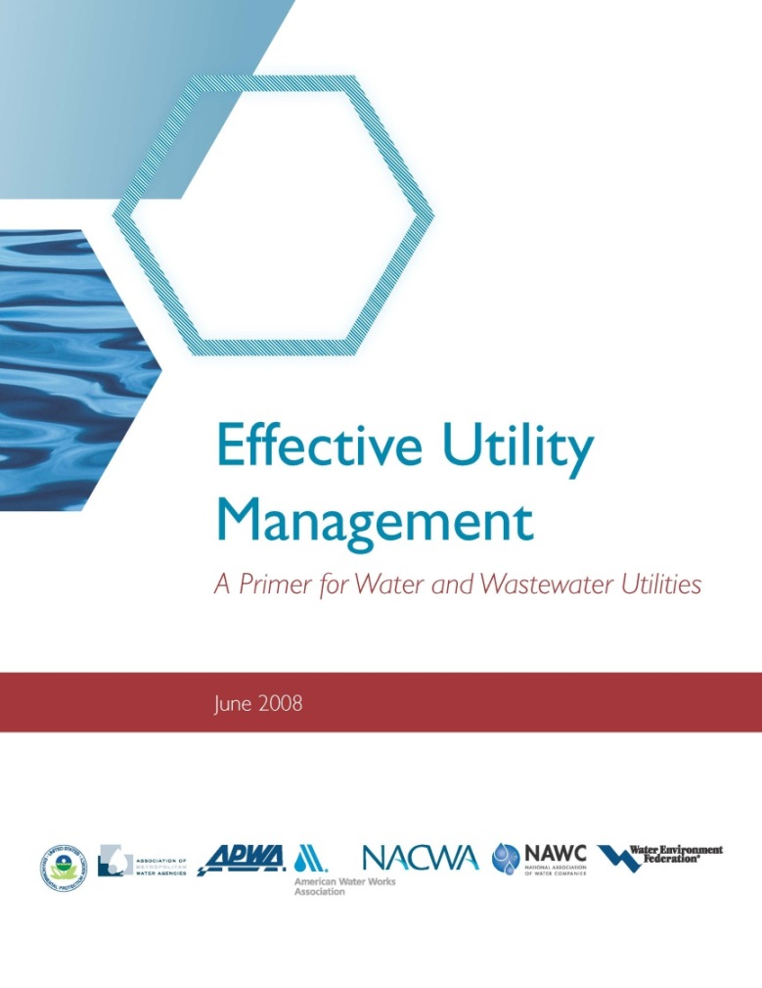
EUM Primer Assessment
Assess Current Conditions
Rank Importance of Attributes
Graph Results
Choose Attributes
Develop and Implement an Improvement Plan
Notes:
Establish leadership team of 15 members
Conduct assessment before retreat

Slide 16
EUM Primer Assessment
Attribute | Attribute Components |  | Step 1 Rate Achievement (1-5) |  | Step 2 Rank Importance (1-10)
Product Quality | Complies with regulatory and reliability requirements. Consistent with customer, public health, and ecological needs.
Customer Satisfaction | Provides reliable, responsive, and affordable services. Receives timely customer feedback. Responsive to customer needs and emergencies.
Notes:
On a 1-to-5 scale, assess current conditions by rating your utility’s systems and approaches and current level of achievement for each Attribute. Consider the degree to which your current management systems effectively support each of the Attributes and their component parts.
Rating Description
1. Effective, systematic approach and implementation; consistently achieve goals.
2. Workable systems in place; mostly achieve goals.
3. Partial systems in place with moderate achievement, but could improve.
4. Occasionally address this when specific need arises.
5. No system for addressing this.
Rank the importance of each Attribute to your utility, based on your utility’s vision, goals, and strategies. The ranking should reflect your perception of how the utility is performing in the Attribute area. Your ranking of each Attribute’s importance might be influenced by current or expected challenges in that particular area, recent accomplishments in addressing these issues, or other factors. Importance ranking is likely to change over time as internal and external conditions change.

Slide 17
EUM Assessment - Achievement
Notes:
Most attributes ranked (3) in that partial systems in place but room for improvement

Slide 18
Attribute Rank of Importance
Product Quality
Water Resource Adequacy
Financial Viability
Infrastructure Stability
Customer Satisfaction
Employee & Leadership Development
Operational Optimization
Community Sustainability
Stakeholder Understanding & Support
Operational Resiliency
Notes:
Executive Director: SS#1 but 3 ranked #10
HR Mgr: ED #1, but #9 for COO
SU received several #9 and #10 but it also received #1’s
Miles’ Law: Where you stand depends on where you sit. We see things and form judgments of things from our own perspective. We need to discipline ourselves to see things from other’s vantage point.

Slide 19
EUM Attribute Assessment Results
Rating | Higher Lower Achievement Achievement | 3.0-3.5 |  |  | FV | IS |  | ED
 |  | 2.5-3.0 |  |  |  |  |  |  | OO |  | SS | OR
 |  | 2-2.5 |  | WR |  |  | CS |  |  | SU
 |  | 1.0-2.0 | PQ
 |  |  | 1 | 2 | 3 | 4 | 5 | 6 | 7 | 8 | 9 | 10
 |  |  | More Important Less Important
 |  |  | Ranking
Product Quality (PQ)
Water Resource Adequacy (WR)
Financial Viability (FV)
Infrastructure Stability (IS)
Customer Satisfaction (CS)
Employee & Leadership Development (ED)
Operational Optimization (OO)
Community Sustainability (SU)
Stakeholder Understanding & Support (SS)
Operational Resiliency (OR)
Notes:
Group 1 recommended moving SS up in ranking and PQ down in ranking
Group 2 recommended moving SS up in ranking
Group 3 recommended moving ED to #5, CS to #6, and SS to #7

Slide 20
EUM Benchmarking Tool Results
1
9
5
2
6
8
7
10
3
4
○ Primer Assessment
Notes:
PQ Gap – Major Concern
SS Gap – Customer Conversations customer engagement portfolio
FV – high target expectations
PQ – more money is need to move target levels
SS – more customer education needed
SS – not easy to address media coverage indicators
IS – all staff needs better understanding of asset conditions
IS – need better data on asset condition and performance
IS – need to measure assets across all asset groups
ED – update succession plan
ED – re-examine partnership with CNM
ED – need recruitment strategy (look at other utilities)
OR – complete safety assessment, improve safety training

Slide 21
Strategic Planning Integration
Establish EUM Leadership Team
EUM Retreat
Review Results Attribute Assessment
Re-Assess Attributes
Review Results Benchmarking Tool
Discussion of Self-Assessment Gaps
Establish Strategic Improvement Groups
Notes:
Tool – comprehensive, detailed process, where we are performing, where should we be
Each group discuss their findings of the benchmarking tool assessment, what ideas or strategies developed to address these performance gaps or to reach the target levels, and if any suggested changes to current or target performance

Slide 22
Thank You
Comments or questions, please contact:
Frank Roth
Albuquerque Bernalillo County
Water Utility Authority
froth@abcwua.org
(505) 289-3102
For more information visit:
www.waterrf.org

