Slide 1
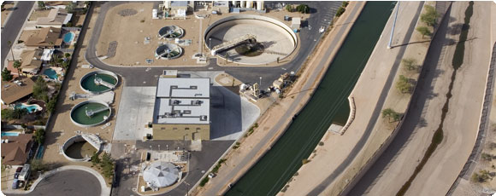
AWWA & Utility Management Kenneth Mercer, Ph.D. Senior Manager of Technical and Research Programs
Notes:
Provide an overview of AWWA Utility Management Resources

Slide 2
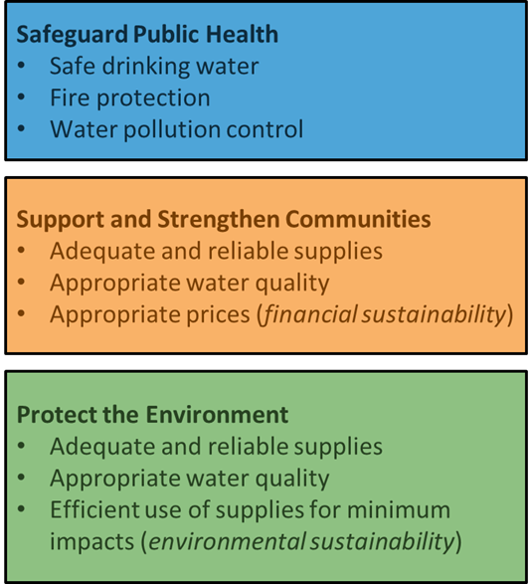
American Water Works Association
Founded in 1881
50,000+ members
3,000+ volunteers
Providing solutions to effectively manage water
Water, wastewater, stormwater, reuse

Slide 3
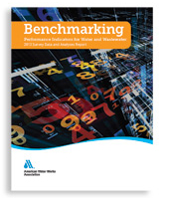
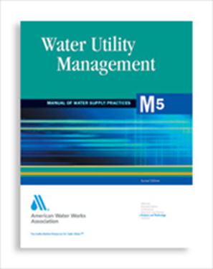
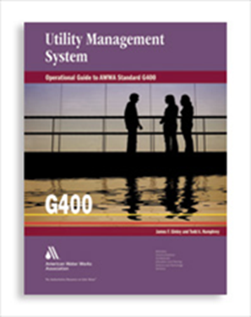
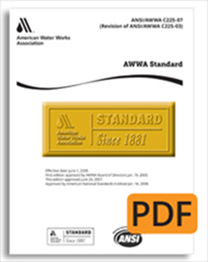
AWWA Utility Management Materials
Utility Benchmarking Program
Management Standards
Partnership for Safe Water+
Publications
Training (in-person and e-Learning)
Conferences and Events

Slide 4
AWWA Utility Management Materials
Utility Benchmarking Program
Management Standards
Partnership for Safe Water+
Publications
Training (in-person and e-Learning)
Conferences and Events
Notes:
Focus on these

Slide 5
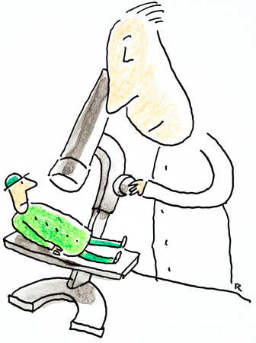
Utilities Compelled to Answer…
How are we performing?
How do we compare?
How can we improve?
http://bellace85.files.wordpress.com/2012/05/under-microscope.jpg

Slide 6
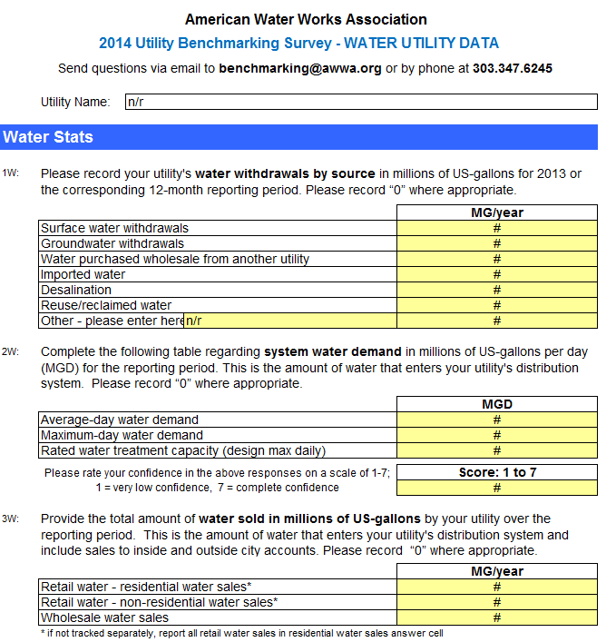
Utility Benchmarking Program
AWWA began developing a utility benchmarking program in 1995
Previously QualServe
Well-defined and time-tested performance indicators specific to the water sector
Annual Utility Benchmarking Survey
Definitions and calculations
Participant report
Public release of aggregate results
Focused Utility Benchmarking Workshops
Notes:
AWWA’s benchmarking program continuously tracks utility performance indicators (PIs)
1. Operational efficiency
2. Managerial effectiveness

Slide 7
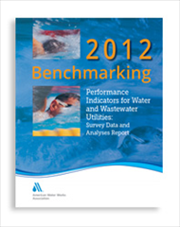
Utility Benchmarking Program
Performance indicators generalized/ normalized in order to provide greatest general applicability
Align with EUM
Report central tendency measures (25th, 50th, 75th)
Provides system for decision-makers to understand/quantify past and current performance
Set reasonable targets for the future
Notes:
Performance monitoring and improvement
1. Provides system for decision-makers to understand/quantify past and current performance
2. Set reasonable targets for the future

Slide 8
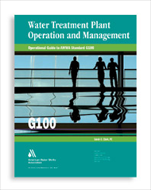
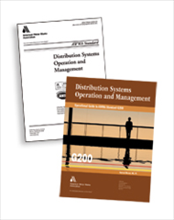
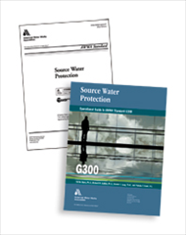
Utility Management Standards
ANSI/AWWA G100-11 Water Treatment Plant Operation and Management
ANSI/AWWA G200-09 Distribution Systems Operation and Management
ANSI/AWWA G300-14 Source Water Protection
ANSI/AWWA G310-09 Business Practices for Operation and Management
ANSI/AWWA G400-09 Utility Management System
ANSI/AWWA G410-09 Business Practices for Operation and Management
ANSI/AWWA G420-09 Communications and Customer Relations
ANSI/AWWA G430-14 Security Practices for Operation and Management
ANSI/AWWA G440-11 Emergency Preparedness Practices
ANSI/AWWA G480-13 Water Conservation Program Operation and Management
ANSI/AWWA G481-14 Reclaimed Water Program Operation and Management
ANSI/AWWA G510-13 Standard for Wastewater Treatment Plant Operations and Management
Notes:
Don’t read all of these, just want to show the breadth of ANSI/AWWA Utility Management Standards and Guidebooks

Slide 9
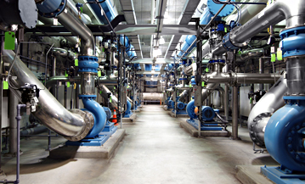
Partnership for Safe Water
Phase I – Commitment
Phase II – Baseline data reporting
Phase III – Self-Assessment completion
Phase IV – Demonstrated optimization
Self-assessment aligns with EUM
Notes:
The treatment and distribution systems are structured the same; they both have these 4 phases:
Phase I – the easy part, sign up, pay membership fee, commit to participate through Phase III
Phase II – compile and submit baseline data, used to measure the impact of the program over time.
Phase III – Using the manual provided by the Program, complete a Self Assessment.
Phase IV – Address Performance Limiting Factors identified during Self Assessment and demonstrate sustained optimized performance
What comes out of the Self Assessment is a prioritized list of Performance Limiting Factors, aspects in any of these areas which are barriers to optimized performance

Slide 10
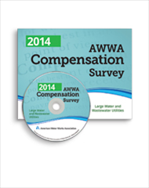
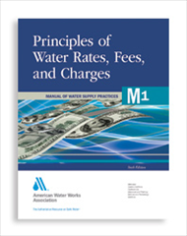
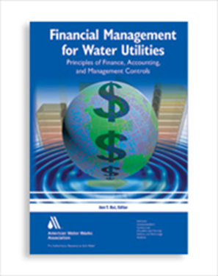
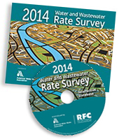
Publications
M1: Principles of Water Rates, Fees and Charges
M5: Water Utility Management
M52: Water Conservation Programs—A Planning Manual
M60: Drought Preparedness and Response
2014 AWWA Compensation Survey: Small and Medium-sized Water and Wastewater Utilities
2014 Water and Wastewater Rates Survey
Utility Management for Water and Wastewater Operators, 2011
Financial Management for Water Utilities: Principles of Finance, Accounting, and Management Controls, 2012
Notes:
Touch on the highlights, many resources beyond this list

Slide 11
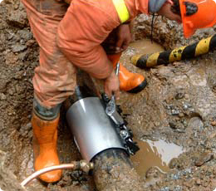
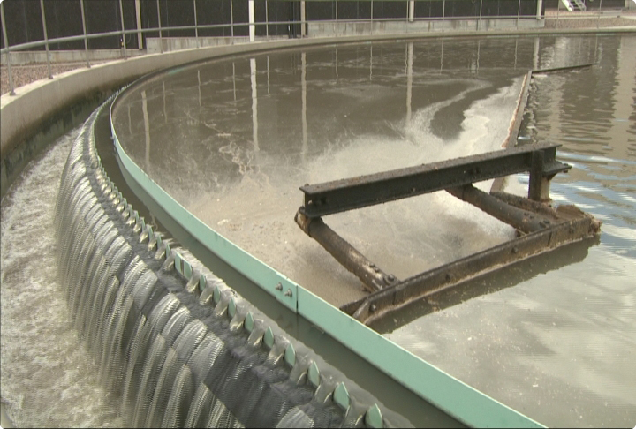
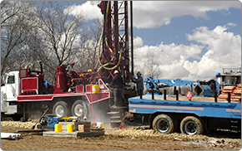
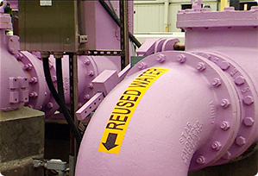
American Water Works Association
“A better world through better water”
http://www.awwa.org

