Slide 1
Effective Utility Management (EUM) Benchmarking
Overview of Project 4313, Products and Feedback from Utilities
Mike Matichich, CH2M
23 April 2015

Slide 2
Agenda
Why Benchmark?
Overview of WRF Project 4313
  Approach and Participants
  Key Findings
Products of the Project
Feedback from Utilities
Closing Thoughts

Slide 3
Why benchmark?
Need for greater efficiency leads to desire to measure performance
Track progress over time
Compare own progress with industry standards, practice of other utilities
Identify specific gaps in order to allocate scarce resources to most important areas
Help document and support budgets, other resource requirements to governing boards and stakeholders
Provide information on progress to stakeholders
  Internal
  External

Slide 4
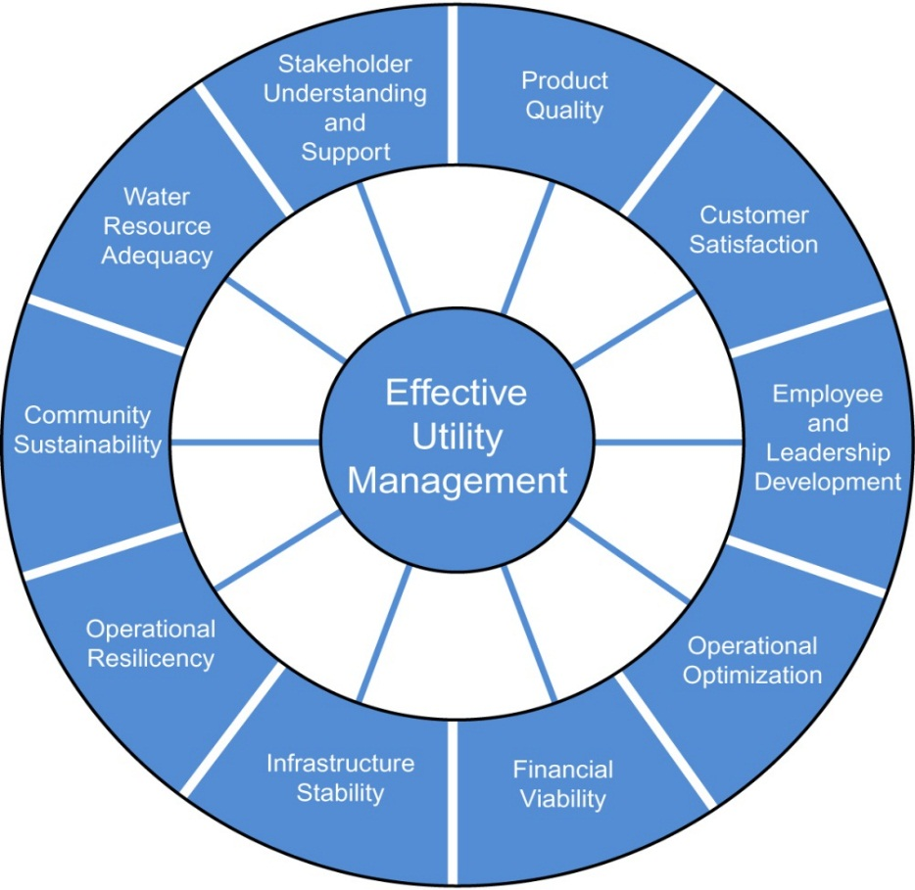
The starting point for the WRF project is the Ten Attributes of Effective Utility Management (EUM) defined in the 2008 EUM Primer and related Primer resources.
www.watereum.org

Slide 5

WRF Project 4313 was funded in 2012 to build upon the prior work in EUM.
Identify “practice areas” for each of the Ten Attributes and key metrics to measure performance for those practices
Develop a benchmarking framework and assessment methodology
Develop a supporting self-assessment benchmarking tool for utilities to compare their performance against their targets
Pilot test with utilities and communicate to stakeholders

Slide 6
Project team
Water Research Foundation
  Linda Reekie, Research Manager
Project Advisory Committee
  Robin Casale Meterchick, American Water (retired)
  Dan Hartman, City of Golden, CO
  JC Goldman, United Water (deceased)
  Jim Horne, USEPA
Industry Associations
  APWA, NACWA, AWWA, NAWC, WEF, AMWA
Participating Utilities
  17 participated during Phase 1
  25 utilities provided feedback for Phase 2
    US (20)
    Canada (3)
    Australia (1)
    UK (1)
Project Team
  CH2M HILL
  Subs
    GHD
    DeMarche Consulting
    Ross Strategic

Slide 7
Utilities ranged from Covington Water (15,000 customers) to New York City DEP (5,500 employees and 9 Million customers).
More than 50 disciplines were represented in the testing participants from engineers and operators to finance directors, utility managers and attorneys.

Slide 8
There is a hierarchy of practice areas and performance measures for each attribute
Attribute
Practice Area 1
Performance Measure 1
Performance Measure 2
Practice Area 2
Performance Measure 1
Performance Measure 2
Practice Area 3
Performance Measure 1
Performance Measure 2
Performance Measure 3

Slide 9
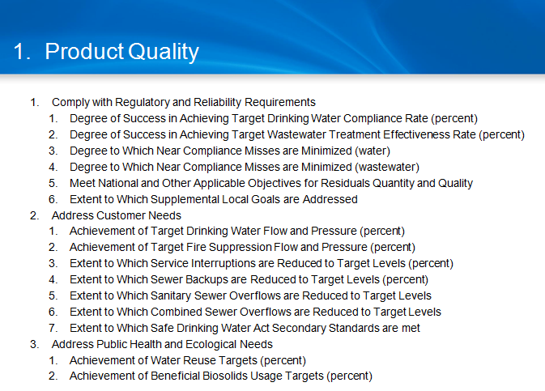
Example of attribute framework

Slide 10
The utilities that tested the process and tool were asked to:
Select 3 attributes to test
Create a customized self-assessment for the 3 attributes
  Practice Areas
  Performance Measures
Score current and target performance for all selected performance measures
Review the results and provide feedback to the research team

Slide 11
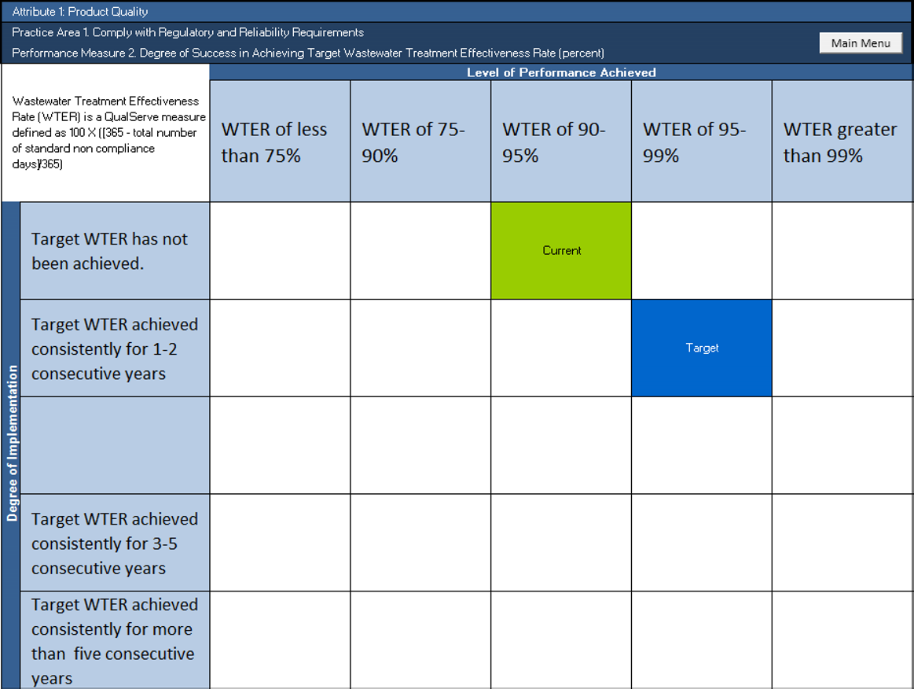
Current and target levels are scored for each included performance measure.
Product Quality: Degree of Success in meeting Wastewater Treatment Effectiveness Rate (WTER)
Current
Target

Slide 12
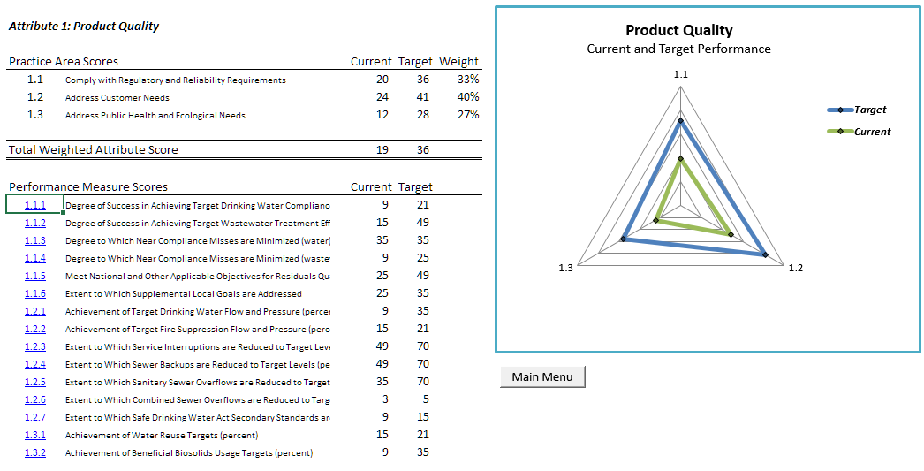
Outputs include comparisons at the attribute level…

Slide 13
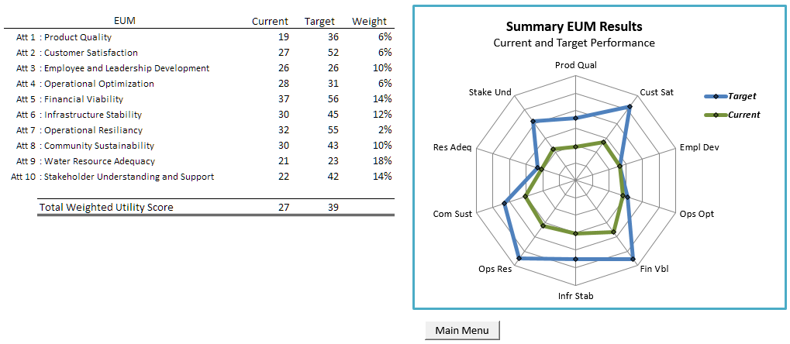
…and overall performance for selected attributes

Slide 14
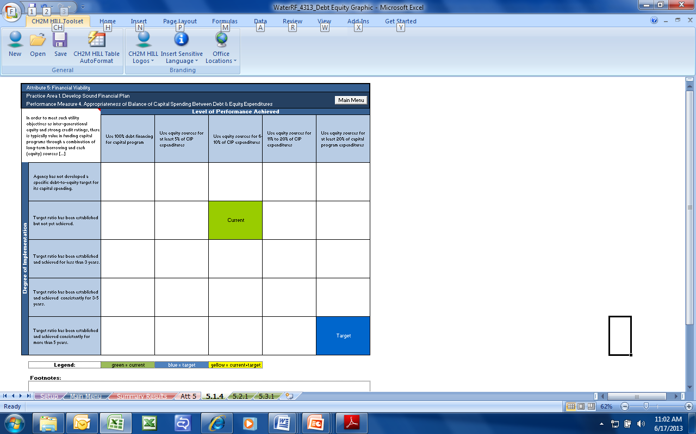
Utilities evaluate results and identify methods to narrow priority gaps.
Financial Viability: Balance in Capital Spending between Debt and Equity (Cash) Sources
Level of Performance
100% debt
At least 5% equity
At least 10% equity
10-20% equity
At least 20% equity
Degree of Implementation
No target established
Target established but not achieved
Current
Target achieved < 3 years
Target achieved 3-5 years
Target
Target achieved > 5 years

Slide 15

For this Financial Viability example, the utility’s team could consider a number of ways to narrow the gap:
Develop additional products and services to increase equity sources;
Defer some of the capital investments to reduce the borrowing needs
Expand the customer base
Increase user fees to existing customers to fund more of the capital program through equity sources;
Other creative ideas that the utility team identifies

Slide 16
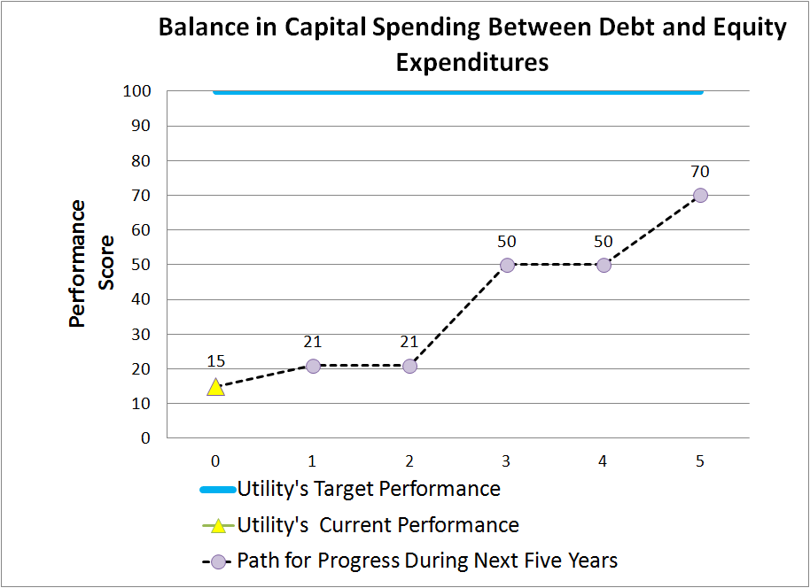
The choice of a specific strategy and timeline to get there should be developed in light of the utility’s unique circumstances

Slide 17
The dialogue among team members is an important outcome of EUM benchmarking for many utilities
Representative feedback from one participating utility:
“The managers agreed that the value of the exercise is in the conversations, and that the measures help structure conversations they might not otherwise have had…The discussion of community sustainability has led to us to learn more about the concept of sustainability and how it should be applied...”

Slide 18
Additional insights from participating utilities
“Picking attribute evaluation teams is vitally important. Strive for members with vested interest as well as different perspectives.”
“Your self-assessment team should be well rounded in experience and knowledge of the specific goals and functions of your utility.”
  “Executive Management must sponsor or champion any benchmarking team. Delegation of this responsibility down from Executive Management can make internal benchmarking seem like busy work.”
  “Utilities need to engage the right knowledgeable people who know about the particular attributes in order to obtain a thorough and comparable assessment.”

Slide 19
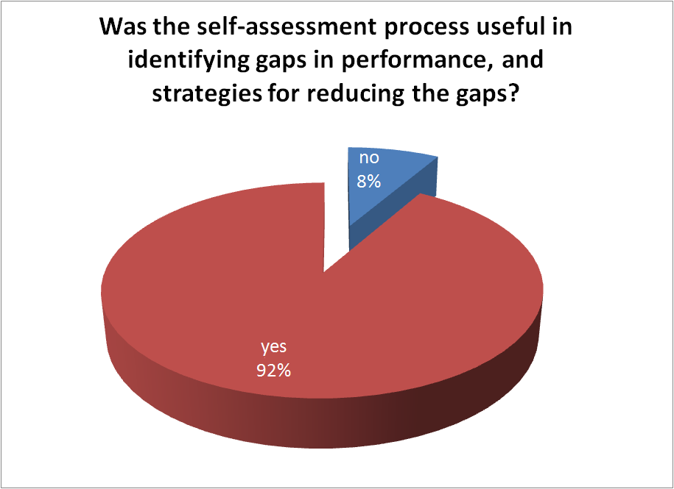
Findings about the benchmarking process

Slide 20
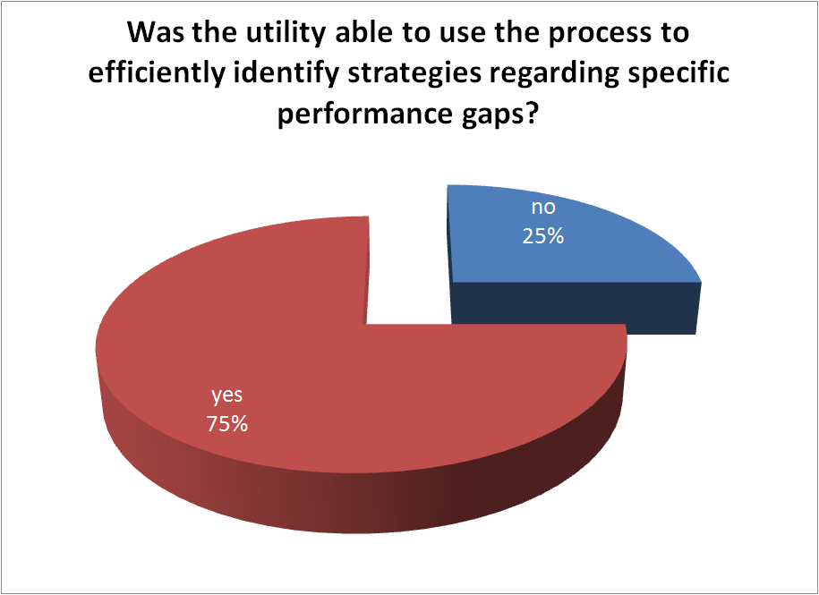
Findings on identifying strategies

Slide 21
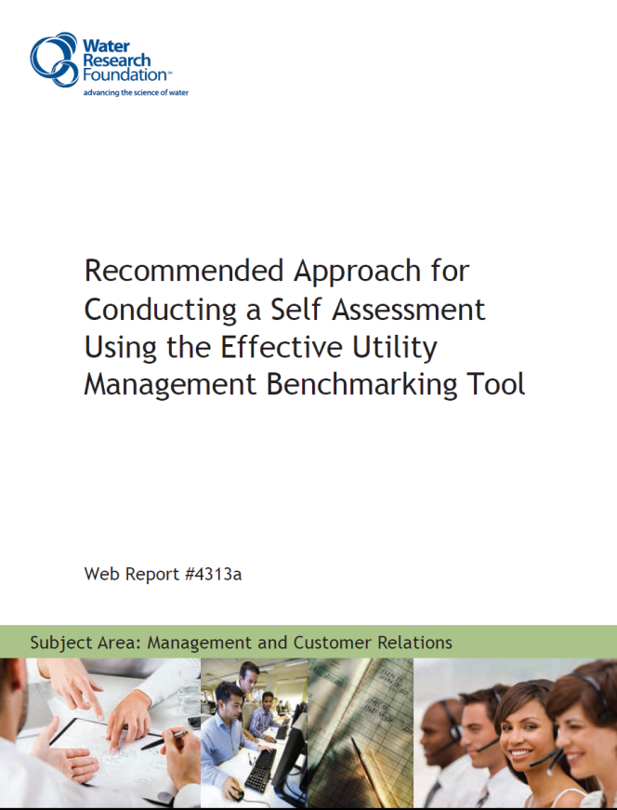

Primary products of Project 4313
Project Report, which includes:
  Literature Review and Summary of Utility Practices
  Feedback from Participating Utilities
Guidance on how to conduct a self-assessment
Benchmarking Tool and Guide
  http://www.waterrf.org/Pages/Projects.aspx?PID=4313

Slide 22
Closing thoughts
Since release of the EUM Primer in 2008, many utilities have found EUM to be an effective way to address the management challenges that they face in the current competitive climate
The Participating Utilities of Project 4313 have found the framework, tool, and benchmarking approach developed for the project to provide substantial added value in their ability to use the EUM concepts
WRF has made all products of this project available as freeware on its website to encourage widespread use by both water and wastewater utilities
Adapting and customizing the standard approach to your context provides the opportunity to derive the greatest value from this process

Slide 23
Thank You
Comments or questions, please contact:
Mike.Matichich@ch2m.com
For more information visit:
www.waterrf.org, search “4313”
www.watereum.org

