Slide 1
EUM Model Benchmarking
Toronto Water EUM Model Evaluation
April 23, 2015
Presenter: Madis Kreem
Business Management Analyst
Toronto Water, Business Operations Management

Slide 2
Content
Background Toronto & City performance mgmt
Toronto Water background
Toronto Water’s KPI performance program
EUM overlaps
EUM development & testing
EUM functionality, comments & advice

Slide 3

Background- Toronto
Toronto is a large metropolis surrounded in the Greater Toronto Area by several growing cities, regions, and its water supply source, Lake Ontario
City’s population (2013) is 2,771,770, with 1,110,672 households, covering over 634 sq kms (245 sq miles)
Toronto Water is one of the 45 City Divisions accountable to Council through the City Manager
The City is organized by 3 clusters of Divisions
Toronto is vibrant and growing, particularly upward! Leads North Am in high rise construction
In July is hosting the PanAm/Parapan Games

Slide 4
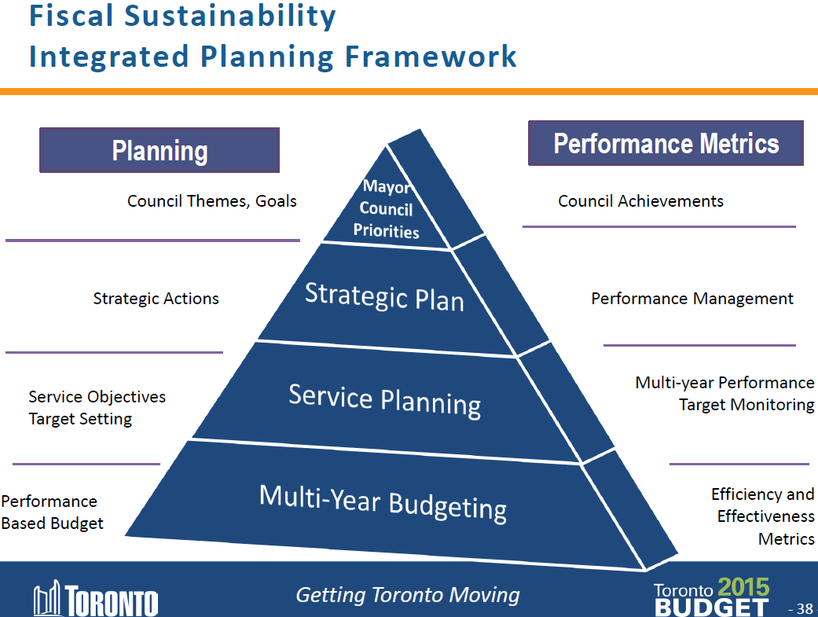
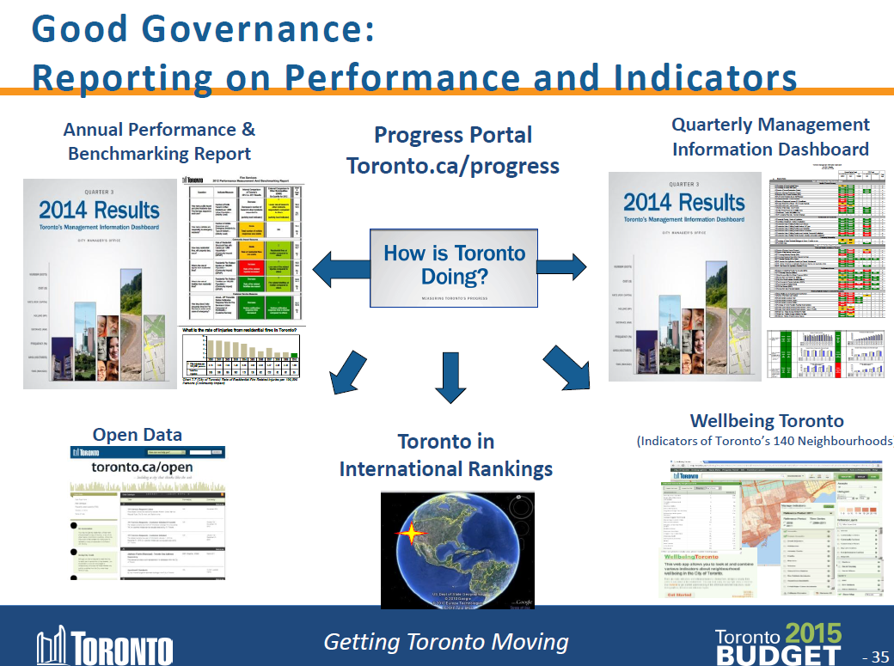
City Planning & Performance

Slide 5
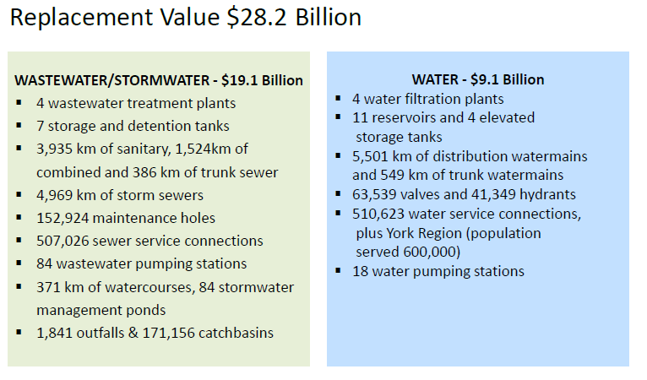
Toronto Water Assets
1755 staff working in 6 sections with an annual capital and operating budget of over $1 billion Cdn

Slide 6
Toronto Water KPI Development
Toronto Water developed it own Divisional Strategic Plan for 2010-2020
Plan led to a need for KPIs, developed by a consultant working together with senior mgmt
Approved high level KPIs were further developed with a staff KPI core team, who still meet monthly
Initial list of KPIs was expanded from 20 to 87
Several KPI development phases, & still continuing
Current challenges: program refresh & automation
Also effective root cause & corrective action

Slide 7

Toronto Water Strategic Plan 2010-2020
Mission Statement
To provide quality water services through supplying drinking water and the treatment of wastewater and storm water to residents, businesses and visitors in order to protect public health, safety and property in an environmentally and a fiscally responsible manner.
Guiding Principles
I. Continuous Service Delivery Improvement
II. Financial Vitality, Viability and Sustainability
^{III. Operational Excellence}
^{IV. Infrastructure Management}
^{V. Employer of Choice}
(Similar to EUM “Attributes”)
20 Strategies
64 Goals
87 KPIs

Slide 8
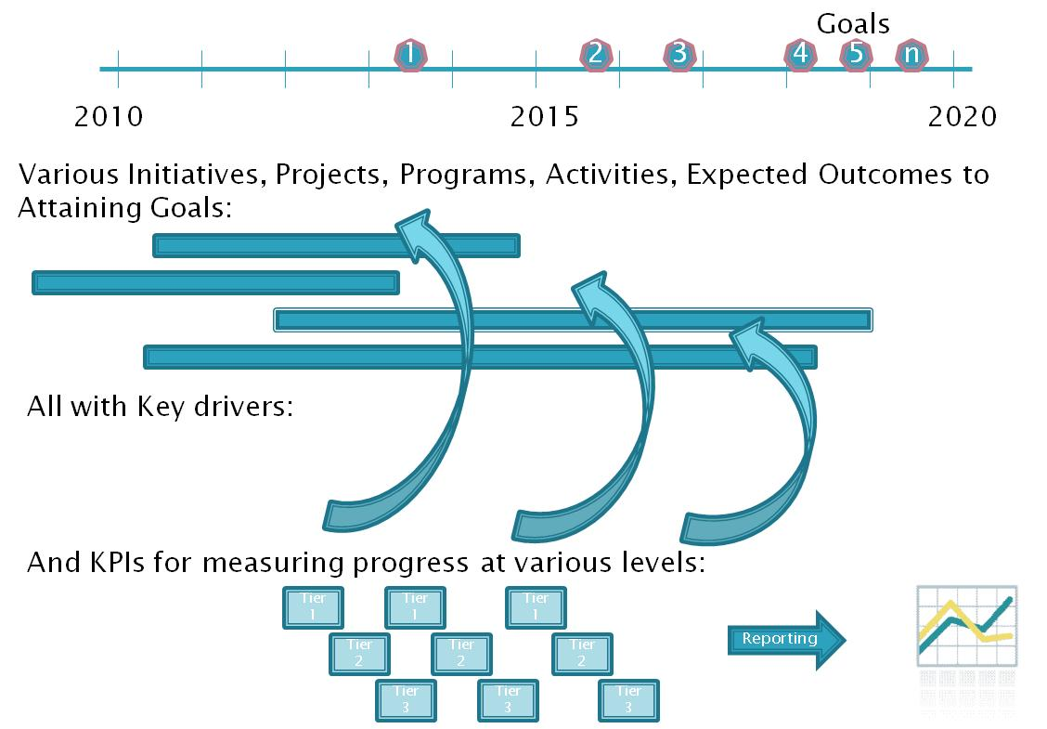
Measuring & Reaching Strategic Goals

Slide 9
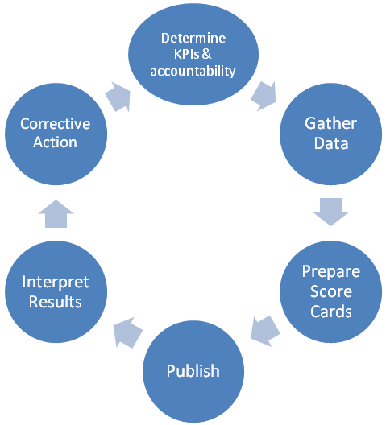
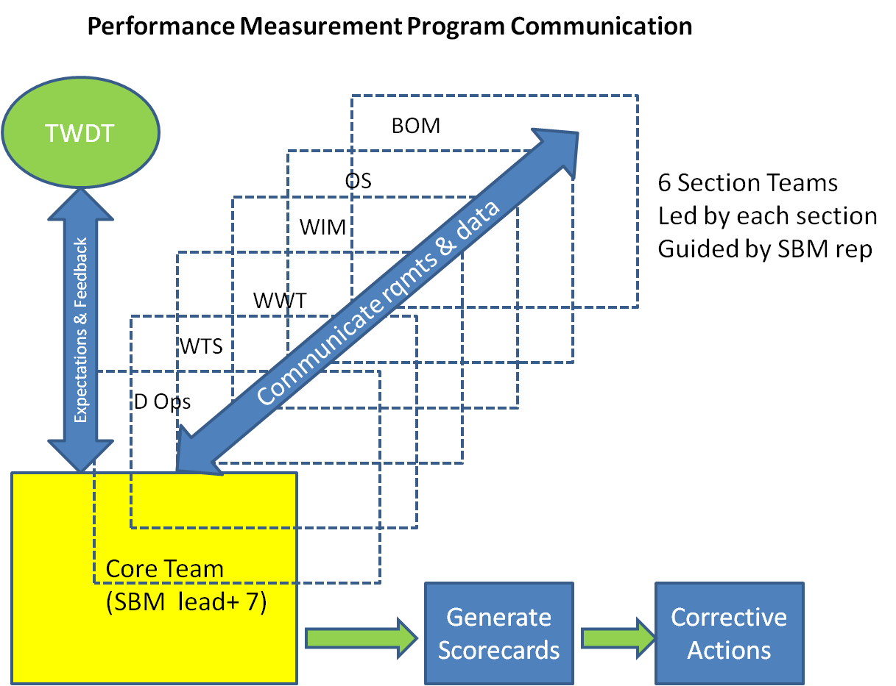
Let the Data Lead You!
Team KPI Goal was not to gather data, but to understand what we are doing, in order to do it better

Slide 10
EUM Link to KPI Reporting
Toronto
Water
Cluster B
Performance is measured by various groups for different drivers
FPARS
KPI Core
Team
EUM
OMBI
City

Slide 11
Various Model Similarities
Toronto Water | United States | Alberta | Australia | UK
Performance Areas | EUM Guidance | Edmonton (Epcor) | Urban Regions | OFWAT
Continuous Service Delivery Improvement | Product Quality | Water & Wastewater System Reliability Index | Water Resources | Customer experience
Financial Vitality, Viability and Sustainability | Community Sustainability | Water & Wastewater Quality Index | Asset Data | Reliability and Availability
Operational Excellence | Customer Satisfaction | Water & Wastewater Customer Service Index | The Customers | Environmental impact
Infrastructure Management | Employee & Leadership Development | Environment Index | Environment | Financial
Employer of Choice | Operational Optimization | Safety Index | Pricing and Finance
Capital Delivery Performance | Financial Viability | Financial Performance | Public Health
Operating Performance | Infrastructure Stability
Financial Health | Operational Resiliency
Customer Service | Water Resource Adequacy
Service Levels | Stakeholder Understanding & Support
Compliance
Product Quality
Resilience & Technology
People
Strategic Plan
Other Key Areas

Slide 12
EUM Model Testing
Toronto Water participated in EUM report & testing
EUM attributes tested:
  Customer Satisfaction
  Operational Optimization
Infrastructure Stability was not tested but was planned; recently we did a major Asset Mgmt similar audit
Used team approach of some subject experts to assess
Test results are subjective & perhaps were some errors with weighting of 3 attributes instead of 2
Spider graph result was a great visual for final results!

Slide 13
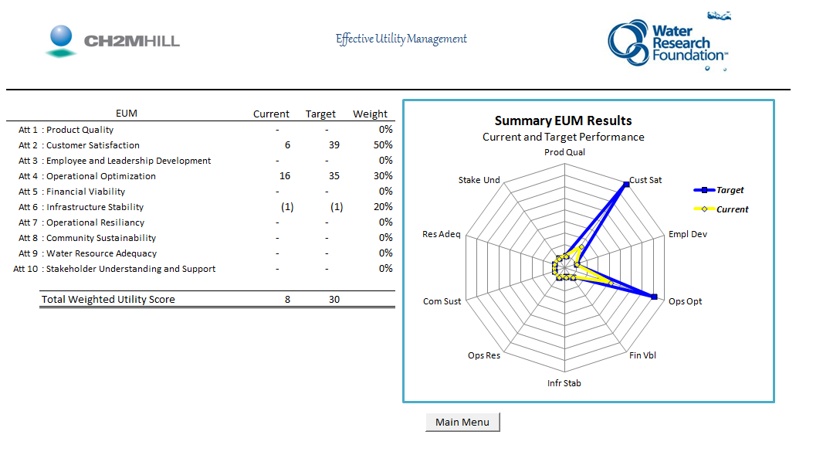
EUM Results – 2 Metrics

Slide 14
EUM Model Test- Some Comments
The “right people” need to be engaged to participate in providing subjective & valid EUM assessments
Facilitator, familiar with EUM tool and solving issues needs to be internally engaged to help get valid results
Senior management support & encouragement is helpful
Utilities vary in strategic development & measurement
The adaptability of the tool is a good feature
EUM tool needs engagement, motivation, training, & scheduling….then deciding what to do with EUM results
Tool helped with validating some performance areas

Slide 15
EUM Model Advice Going Forward
EUM tool provides a good performance assessment for utilities not already heavily engaged with strategy & KPIs
Helpful for utilities to clarify their strategic objectives, and not rely on the 10 EUM attributes & tool to do that
Model needs some experience to use effectively
Perhaps EUM attribute inputs could be independent of the EUM results, with on-line surveys & then merged results
EUM model can add value and be a periodic new “lens” for those utilities strategically developed in KPI programs,
Wider usage by more utilities would help

Slide 16
Thank You
Comments or questions, please contact Madis Kreem at
mkreem@toronto.ca
416-338-4789
For more information visit:
www.waterrf.org

