Slide 1
Effective Utility Management
Louisville MSD Stakeholder Engagement Plan
April 23, 2015

Slide 2

Louisville MSD Stakeholder Engagement Plan
IWA Conference – Cincinnati, Ohio
Greg C. Heitzman, P.E.
Executive Director
Louisville Metropolitan Sewer District
Louisville, Kentucky

Slide 3
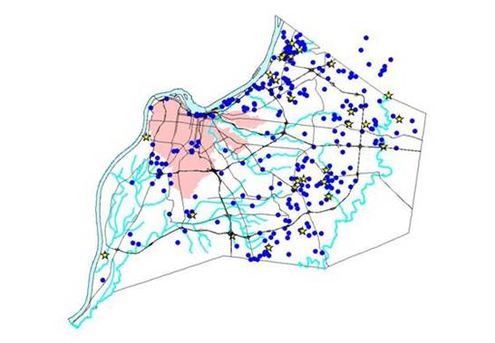

Louisville MSD Stats
Wastewater, Drainage and Flood Protection
Population/Customers: 700,000/230,000
400 square mile service area
5 regional wastewater plants
190 MGD treatment dry weather capacity
300 pump stations
3,200 miles sewer, 790 miles of streams
29 mile flood protection system
FY2015 Revenue: $260 million
Budgets/Employees: OpX $116M; CapX $118M; 655 employees
$850 million Consent Decree for CSO/SSO, complete by 2024
Average Monthly Wastewater Bill: $37.00 for 5,000 gallons

Slide 4
Strategic Business Planning
Louisville MSD embarked on a Strategic Business Plan process in 2012
Identified a new Vision and Mission
The Strategic Business Plan Includes:
  Core Values
  SWOT Analysis
  Key constituent groups (stakeholders)
  8 Strategies
  Goals and Objectives (Key Performance Metrics)

Slide 5

Louisville MSD Strategic Plan
MSD VISION:
Achieving Clean, Safe Waterways for a Healthy and Vibrant Community
MSD MISSION:
Providing Exceptional Wastewater, Drainage and Flood Protection Services for Our Community

Slide 6
MSD Values:
Employees, Customer Service, Public Education, Accountability, Environment, Community
MSD Constituents/Stakeholders:
Customers, Employees, Regulatory and Government Agencies, Elected Officials, Community, Suppliers, Developers

Slide 7
MSD Business Strategies
Build MSD’s Brand Promise
Provide Premium Customer Care and Service
Improve Information Technology
Invest in Infrastructure
5. Develop Disaster Response and Business Continuity Plan
6. Develop and Invest in Employees
7. Implement Partnerships
8. Ensure Financial Viability

Slide 8
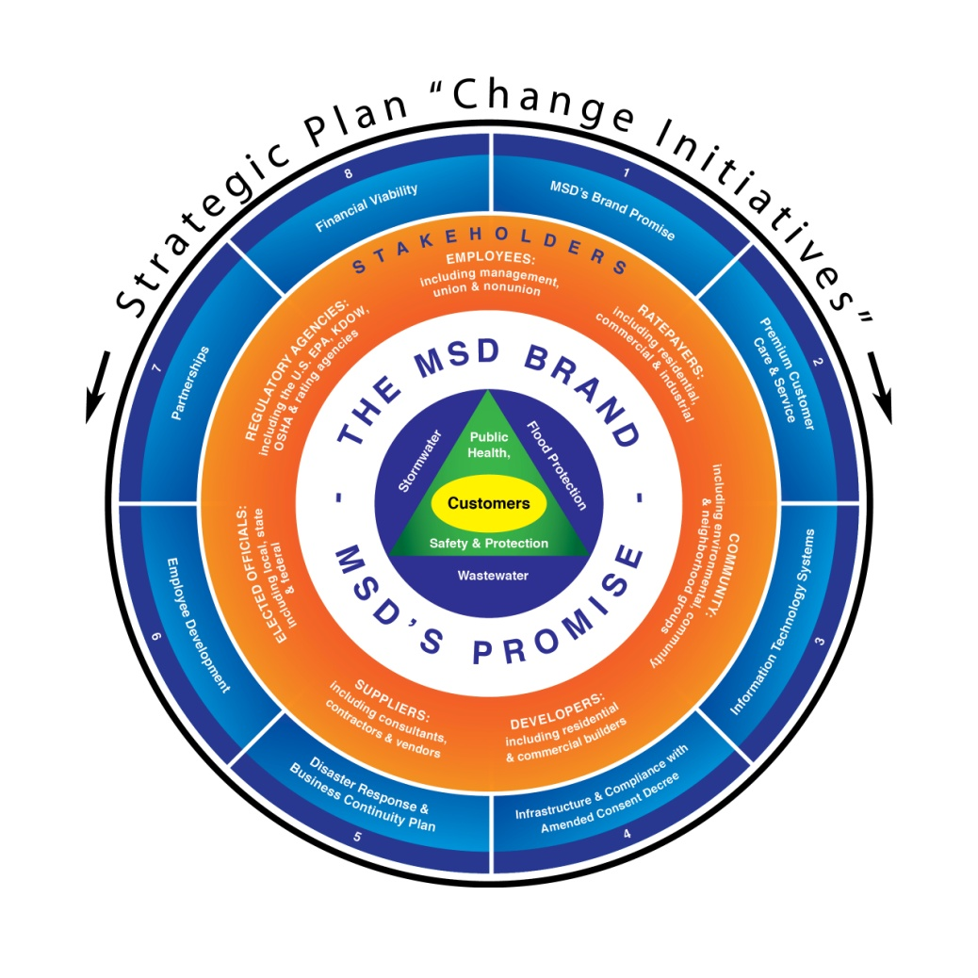
MSD
Strategy
Wheel

Slide 9
Why Effective Utilities Management?
Water/WW Industry Best Practice
Benchmarking with similar sized WW utilities
Part of Louisville’s “One Water” Initiative
Sharing Information and Process across business units
Promotes holistic thinking, breaks down ‘silos”
Establishes base model for performance (team and employee)
Promotes accountability
Provides Reporting Platform for Stakeholders

Slide 10
EUM Resourcing and Development Team
Team Sponsor: Executive Director
Team Members:
Public Relations
Customer Relations
Engineering
Finance
Operations – Metrics
Operations - Treatment
Human Resources
EUM Consulting Resource: CH2M Hill
Notes:
Acknowledge how this attribute differed from the others, in that it was more challenging to apply numerically based metrics.
To achieve this, we modified the benchmarking tool criteria.
The practice areas we selected were….

Slide 11
Louisville MSD adopted the Effective Utilities Management (EUM) Model for Metric and Benchmarking
10 Attributes of High Performing W/WW Utilities:
Product Quality
Customer Satisfaction
Employee/Leadership Development
Operational Optimization
Financial Viability
Infrastructure Reliability
Operational Resiliency
Community Sustainability
Water Resource Adequacy
Stakeholder Engagement

Slide 12
Attribute 10
Stakeholder Understanding and Support
Challenge:
How do we “quantify and measure” a “subjective” practice?
MSD modified the EUM benchmarking tool to quantify stakeholder engagement and make it measureable.
Notes:
Acknowledge how this attribute differed from the others, in that it was more challenging to apply numerically based metrics.
To achieve this, we modified the benchmarking tool criteria.
The practice areas we selected were….

Slide 13
Stakeholder Engagement Elements:
Stakeholder Identification
Degree of Implementation
Level of Performance
Performance Assessment (2 Dimensional)
Implementation

Slide 14
Attribute 10 –Step 1
Identify MSD’s Primary Stakeholder Groups
Louisville
MSD’s
Stakeholder
Groups
1. Mayor & Metro Agencies
2. MSD Board of Directors
3. Elected Officials
5. Customers
6. Employees
7. Developers
4. Regulatory Agencies
Notes:
The major stakeholder groups, some of which contain smaller, sub-groups.

Slide 15
Attribute 10 – Step 2
Establish Degree of Implementation Criteria
Level 1 - No stakeholder engagement plan in place, with only informal, ad-hoc or informal communication taking place.
Level 2 - Stakeholder engagement plan created, while informal, ad-hoc, or issue specific communication persist.
Level 3 - Stakeholder engagement plan in place and some structured engagement consistent with the plan is implemented.
Level 4 - Stakeholder engagement plan in place with reasonable capacity for structured engagement consistent with the plan being implemented.
Level 5 - Stakeholder engagement plan in place with strong capacity for structured engagement consistent with the plan being implemented.

Slide 16
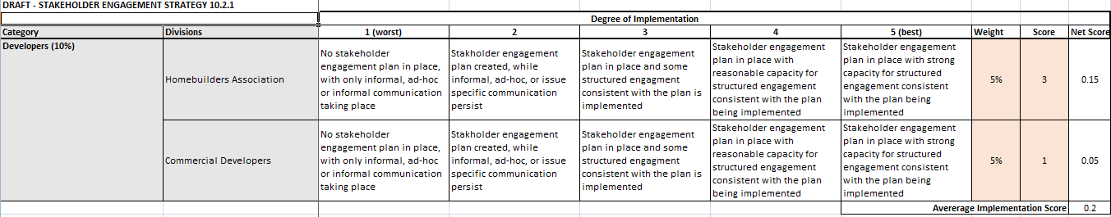
Attribute 10 – Step 2
Assess and Measure Degree of Implementation
Degree of Implementation: Score 1-5
Developers
Homebuilders
Commercial Builders
Notes:
For Developer groups, this demonstrates the scoring matrix for determining success for development of the engagement plan.

Slide 17
Attribute 10 – Step 3
Establish Level of Performance Criteria
Level 1 - MSD attends less than 50% of monthly meetings.
Level 2 - MSD attends 50% - 65% of monthly meetings.
Level 3 - MSD attends more than 65% but less than 80% of monthly meetings.
Level 4 - MSD attends 80% - 90% of monthly meetings.
Level 5 - MSD attends more than 90% of monthly meetings.

Slide 18
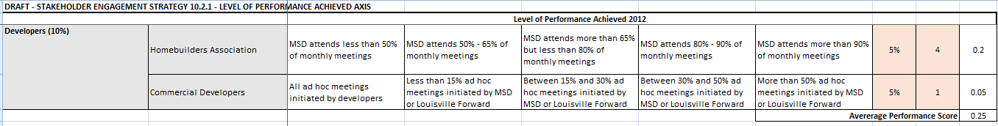
Attribute 10 – Step 3
Assess and Measure Level of Performance
Level of Performance: Score 1-5
Developers
Homebuilders
Commercial Builders
Notes:
This is an example of our scoring matrix for our success in implementing the engagement plan.

Slide 19
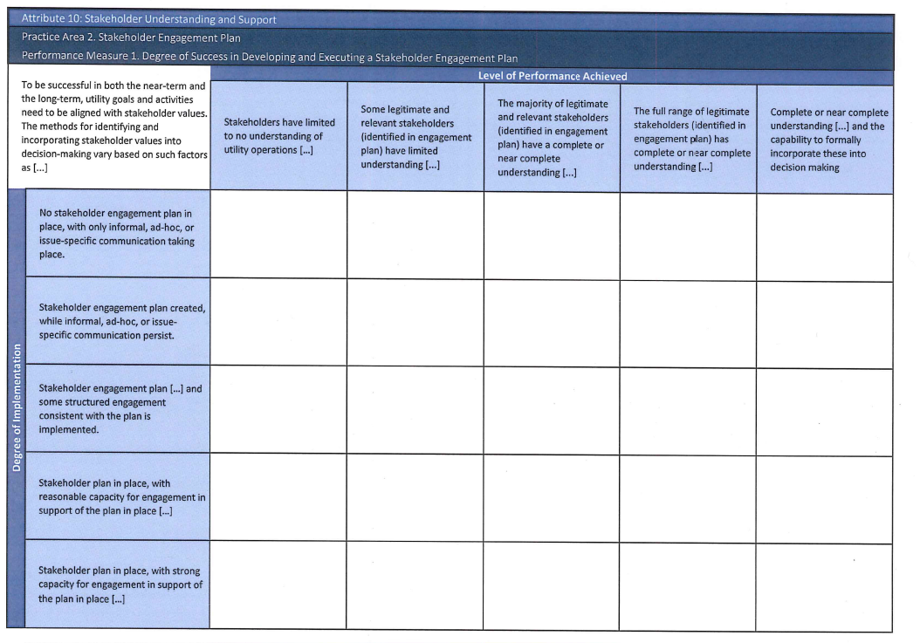

Attribute 10 – Step 4
Overall Performance Assessment
Level of Performance: Score 1-5
Degree of Implementation: Score 1-5
Rating
1x1=1
Rating
5x1=5
FY12
Baseline (2)
Continuous Improvement
FY15 (9)
FY16 (12)
FY18
Target (16)
Rating
1x5=5
Rating
5x5=25

Slide 20
Attribute 10 – Step 5
Implementation
Communicate with Stakeholders
Engage with Stakeholders (work the plan)
Track Progress (quarterly, semi-annually, annually)
Establish Goals/Targets 3-5 years
Revisit Performance and Goals & Targets Annually
Report and Communicate to Governing Body

Slide 21
Effective Utilities Management (EUM)
An effective tool for:
Determining strategic areas of focus
Determining priority areas to improve
Establishing a baseline of performance
Determining future performance objectives
Measuring Progress
Benchmarking with other W/WW utilities
Building collaboration across business units of utility
Reporting progress to governing body (Mayor, Board, Stakeholders)

Slide 22

Thank You !
Comments or questions, please contact:
Greg.Heitzman@louisvillemsd.org
For more information visit:
www.waterrf.org
Special Thanks to the Water Research Foundation and CH2M Hill for assistance with development of the EUM model at Louisville MSD

