Slide 1
Utilizing a Phased Approach to Implement EUM
Louisville Water Company (LWC)
Amber Halloran – Vice President, Treasurer
Matthew Griffith – Business Development Analyst

Slide 2
About LWC
Ownership/Governance
Water Source
Customers/Geographic Served
Treatment Capacity

Slide 3
Challenges
Increases in the cost of electricity, chemicals, and fuel used to pump, treat, and supply water
Rising salaries, pension, and health care costs for workers
Increased security safeguards for the water system since the 9/11 terror attacks
Loss of operational & institutional knowledge: 25-30% employee turn-over in 3-5 years due to retirement.
Political pressure to minimize rate increases

Slide 4
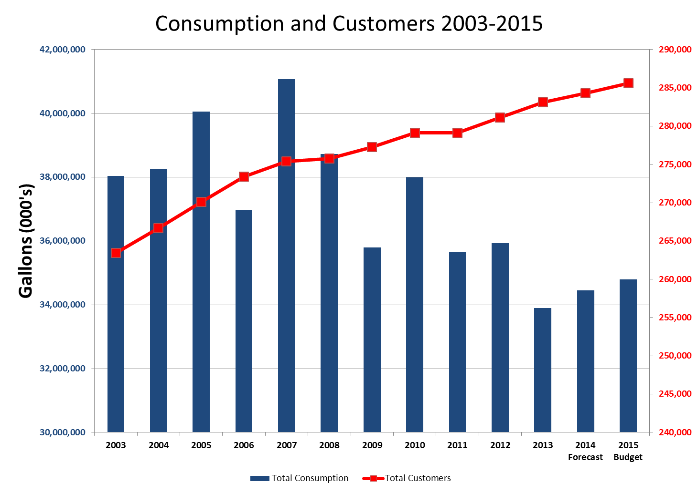

Slide 5
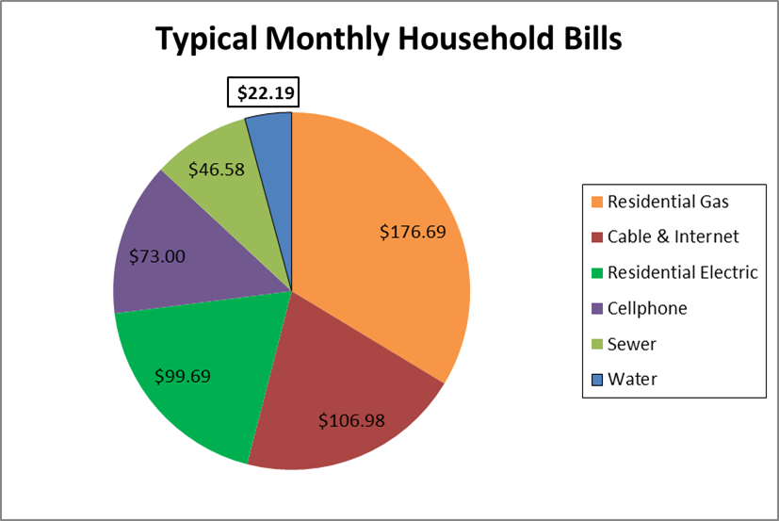
Low Rates Aren’t Enough

Slide 6
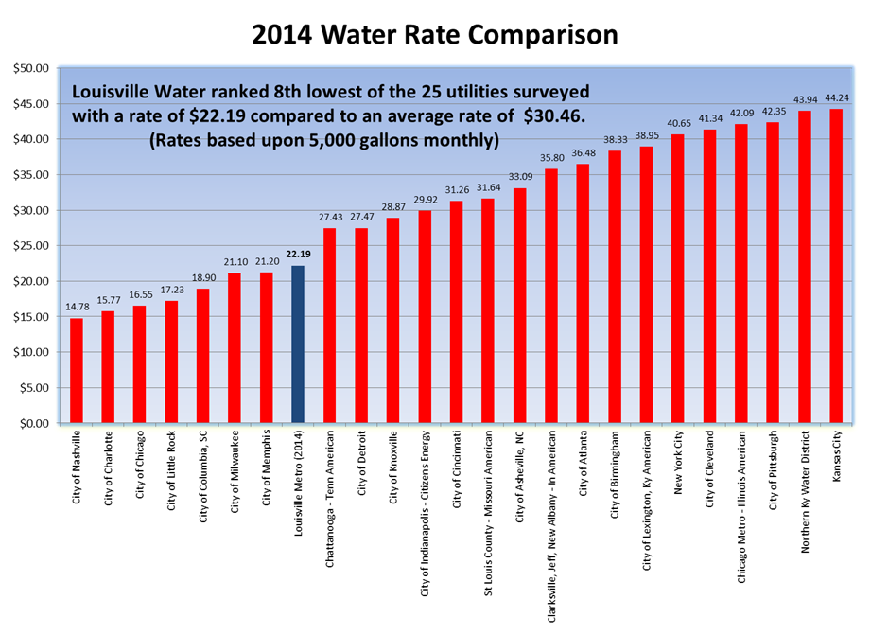

Slide 7
LWC Early Participation EUM
Louisville Water was a participant in EUM with early involvement in attribute development
Participation in tool development
Provided feedback on attributes and tool
Prepared summary of attributes for 2013.

Slide 8
One Water Initiative
Mayor Advisory Group Task Force created
Examine operations of LWC, MSD, Public Works
Evaluate synergies, partnerships, shared resources, and opportunities to reduce costs
Findings
Significant operational efficiencies and savings can be achieved
Recommendations
Establish quarterly reporting for benchmarks and key milestones to measure progress

Slide 9
Why EUM?
Gap analysis helps identify opportunities for organizational efficiencies
Accountability and Transparency
Meet stakeholder expectations

Slide 10
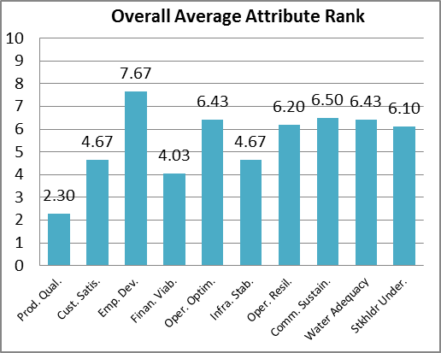
Ranking the Attributes
Surveyed Executives and Management; ranked attributes based on current level of achievement and importance

Slide 11
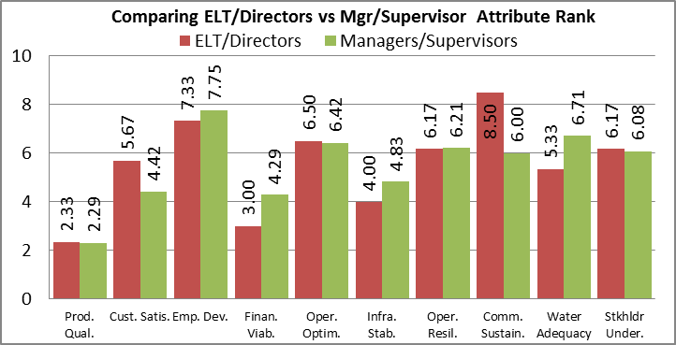
Survey Results
Survey showed that there was general consensus for most attributes

Slide 12
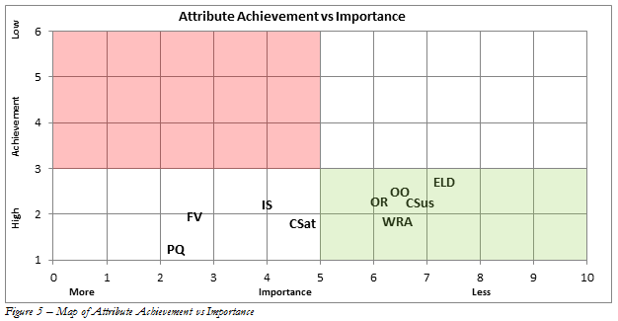
Phased Approach
Decision made to focus on most important and highest achieving attributes first

Slide 13
Phase I
1. Product Quality
2. Customer Satisfaction
5. Financial Viability
10. Stakeholder Understanding & Support

Slide 14
Phase II
3. Employee Leadership & Development
4. Operational Optimization
6. Infrastructure Stability
7. Operational Resiliency
8. Community Sustainability

Slide 15
Process
Reach consensus around the definition and value of each performance measure used. Re-define if necessary. Document data sources used and person(s) responsible for data.
Define the “Level of Performance” and “Degree of Implementation” scale.
Gather data through 2014 with a base year of 2012.
Set 2015 & 2016 targets for each performance measure.

Slide 16
One Water Opportunities
Develop tool in parallel with MSD
Conduct cross-organizational meetings
Share strategies and lessons learned
Learn more about each other, discover opportunities
Benchmark overlapping functional areas
And most importantly, Build Relationships!

Slide 17
One Water

Slide 18
Sustainability and Impact
Tool complements current Strategic Plan
Consolidation of performance measurement efforts
Cross-functional implications
One-Water benefits

Slide 19
Conclusions and Next Steps
Identify Proper Targets.
The survey does not consider the attribute interdependence.
LWC chose attributes it was most confident in—may have actually caused study to be less revealing than it could have been
Would suggest to start with weaknesses first. This may reveal more opportunities for improvement.

