Slide 2
Sustainable Water Management Conference
Denver, Colorado
March 31, 2014
Presentation by Jack C. Kiefer, PhD and Lisa R. Krentz

Slide 3

Methodology for Determining Baseline Commercial, Institutional, and Industrial End Uses of Water
WRF Project #4375
Jack C. Kiefer, PhD
Lisa R. Krentz

Slide 4
Overview
Project goals and objectives
Background and examples about the research problem
Elements of emerging methodology

Slide 5
WRF 4375: Goals
Methodology for Determining Baseline Commercial, Institutional, and Industrial (CII) End Uses of Water
Provide water utilities with better and consistent means of understanding the amount of water used by their CII customers by category and by end use or purpose
This is methodological development—not direct measurement or estimation of usage rates or end-use metrics or benchmarks!

Slide 6
WRF 4375: Objectives
Establish data requirements and recommended practices for:
Identifying practical or useful classifications of CII users
Evaluating the range of end uses that are present
Calculating alternative metrics of water usage rates

Slide 7
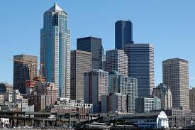
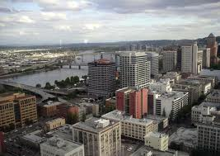
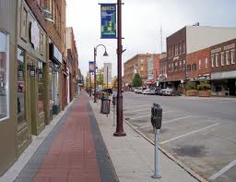
Why are methodological improvements needed?
CII consumption typically 30-50% of utility demands
Improve effectiveness of water use forecasts
Easier targeting for water efficiency programs
Better usage rate metrics for benchmarking
Information for designing rate structures

Slide 8
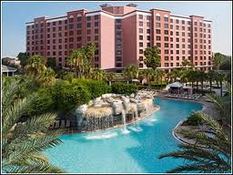
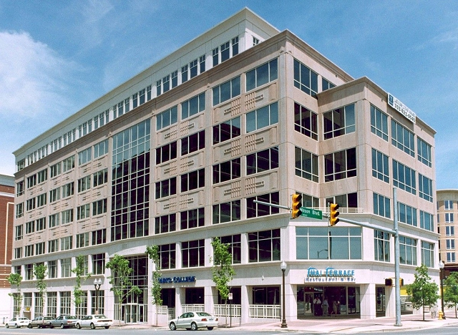
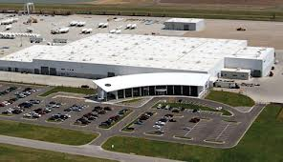
Basics of the “CII Problem”
Heterogeneous sector
Lack of consistent classification
Significant variability in water use between and within classes of customers
Water use is a “derived demand” that is bundled into production of goods and services
“Explanatory” data generally lacking

Slide 9
Common and Less Common Classifications
Customary CII groupings
  Single sector—Nonresidential “catch-all”
  Commercial and Industrial—sometimes Institutional/Govt/Public
  Classification criteria not always clear
Tied to wastewater charges
  Phoenix AZ example — previous system of 34 classes (19 CII)
Linked to external classifications
  Land use/Building type
    City of Austin example — 49 premise codes (majority nonresidential)
    Florida Department of Revenue — 57 CII categories
  NAICS or “NAICS-like”

Slide 10
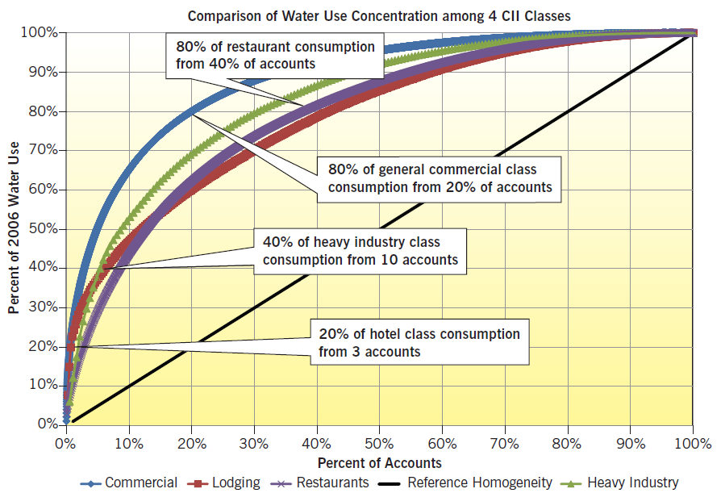
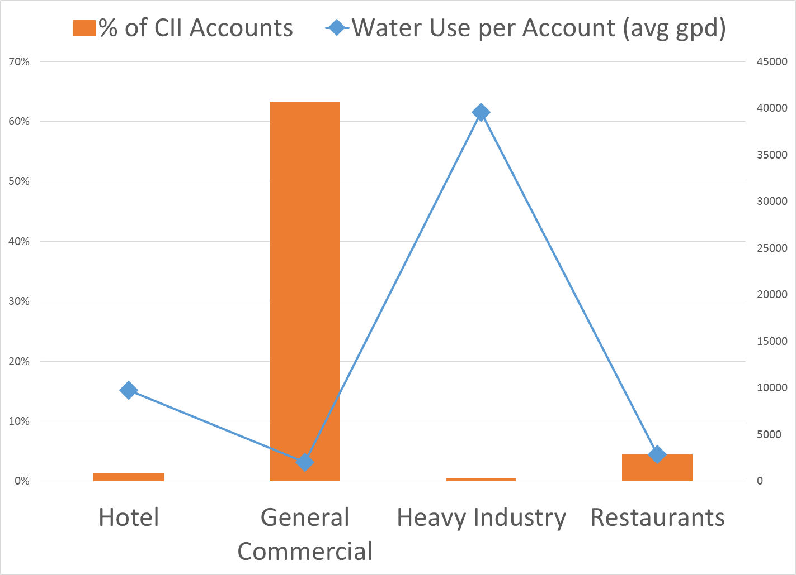
Heterogeneity and Variability

Slide 11
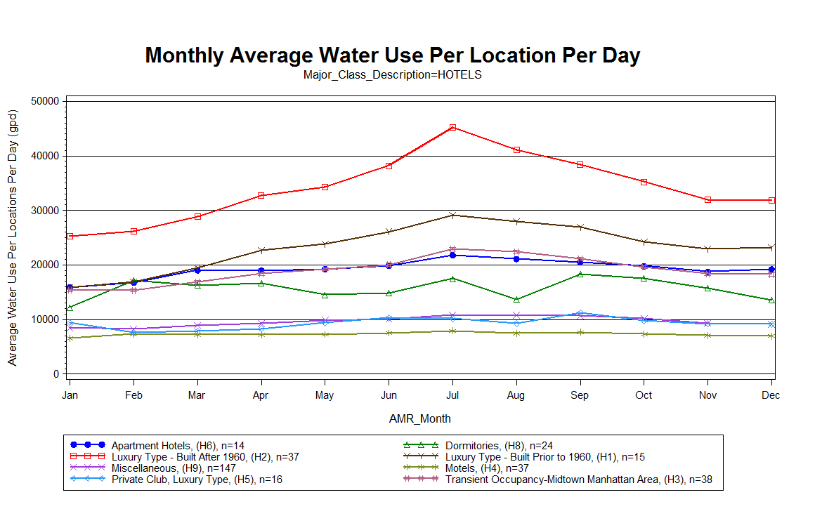
Within-Class Variability (Lodging example)
Luxury Hotels
Motels

Slide 12
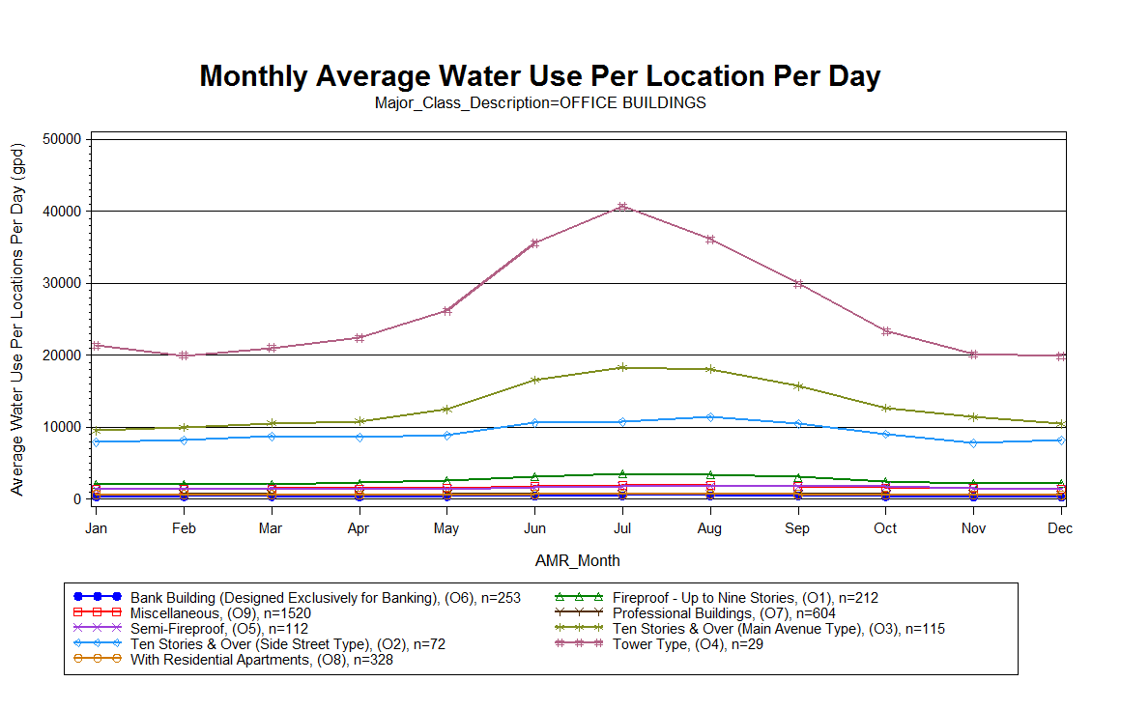
Within-Class Variability (Office Building example)
Tower Type

Slide 13
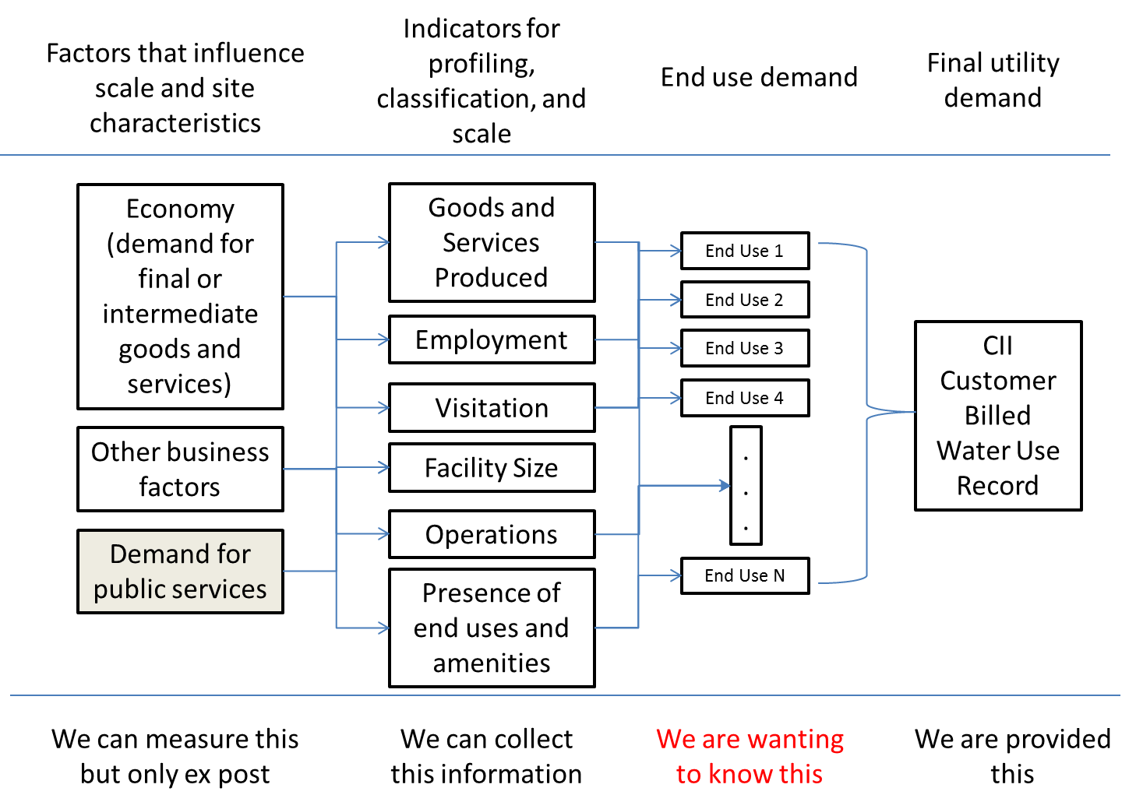
Basics of the “CII Problem”

Slide 14
Basics of the “CII Problem”

Slide 15
Basics of the “CII Problem”

Slide 16
Basics of the “CII Problem”

Slide 17
Example Drivers of End Use Consumption and Related Proxies
End Use Category | Demand Drivers | Proxies of Scale or Capacity
Cooling (water based) | Preferences/Policies | Tonnage | Cubic Footage | Square Footage
Irrigation | Irrigated Landscape Area | Irrigable Area | ET | Air Temperature
Sanitary | People (Visitors + Employment) | Number of Fixtures | Square Footage | Number of Employees
Process water | Production Level | Number of Employees | Square Footage
Other/Misc
Pools | Preferences/Policies | Area | ET | Air Temperature
Food service | Volume of service (meals served) | Area | Number of Employees | Seating capacity
Single water use record not broken into end uses
Multiple drivers or proxies of scale

Slide 18
Differentiating Scale from Rate
(or Intensity) of Use
Rate of use
Driver
For example:
Water use in a school = avg. water use per student x students
Water use in hotel = avg. water use per occupied room x occupied rooms
Water use for irrigation = avg. water use per irrigated sq. ft. x irrigated area

Slide 19
Scale, Intensity, and Sementti
Differentiating Scale from Rate
(or Intensity) of Use
Q
Scatterplot of water use and some measure of scale for a set of customers in a given CII class
N
Rooms

Slide 20
Scale, Intensity, and Segmentation
Differentiating Scale from Rate
(or Intensity) of Use
Q
Q = a + qN
General effects of scale
(e.g., water use increases with employment, production, size of facility)
N

Slide 21
Scale, Intensity, and Segmentation
Differentiating Scale from Rate
(or Intensity) of Use
Q
q(no irrigation, no cooling)
N

Slide 22
Scale, Intensity, and Segmentation
Differentiating Scale from Rate
(or Intensity) of Use
Q
q(irrigation, no cooling)
q(no irrigation, no cooling)
N

Slide 23
Scale, Intensity, and Segmentation
Differentiating Scale from Rate
(or Intensity) of Use
Q
q(irrigation, cooling)
q(irrigation, no cooling)
q(no irrigation, no cooling)
N

Slide 24
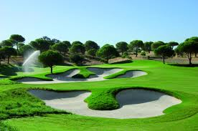
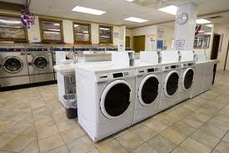
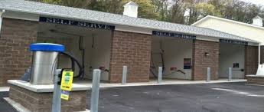
Basics of Emerging CII Methodology
Classify customers along some common definitions and criteria
  Vast majority of CII water use and accounts reside in 20-25 categories
  End use dominant classes relatively easy to define

Slide 25
Example CII Classification Scheme
Lodging
Office Building
School or College
Health Care Facility
Eating or Drinking Place
Retail Store
Warehouse
Auto/Auto Service
Religious Building
Retirement or Nursing Home
Manufacturing
Other Commercial
Other Institutional
Other Industrial
Landscape only
Laundromat
Commercial or Industrial Laundry
Car Wash
Park or Recreational Area
Golf Course
Power Plant/Utility
Server Facility/Data Center

Slide 26
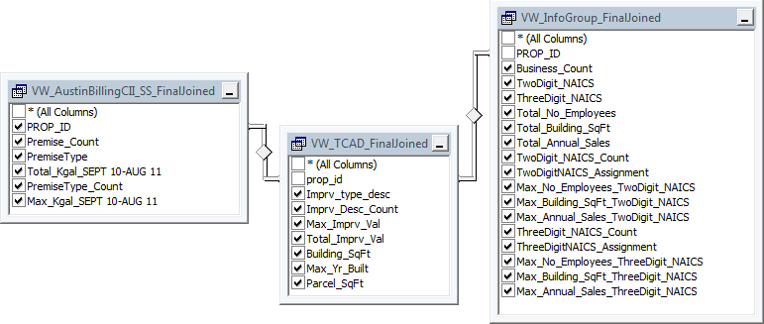
Basics of Emerging CII Methodology
Unless classification capabilities already exist, linkage to external data is helpful for
  Defining NAICS-like categories
  Defining customer as a “water-using location”
  Assigning customers into classes

Slide 27
Basics of Emerging CII Methodology
What do tax appraiser or parcel-level data provide?
  A useful measure of scale: square-footage
  Potential indicator for passive efficiency: year built and year improved
  Lot size, footprint, stories, other
  Common spatial identifier to link to other data sources

Slide 28
Basics of Emerging CII Methodology
Primary data collection needed for further market segmentation of CII customers (surveys or audits)
Data collection instrument developed to
  Establish fundamental “global” differentiators
    Irrigation?
    Cooling?
    Alternative supply source(s)?
  Dig deeper into operations
    Business/property sub-classification
    Presence of other end uses
    Employment, visitation, production
    Hours of operation, etc.

Slide 29
Info Management Methodology

Slide 31
All/enhanced amenities, high occupancy
Irrigation, pools, similar amenities
No irrigation, no cooling, no pools

Slide 32
Cautions
Significant information management work required
  Account geocoding
  Multiple meters serving a “location”
  Matching of accounts/meters to parcels
    1 to 1 (good!)
    1 to many/many to 1
    Many to many

Slide 33
Cautions
Significant information management work required (continued)
  Matching of business data
    Can cost $$
    Can have a mismatch between location and corporate data
  Mixed use/multiple business locations
Primary data collection involves sampling and logistics

Slide 34
Next Steps
Finish “beta-testing” of data collection instrument
Refine and recommend final methodology
Develop some illustrative examples
Project report

Slide 35
Thanks!
Utilities
  City of Austin
  East Bay Municipal Utility District
  New York City Department of Environmental Protection
  City of Boulder
  City of Fort Collins
  Colorado Springs Utilities
  Tampa Bay Water
  City of Phoenix
Other Team Members
  Ben Dziegielewski
  University of Florida
  William (Bill) Hoffmann
Maureen Hodgins, Water Research Foundation
Jack C. Kiefer, PhD
jkiefer@hazenandsawyer.com
618.889.0498

