Slide 1
www.Competitive Edge Performance.net
Performance Management &
Benchmarking
2015 IWA Conference
Cincinnati
Rick Bickerstaff

Slide 2
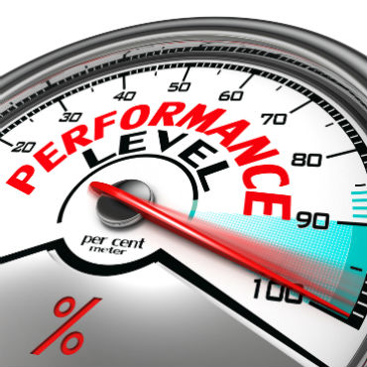
Measurement
“
What gets measured gets managed, and what gets managed gets done.
”

Slide 3
Agenda
Introduction
Strategy
Framework
Results
Comparisons
Analysis
Decisions
S.Y.S.T.E.M.
2

Slide 4
Charleston
Water System

Slide 5
Why
we measure
Where have we been?
Results
Trends
Where are we?
Comparisons
Benchmarks
Best Practices
Where do we want to go?
Performance Projections
Customer Requirements
Targets

Slide 6
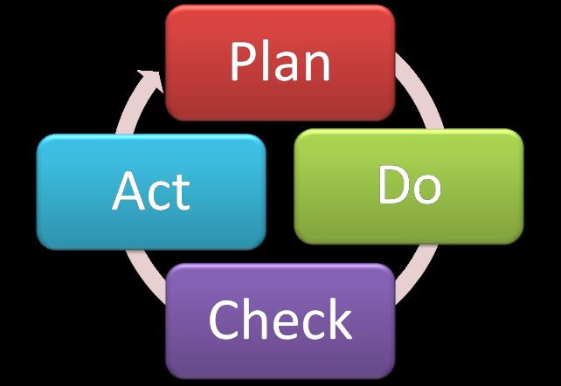
Why
we measure
Measurement results should:
Tell you what to improve
Help you prioritize what to focus on
Become a major input into your organization’s goals and/or strategic plan
Promote accountability
Facilitate continuous improvement
Satisfy stakeholder expectations

Slide 7
What
we measure
Measure:
What is most important to your customers, stakeholders, and you.
What is critical to quality (CTQ)
Inputs, Process, Outputs (SIPOC)
Measure:
Process efficiency
Process effectiveness
Process adaptability

Slide 8
Leadership
must drive it
The MUSTS:
Expectations must come from senior leadership
Leadership must constantly direct focus towards performance measurement
Leadership must constantly ask for results
Leadership must think critically

Slide 9
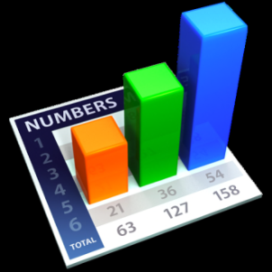
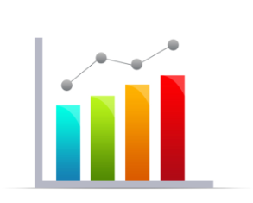
Systematic
processes
Strategy
Results
Comparisons
Decisions
Analysis
Framework

Slide 10
Strategy
Strategy
Framework
Results
Comparisons
Decisions
Analysis

Slide 11
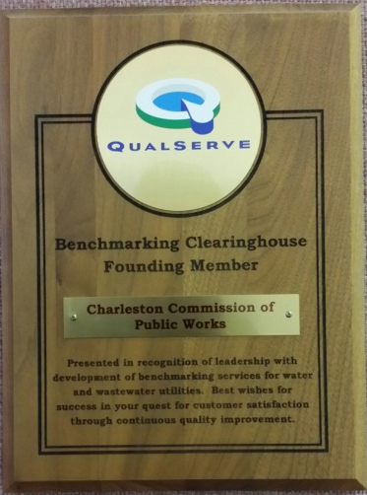
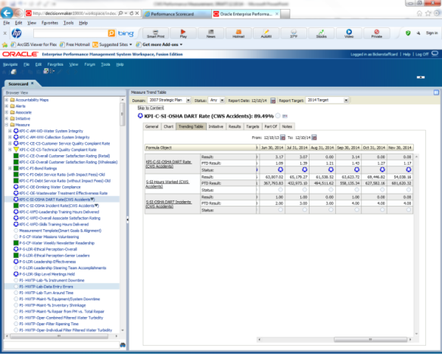
Strategy Drives
Measurement
2000
2002
2007
Timeline

Slide 12
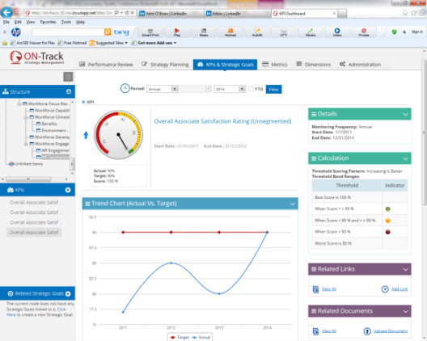
ON-Track
By
ITWORX
National
Malcolm Baldrige Quality Award
Baldrige Criteria for Performance Excellence
(50% is based on measurement)
2011
2014
Timeline
S.C. Governor’s Quality Award
2013
2017

Slide 13
Charleston Water System’s
Strategy
Strategic Area #3 - Measurement
Reliable & sustainable measurement, benchmarking and data analysis system
Reliable & comparable benchmarking sources
Guidance for target setting
Systematic review & reporting process
To drive data based decision making.
Strategic Area
Strategic Goal
Tactical Actions

Slide 14
Develop the
Framework
Strategy
Results
Comparisons
Decisions
Analysis
Framework
PIs / KPIs
Definitions
Leading
Lagging

Slide 15
CWS Measurement Hierarchy
Financial & Market Results
Product & Process Results
Leadership Results
Customer Focused Results
Workforce Focused Results
Charleston Water System
Measurement Hierarchy
=
Baldrige Criteria for Performance Excellence

Slide 16
Charleston Water System
Measurement Hierarchy
CWS Strategy
Measurement Team
Operations Focus Team
Leadership Results
Customer Focus Team
Workforce Focus Team
Leadership Team
Financial & Market Results
Customer Focused Results
Workforce Focused Results
Product & Process Results
Strategic Teams
KPIs
Weight
18%
18%
19%
19%
26%

Slide 17
Charleston Water System
Measurement Hierarchy
CWS Measurement Hierarchy
Financial & Market Results
Product & Process Results
Leadership Results
Customer Focused Results
Workforce Focused Results
Workforce Climate
Workforce Development
Workforce Capacity
Debt Ratio
Growth Rate
Return on Assets
KPI Level
30%
Roll Up
PI Level
40%
30%

Slide 18
Leading & Lagging
Indicators
CWS Measurement Hierarchy
OSHA Accident Rate
Workforce Engagement
Workforce Capacity
Training Hours/Employee
Leadership Academy Graduates
Things you can influence
Lagging
Leading
Things you can control

Slide 19
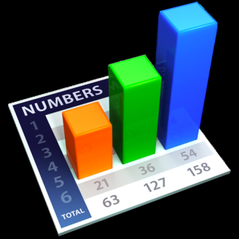
Capture the
Results
Strategy
Results
Comparisons
Decisions
Analysis
Framework
Collection Plan
Repository
Monitoring Plan

Slide 20
Capture the
Results
Customer Requirements
Results

Slide 21
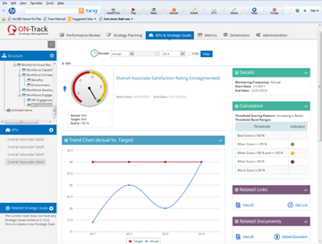
Repository
(Home)
www.ITWorx.com

Slide 22
Compare
your results
Strategy
Decisions
Framework
Requirements
Analysis
Results
Benchmarking
Comparisons

Slide 23
Capture the
Results
Benchmarking
Customer Requirements

Slide 24
Effective Utility Management
Charleston Water System’s Contributions
http://watereum.org/resources/resource-toolbox/

Slide 25
Compare
your results
CWS participated in the development of the EUM Benchmarking Tool

Slide 26
Compare
your results
Gap analyses were conducted using the tool on parts of the EUM.
Plans exist to:
Complete gap analyses
Use gap analyses to identify tactical benchmarking actions (2015-2016)

Slide 27
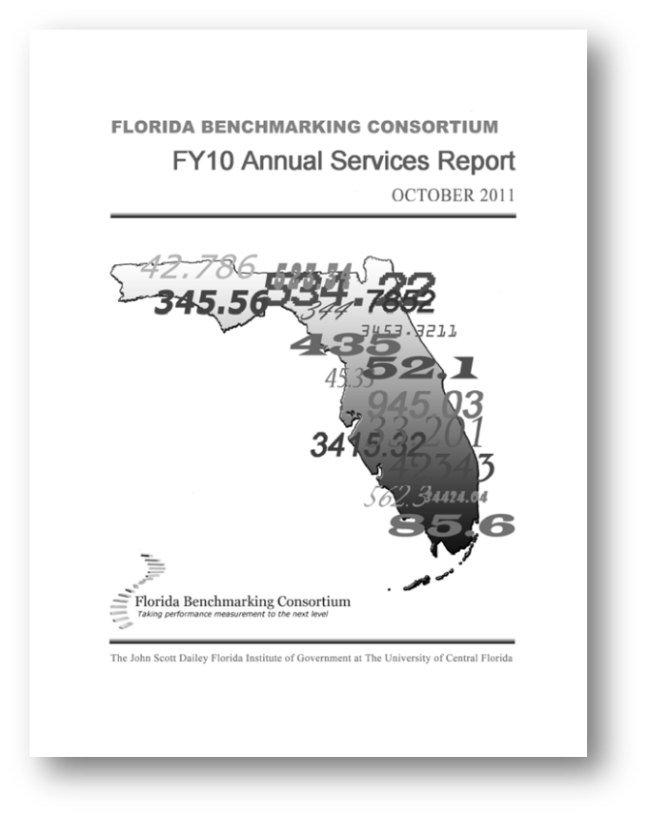
Benchmarking
Sources
Local (State)
Regional
Florida Benchmarking Consortium
North Carolina Local Government Performance Measurement Project

Slide 28
Benchmarking
Sources
National
AWWA Benchmarking Program (QualServe, 2002)
Baldrige Award Winners

Slide 29
Benchmarking
Sources
International
European Benchmarking Consortium
International Benchmarking Network for Water &Sanitation Utilities (IBNET)
National Water & Wastewater Benchmarking Initiative (Canada)
Pacific Water & Wastes Association
National Performance Report (Australia)

Slide 30
Analyze
data
Strategy
Results
Comparisons
Decisions
Analysis
Framework
Validate
Correlate
Root-cause

Slide 31
Analyze
data
Validation
Statistical analysis
Charts:
Histogram
Pareto charts
Pie charts
Run charts
Control charts
Box plots
Correlation analysis (scatter diagrams)
Root-cause analysis (RCA)
Sigma performance

Slide 32
Decision
making
Strategy
Projections
Decisions
Framework
Targets
Goals
Analysis
Results
Strategies
Comparisons

Slide 33
Decision
making
Data should tell us:
What to work on
When to work on it
Why to work on it (validated)
How to work on it

Slide 34
Decision
making
Strategy
Adjust
Decisions
Framework
Improve
Innovate
Analysis
Results
Comparisons

Slide 35
Systematic
Processes
Managing the Process
2
S Y S T E M

Slide 36
Systematic
Processes
Schedule
Yardstick
Standard
Team
Maintain
Execute/
Evaluate
2
S Y S T E M

Slide 37
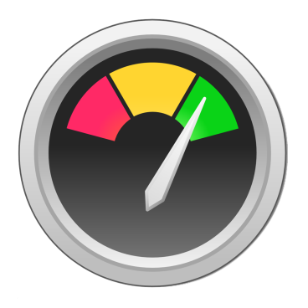
Systematic
Processes
Schedule
Yardstick
Standard
Team
Maintain
Execute/
Evaluate
2
S Y S T E M

Slide 38
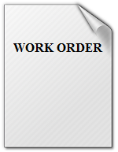
Systematic
Processes
Schedule
Yardstick
Standard
Team
Maintain
Execute/
Evaluate
2
S Y S T E M

Slide 39
Systematic
Processes
Schedule
Yardstick
Standard
Team
Maintain
Execute/
Evaluate
Adjust
2
S Y S T E M

Slide 40
Systematic
Processes
Schedule
Yardstick
Standard
Team
Maintain
Execute/
Evaluate
Improve
2
S Y S T E M

Slide 41
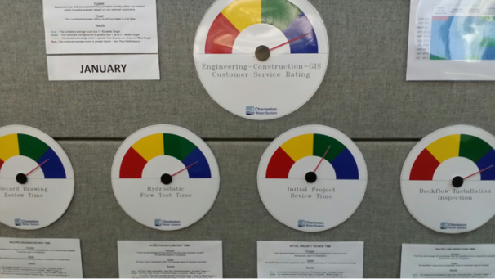
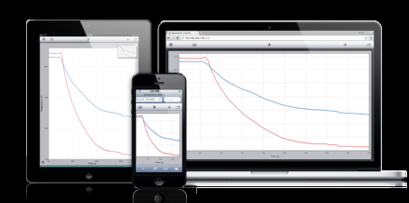
Data
Sharing
Written:
Agendas
Meeting minutes
Reports
Visual:
Displays
TVs
Dashboards
Bulletin boards
Mobile devices

Slide 42
In Conclusion
Measurement Requires
Laser focus
Discipline
Starts at the top
Resources
Teams / Teamwork
Software
Continuous
Evaluation
Analysis
Communication
Use of results
Decision making
Continuous improvement

Slide 43
www.CompetitiveEdgePerformance.net
Thank you for your time and attention!
Contact Information:
Rick Bickerstaff
Rick@CompetitiveEdgePerformance.net
843.297.2596

