Slide 1
Webcast
Opportunities and Barriers for Renewable and Distributed Energy at Drinking Water and Wastewater Utilities.
Steven Kenway, Steven Conrad, James McCall, Maria Cuencia, Jeff Carmichael
10 October 2019

Slide 2
Housekeeping Items
Submit questions through the question box at any time! We will do a Q&A near the end of the webcast.
Slides and a recording of the webcast will be available at www.waterrf.org.
Send an email to Michelle Suazo at msuazo@waterrf.org for a PDH certificate.
Survey at the end of the webcast.

Slide 3
Input your webinar questions here
Q&A at end of webinar

Slide 4
Download presentation
Slides and recording will be available to WRF subscribers WITHIN 24 hours after the webcast

Slide 5
Webcast Agenda
Introductions (Ashwin Dhanasekar, WRF).
Study background and findings (Steven Kenway, UQ)
  Approach (Chapter 1)
  DER opportunities and drivers (Chapters 2 and 3)
  Case study summaries (Chapter 4)
  Risks and success factors summary (Chapter 9)
  DER Tools and case studies (James McCall, NREL) (Section 8.3 and Appendix E and B).
  Biogas and codigestion at NYDEP (Maria Cuencia) (Appendix B).
  Heat and Gas recovery Jeff Carmichael (Metro Vancouver) (B).
  Policy Action Plan Highlights (Steve Conrad, UBC) (Chapters 8-10).

Slide 6
Project 4625 Final Report
Kenway, S., Conrad, S. Jawad, M. Gledhill, J, Bravo, R, Strazzabosco, A, and Howe, C, 2019, Opportunities and Barriers for Distributed/Renewable Energy Resource Development at Water and Wastewater Utilities. Denver: CO, Water Research Foundation.
Available from: WRF Link
Note: First register (free) then download the 10MB report.

Slide 7


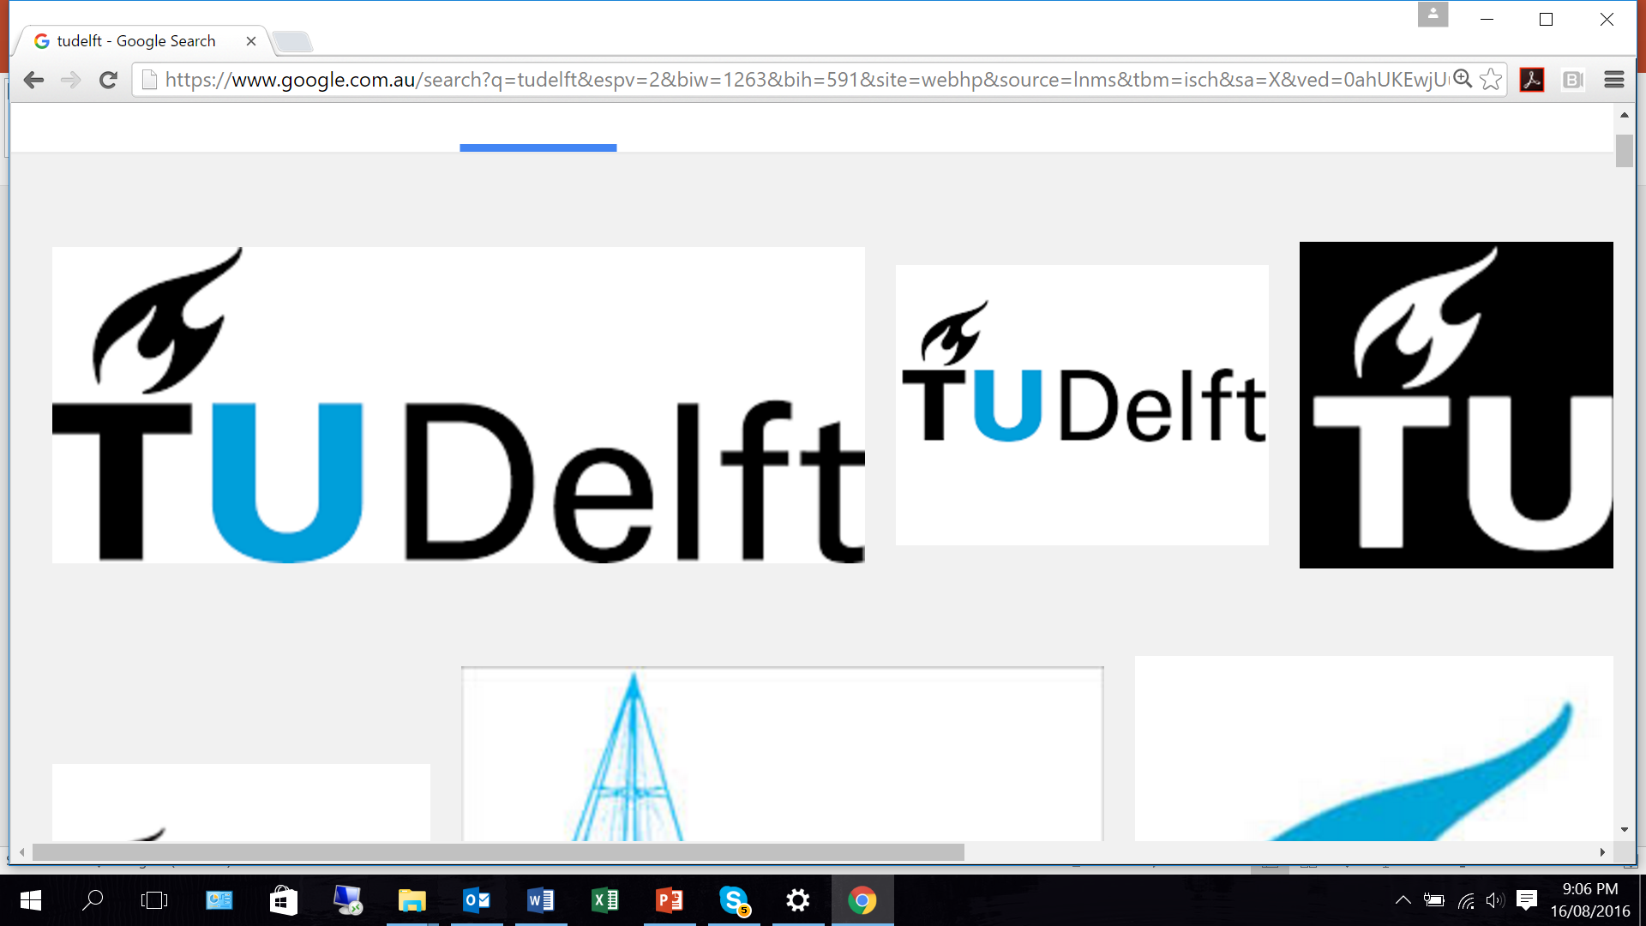
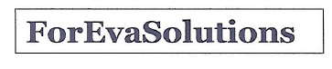
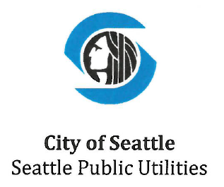

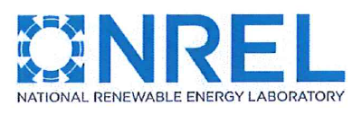
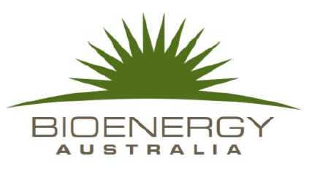
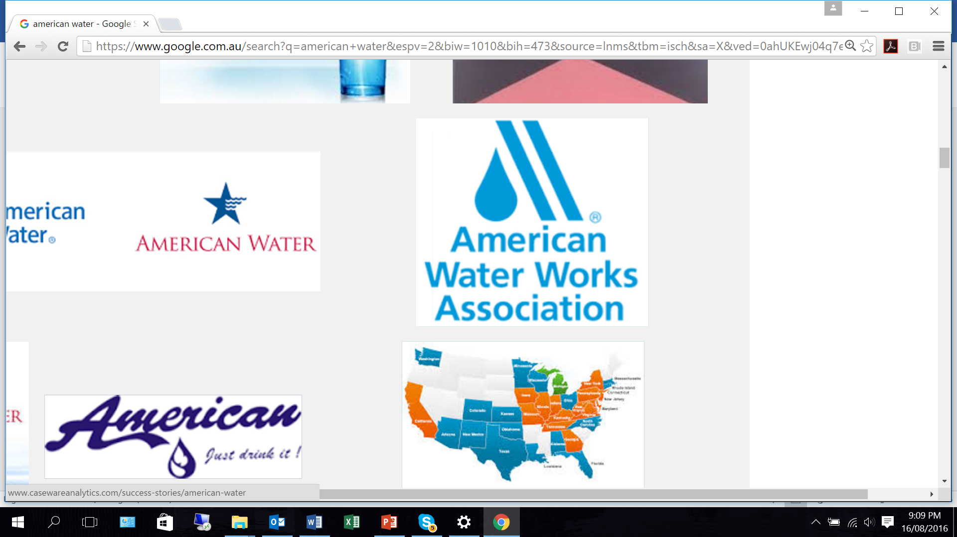
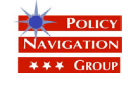


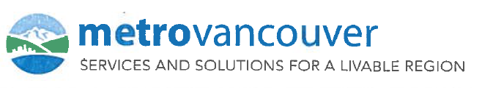

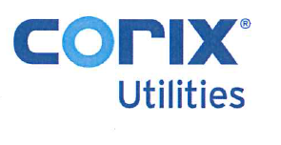

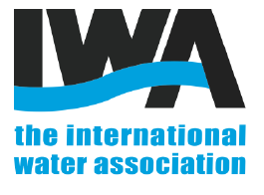
First, big thanks to co-authors, partners, case study partners, team, steering committee, and others.
Maria Brusher Consulting
Portland Water Bureau, Boulder Water, DC Water,
Chatham-Kent PUC Entegrus, California Energy Commission, Massachusetts Water Resources Authority, Stantec

Slide 8
Project 4625 Objectives
Identify opportunities for DER/Renewables as stand-alone and electric-grid connected projects within the current policy and regulatory environment.
Identify opportunities to overcome barriers and conflicts through legislative and regulatory change or flexibility.
Understand how entities have managed risks considering different DER types and reliabilities, and
Develop a practical, useful and accessible Guidebook for DER integration for water and wastewater utilities.

Slide 9
Project Background
Energy routinely 10% or more of US utility operating costs (can be significantly more).
In 2012, public water and wastewater (U.S.) consumed 39.2 and 30.2 billion kWh electricity, approximately 1.85% of U.S. total.
Energy recovery opportunities exceed the electricity requirements for all treatment in North America 9-fold.
However:
  Currently limited integrated water- energy planning or resources (See WRF 4469).
  Successful grid integration of DER can be problematic – multiple site- and state-specific risks and challenges.

Slide 10


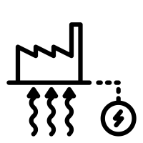




What are Distributed Energy Resources?
Local energy generation resources, energy storage, and demand response technologies (including efficiency). – Smaller power sources that can be aggregated to provide power necessary to meet regular demand.
Ancillary elements, storage, micro-grids, energy management systems etc…
Algal Biofuel
Anaerobic Digestion
Anaerobic Digestion with Co-Digestion
Fuel Cell
Geothermal
Heat Recovery
Hydropower
Solar PV
Thermal conversion
Tidal
Wave
Wind

Slide 11
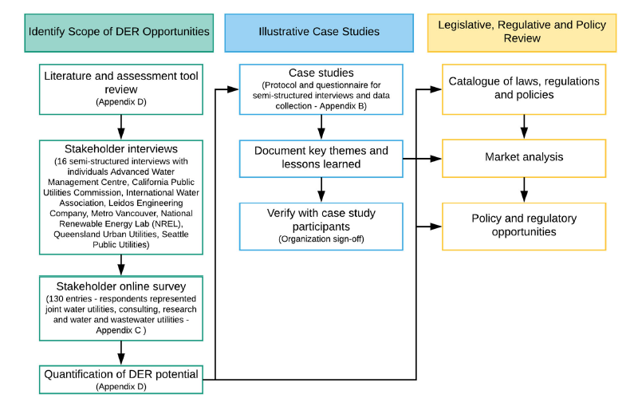
Project Method
Glossary of ~140 terms (Appendix A). Risks and their management.
Glossary of ~140 terms (Appendix A)
Glossary of ~140 terms (Appendix A)

Slide 12
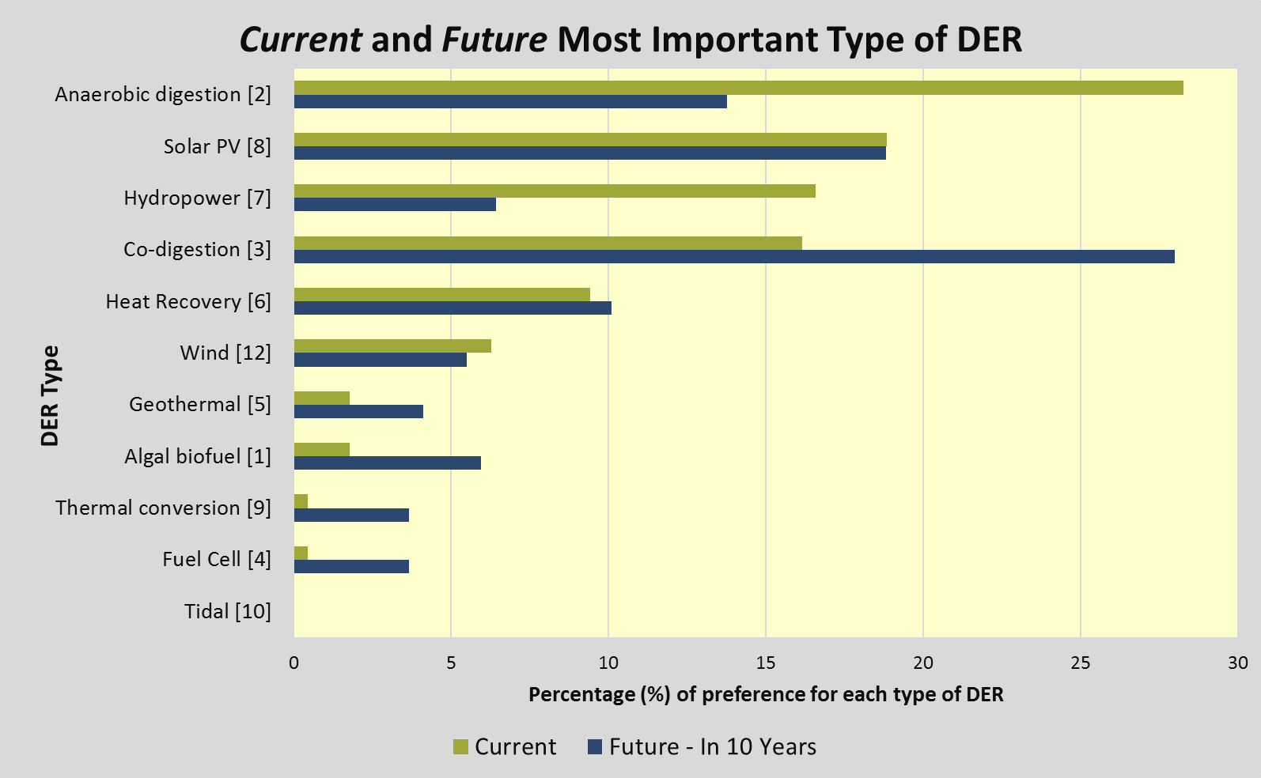
DER opportunities, now and in future*
*As perceived by survey respondents

Slide 13
Biogas physical potential* Collectively 3,000 GWh/a if all 1,241 WWTP with anaerobic digesters generated electricity, or 5,000 GWh/a if biogas used for electricity from all 3,201 WWTP > 5MGD. More with co-digestion.
*Note emerging technologies not considered, economic potential depends on multiple additional factors. See also NREL Renewable Energy Interactive Mapping Tools – Biomass atlas example later in this presentation.

Slide 14
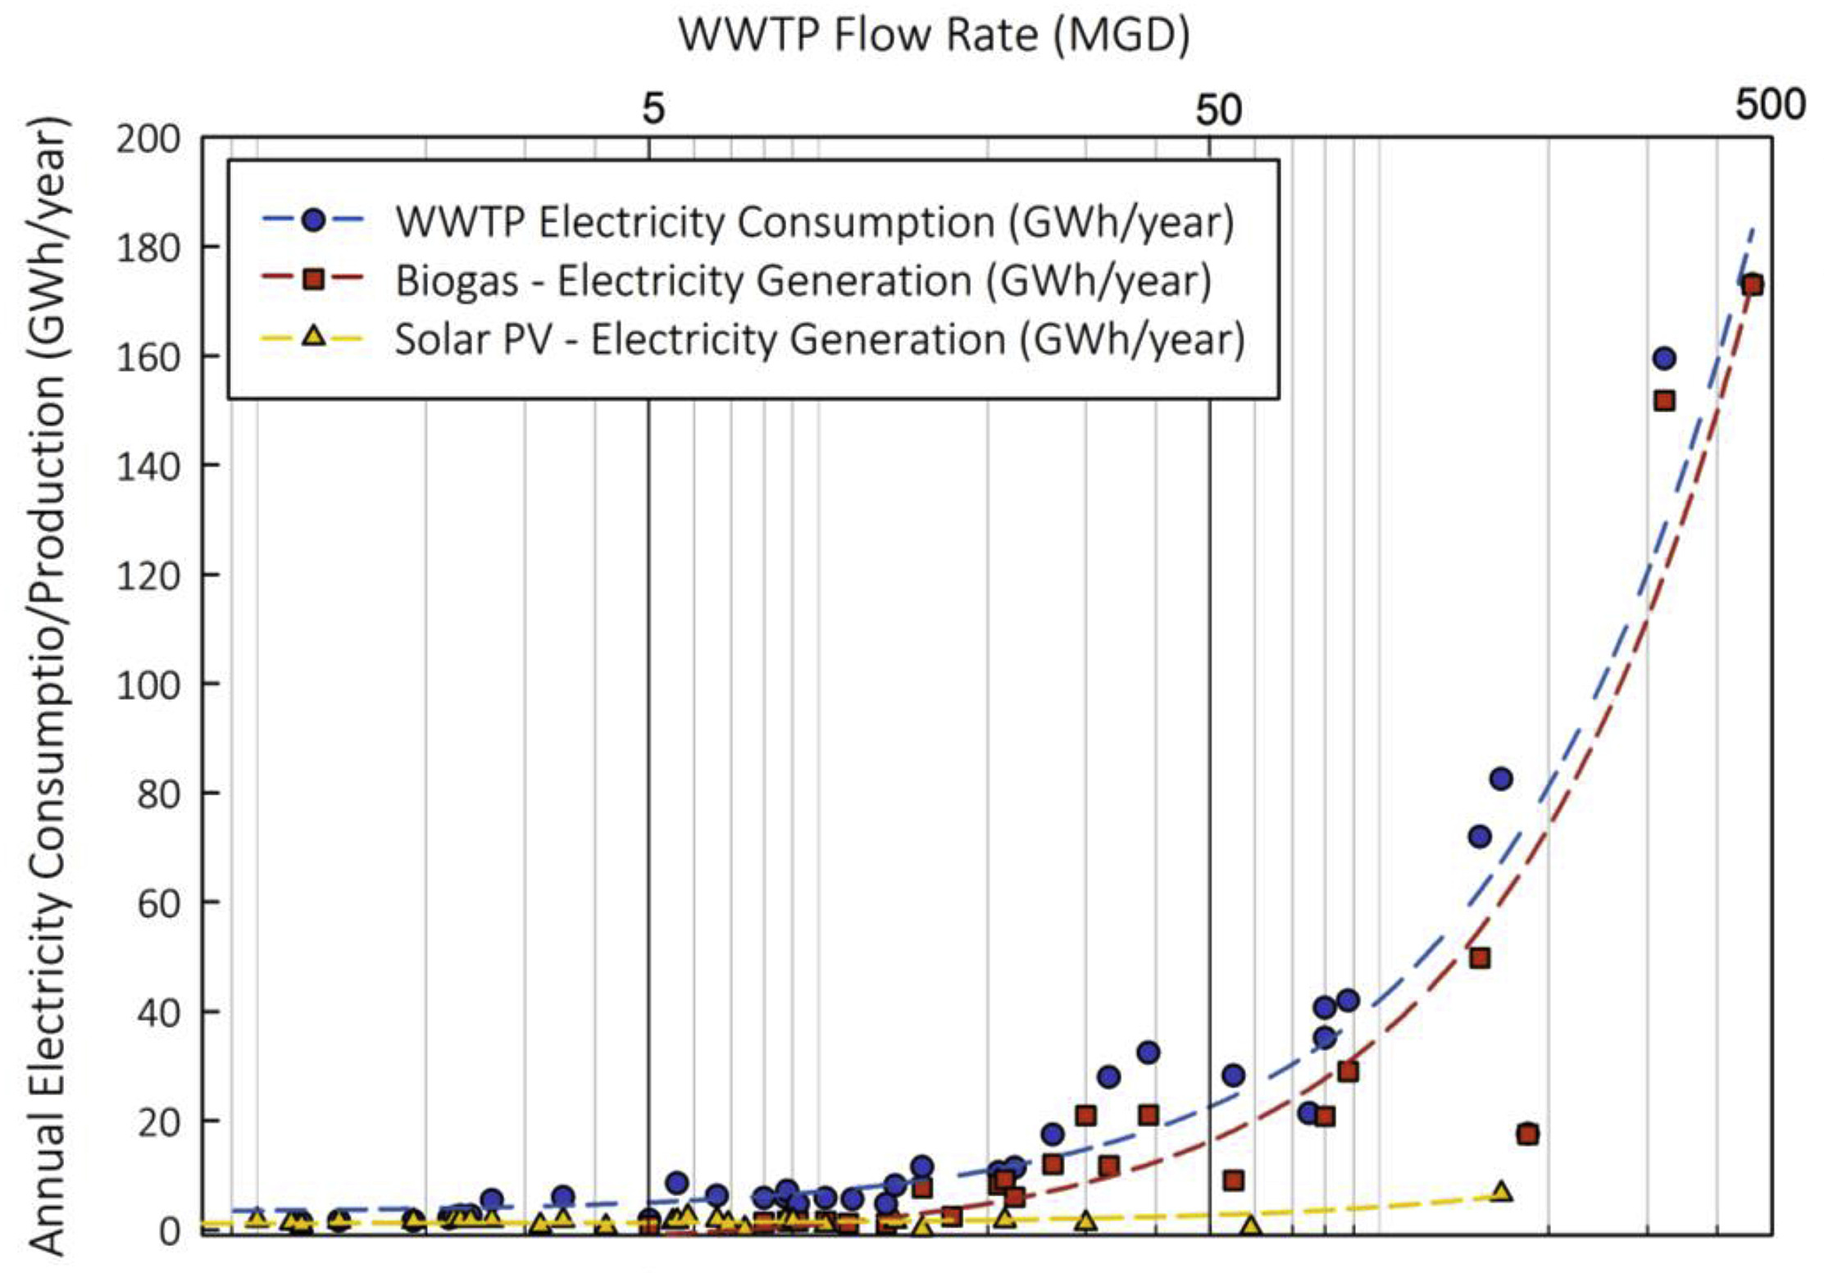
Size of WWT plant has a marked influence on DER type adopted. Example from Californian analysis.
Biogas is limited by the economies of scale
Solar PV is more common at smaller plants
Source: Strazzabosco et al 2019. Solar PV adoption in wastewater treatment plants: A review of practice in California. Journal of Environmental Management. 248. Link

Slide 15
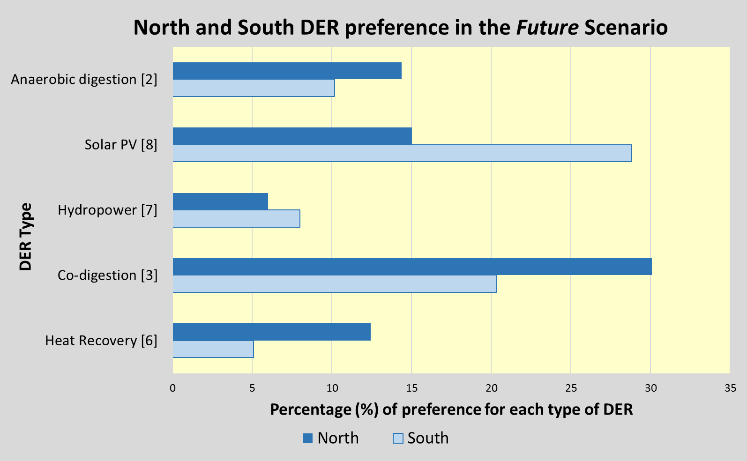
Opportunities for DER differ with location
Co-digestion, anaerobic digestion, and heat recovery more relevant in the North, and Solar PV in the South.

Slide 16
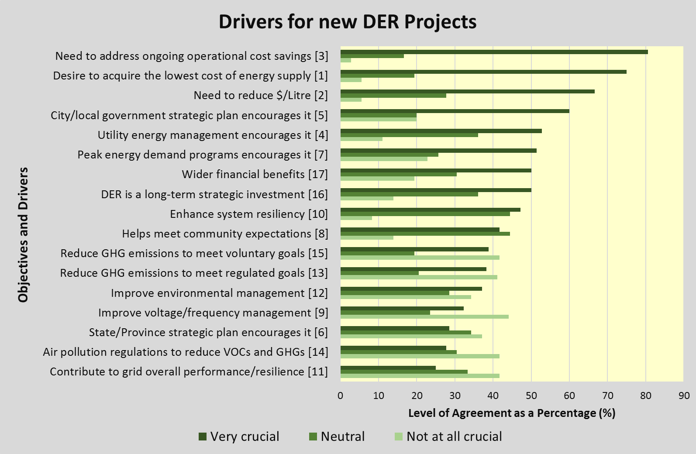
Drivers for Distributed Energy Projects

Slide 17
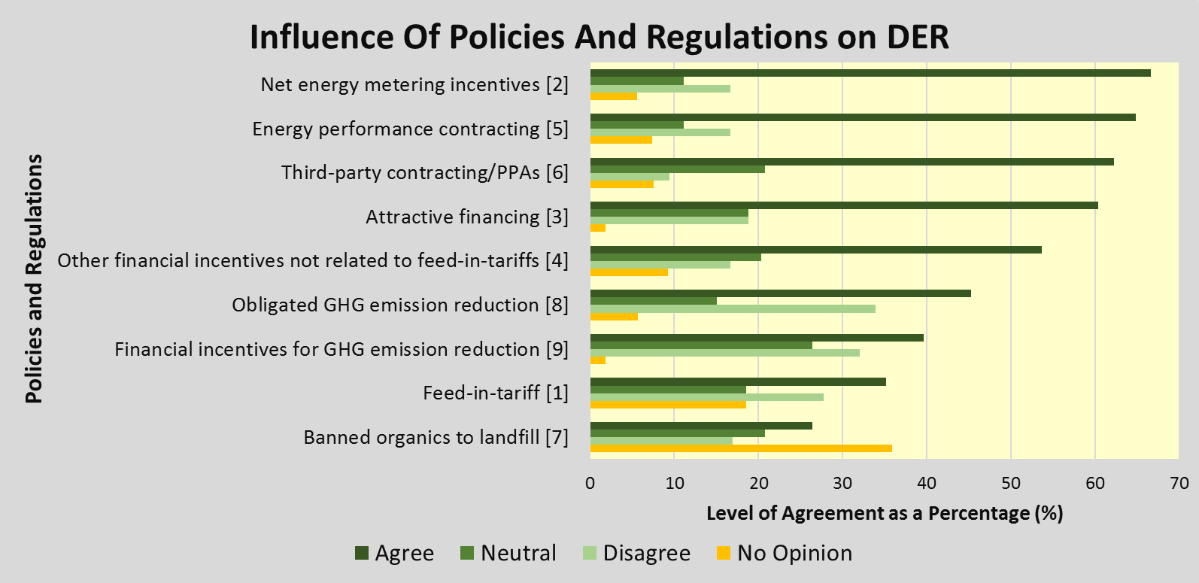
Assessment of the Influence of Policies and Regulations on the Development of DER at Water and Wastewater Utilities

Slide 18
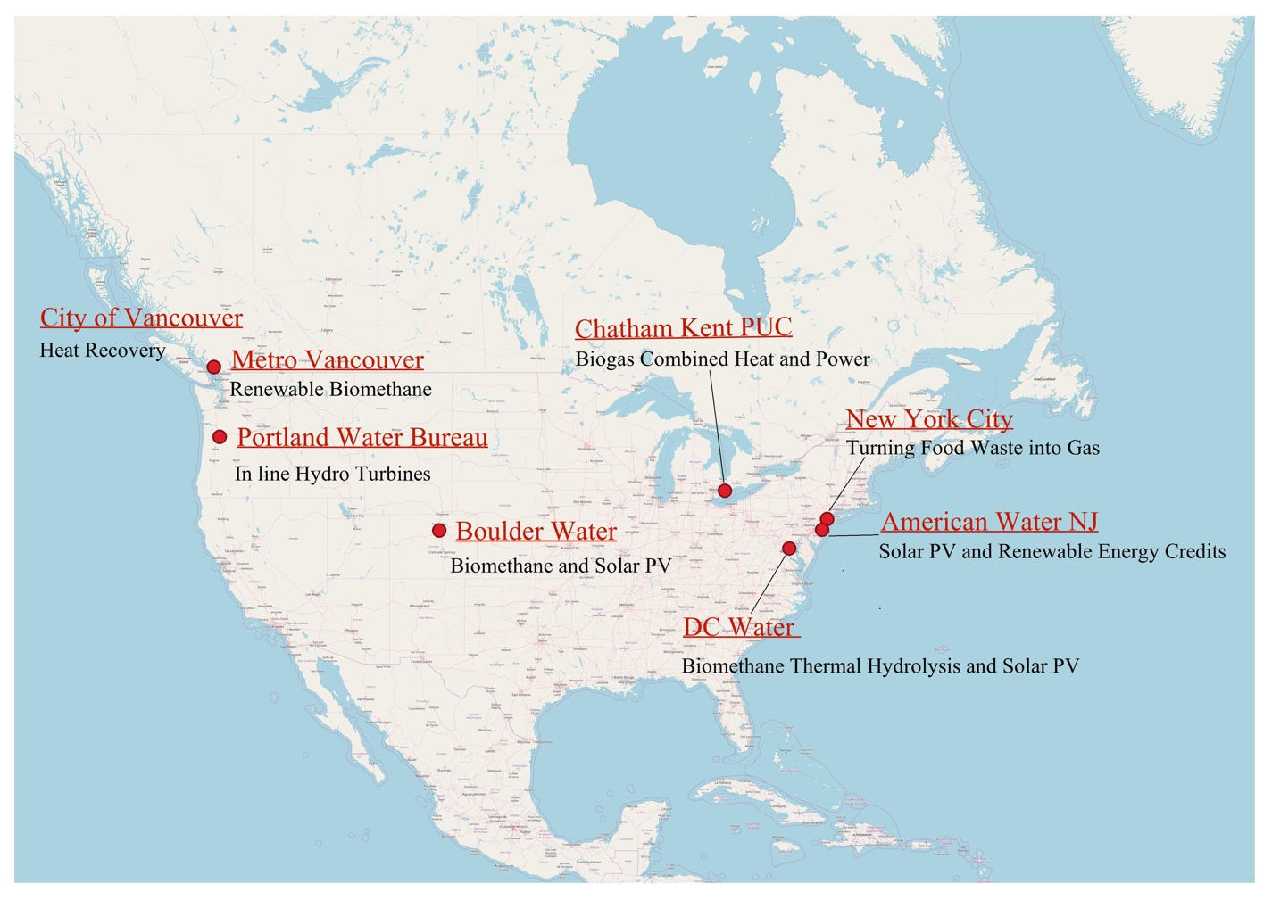
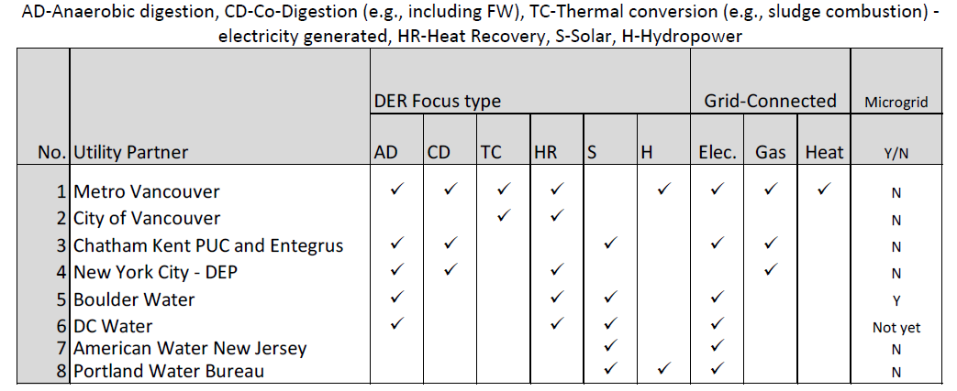
Case studies summary
How DER have succeeded, key drivers, related regulations, stakeholders and how risks overcome.

Slide 19
Tools to Promote DER Development and Case Study Learnings
James McCall
Water Research Foundation (WRF) Webinar
October 10th, 2019

Slide 20
Agenda
Project Motivation/Guidebooks
Overview of DER Tools
  Incentives, policies, and permitting
  Technical and economic models
Case Study Learnings
  Boulder Water – solar PV
  DC Water – biomethane, thermal hydrolysis, and solar PV

Slide 21
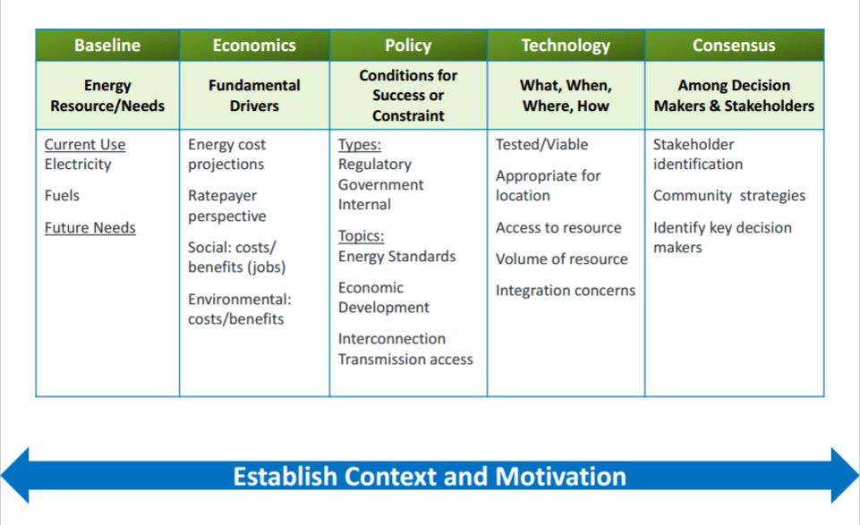
Project Fundamentals (BEPTC)

Slide 22
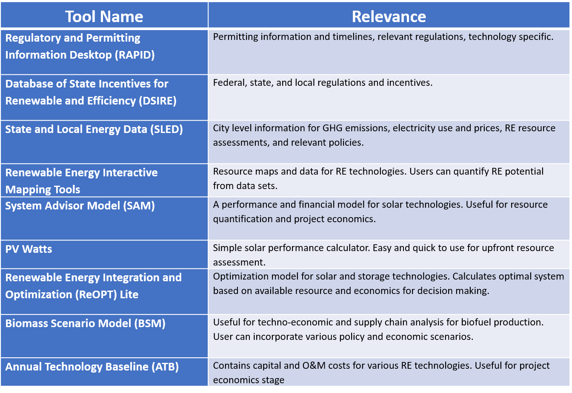
Tools Summary – Appendix E

Slide 23


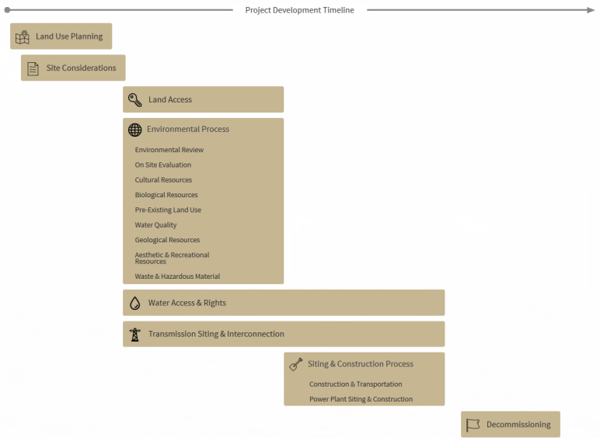
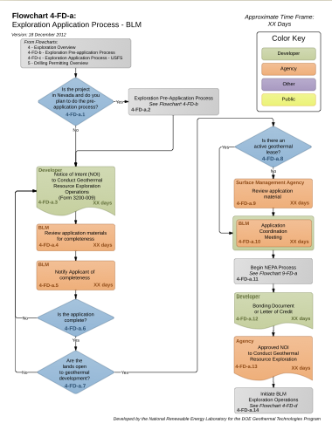
RAPID Toolkit
http://en.openei.org/wiki/RAPID
One-stop shop for permits, processes, guidance, regulations, best practices, and other relevant information for renewable energy projects

Slide 24
Database of State Incentives for Renewables and Efficiency (DSIRE)
Run by NC Clean Energy Technology Center
Contains relevant incentives, policies, and utility programs
  State and Federal level
  Can filter by technology, incentive type, and sector
Publishes information regarding net metering policies by state
https://www.dsireusa.org/

Slide 25
State and Local Energy Data (SLED)
SLED providers an energy profiler and decision support tool
A city’s energy profile contains:
  Greenhouse gas emissions
  Electricity generation
  Natural gas and other fuel source costs
  Renewable energy resource potential
  Transportation, buildings, and industry data
Provides insight for developers, utilities, and policy makers of past DER actions
https://www.eere.energy.gov/sled/#/

Slide 26
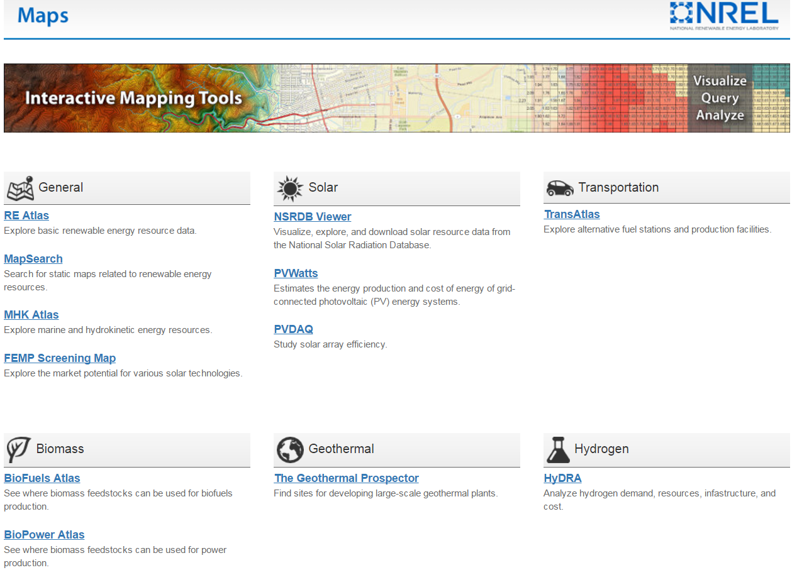
Renewable Energy Interactive Mapping Tools
https://maps.nrel.gov/

Slide 27
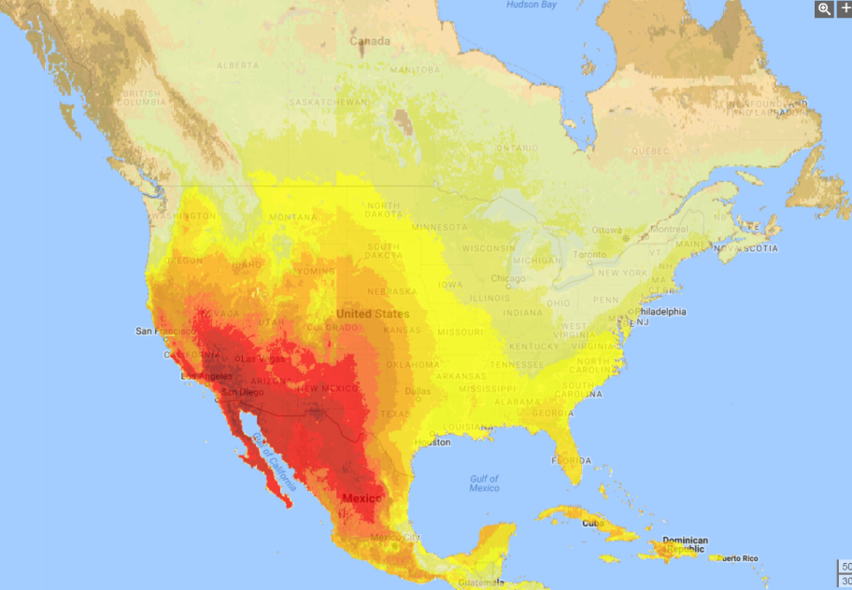
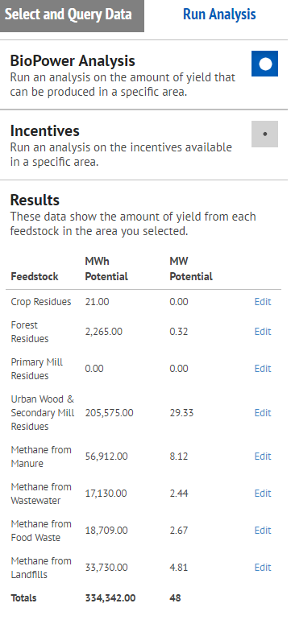
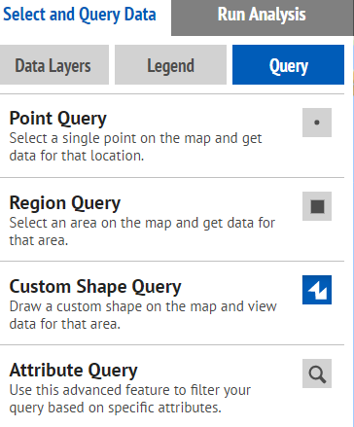
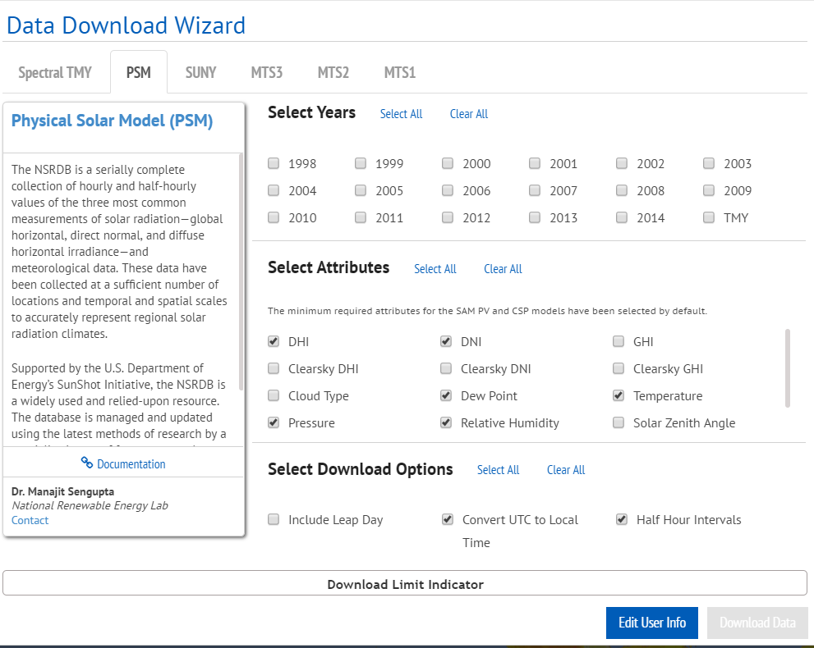
Interactive Tool Features – Technical Potential

Slide 28

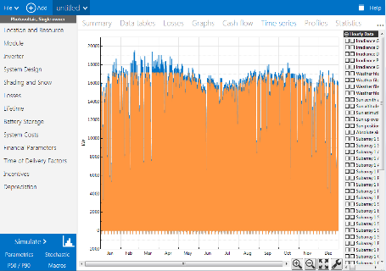
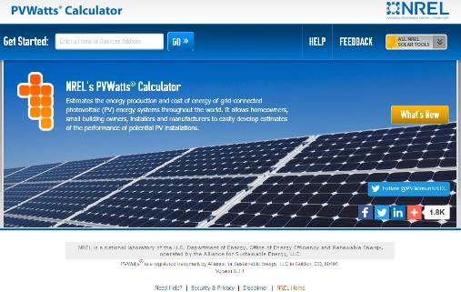
System Advisor Model (SAM) & PVWatts
System Advisor Model
Free software that enable detailed performance and financial analysis for renewable energy systems
Technologies
Photovoltaics, detailed & PVWatts
Battery storage
Concentrating solar power
Wind
Geothermal
Biomass
Solar water heating
Financials
Behind-the-meter
residential
commercial
Power purchase agreements
single owner
equity flips
sale-leaseback
Simple LCOE calculator
http://sam.nrel.gov/download
https://pvwatts.nrel.gov

Slide 29
Steps to Modeling Renewable Energy
Weather Data
Costs
System Specs
Compensation
System Losses
Financing
Electricity Production
Incentives
Results
Annual, Monthly, and Hourly Output, Capacity Factor, LCOE, NPV, Payback, Revenue

Slide 30









REopt Model
Identifies optimal technologies and operating strategies to meet site energy/water loads at minimum cost
Goals
Net Zero
30% RE
Carbon Neutral
Economics
Discount Rate
Technology Costs
Incentives
Utility
TOU Electricity Rates
Demand Charges
Ancillary Services
Online, Lite version of full ReOPT model
  Online version only looks at solar PV, wind & battery systems
https://reopt.nrel.gov/tool
Resources
Renewable Generation
Solar PV
Wind
Biomass, etc.
Conventional Generation
Electric Grid
Diesel
Natural Gas
CHP (multiple types)
Optimized minimum cost solution
Technology Mix
Technology Size
Dispatch in every time-step
REopt
Energy Planning Platform
Energy Storage
Batteries
Thermal
Water tanks
Portfolio
Campus
Microgrid
Resiliency
Dispatchable Loads
Water Treatment
HVAC
Thermal Load
Electric Load
Energy Efficiency
Water Demand

Slide 31
Case study – Boulder Water
Solar PV

Slide 32
Boulder Water – solar PV
Installed 1 MW PV system on city land in 2010; provides 10-15% of plant’s electricity demand
  Chose to upgrade electrical system and controls onsite with PV installation
System is owned by 3rd party and generation sold via power purchase agreement (PPA)
Drivers
  PPA structure, no upfront cash or rate increase
  City of Boulder’s aggressive renewable energy goals
  Price hedging for future electricity rate increases
  Little change to plant operations
  Experience with past DER from anaerobic digestion implementation
Learnings
  Include city and utility in development process early
  Accurate communication of schedule and permitting is key

Slide 33
Case study – DC Water
Thermal hydrolysis and solar PV

Slide 34
DC Water – thermal hydrolysis
Design started early 2000’s; installed by CAMBI in 2015
  Waste heat is captured from onsite biomethane generators
  Produces a class A biosolid (usable in rural and urban settings) after process
  Reduces waste from aerobic digestors by 50%
Reduction of nitrogen discharge and waste reduction was a large driver (environmental permitting)
Savings from both reduced electricity and trucking waste costs were secondary drivers, but large selling point
Space constraints were a factor in technology selection
Uncertainty: first implementation of this technology in U.S.

Slide 35
DC Water – solar PV
In Request for Proposal (RPF) and development process for 5 MW PV system on top of buildings, car ports, and processing tanks
Looking at PPA structure – no upfront cost to rate payers
Main driver(s): reduced electricity sales and price hedging
  Policy incentive: DC has solar carve-out for PV within the district. Offers a high renewable energy credit (REC) price ($500/MWh)

Slide 36
DC Water - Lessons
Examine both water AND energy system impacts
Incorporation of DC Energy Council on DC Water board
Technology and finance communication was key
Leverage expertise for specific DER resource
Both efforts are in second iteration
  CAMBI: technology selection and design limited 1st project
    Building permits delayed construction within District
  PV: expiration of Investment Tax Credit (ITC) and power purchase agreement (PPA) financing limited 1st project
    Interconnection and permits limited small PV project
Interested in other projects but concerns about plant resources and employee bandwidth

Slide 37
New York City Department of Environmental Protection, Waste Management New York and National Grid – Public and Private Sectors Partnering to Turn Food Waste into Gas
Maria Cuenca, EIT., ENV SP
October 10, 2019
Notes:
Hello everyone my name is Maria Cuenca I am a Sustainability Analyst for the NYCDEP

Slide 38
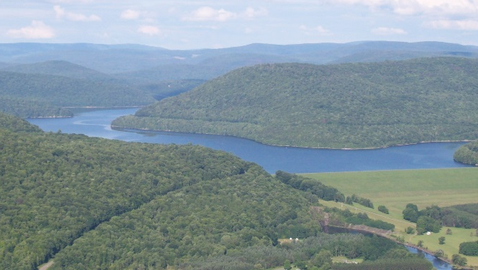
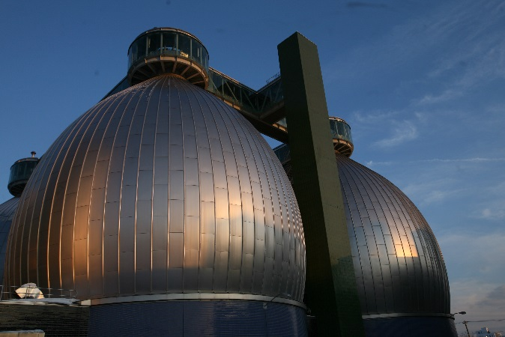
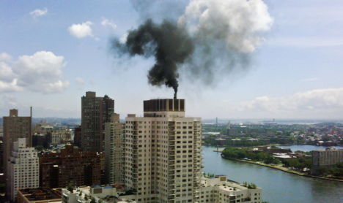
Summary
WATER SUPPLY
Deliver 1.1 billion gallons of water to 9.6 million New Yorkers every day and maintain 7,000 miles of water mains
Protect our 2,000 square mile watershed, including 19 reservoirs and three controlled lakes
WASTEWATER TREATMENT
Treat 1.3 billion gallons of wastewater each day
Operate and maintain 14 plants, 96 pumping stations, and 7,500 miles of sewers
AIR, NOISE, AND HAZARDOUS WASTE
Update and enforce the Air Code to reduce local emissions, and regulate hazardous waste and noise pollution
Notes:
DEP is the largest combined water and wastewater utility in the United States, with nearly 6,000 employees and an annual budget of $3.8 billion (should be updated yearly)

Slide 39
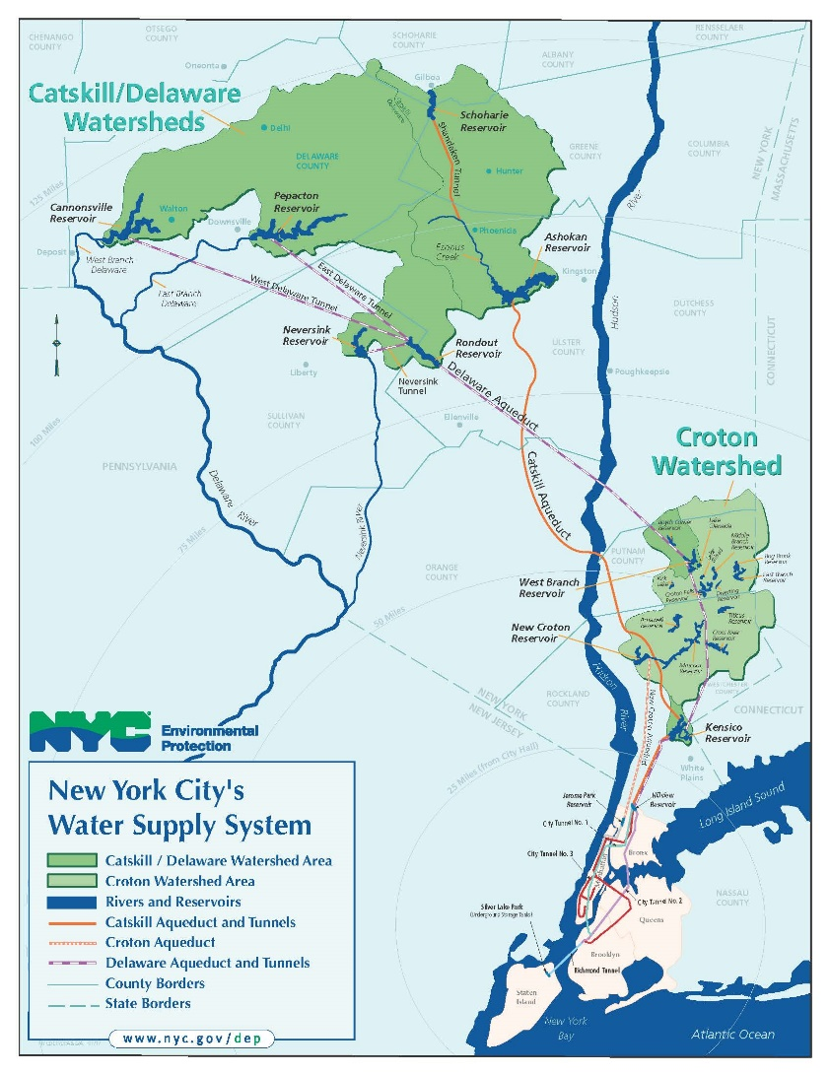
Water Supply

Slide 40
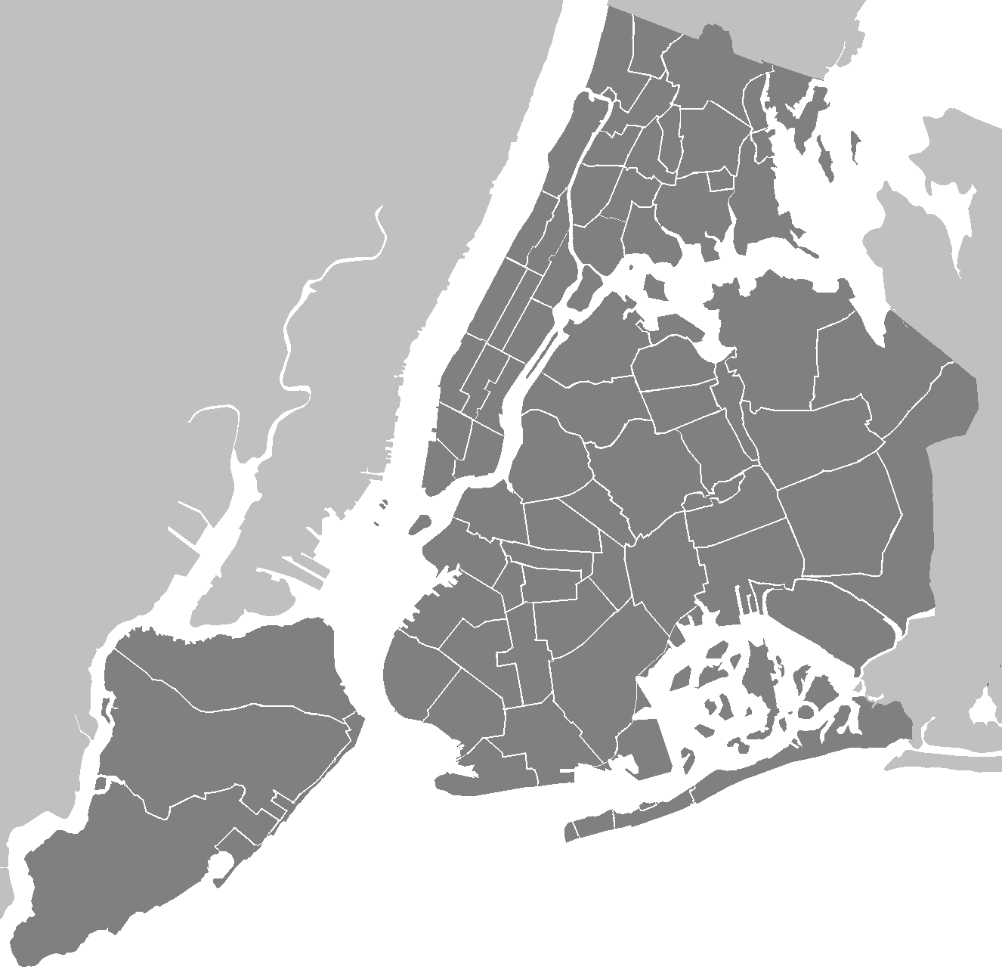
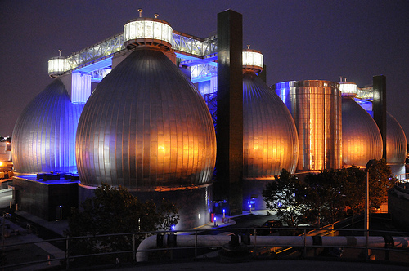
Newtown Creek Brooklyn, NY
Newtown Creek WWTP
Located in Greenpoint, Brooklyn
Capacity: 330 MGD (largest)
Population: 1M: East Manhattan, West Queens, North Brooklyn
2004: Digester eggs upgrade complete
Biogas used in on site boilers for process and building needs

Slide 41
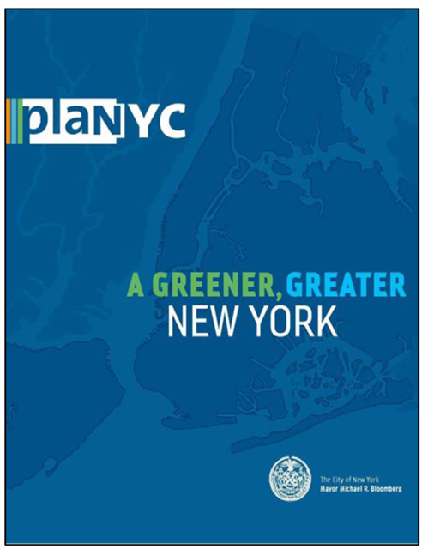

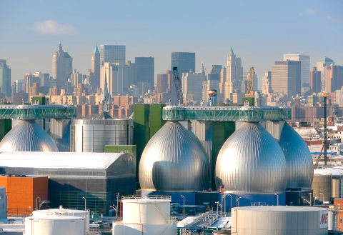



Project Timeline & NYCDEP Incentives
2009 NGrid: Meets with NYCDEP to discuss collaboration opportunities for GHG reductions
Anticipated: Begin operation of Biogas-to-Grid project
2004
2007
2010
2015
2016
2019
Completed: Newtown Creek Digester Tank Upgrade
Published: Mayor Michael Bloomberg’s PlaNYC for a greener, greater New York
Published: Mayor Bill DeBlasio’s OneNYC the plan for a Strong and Just City.
The plan commits to reduce GHG emissions by 80% by 2050
Anticipated: Completion of food waste co-digestion demonstration
Includes NYC’s first plan to commit to reducing GHG emissions
30 x 30
Published: WM approaches DEP to co-digest EBS® produced from NYC food waste from commercial, residential and institutional generators
Kicked Off: WM 3 year demonstration project to assess the operational impacts of co-digestion
Notes:
mayoral goals become internal priorities and objectives.
dThe food waste co-digestion demonstration is still underway and will be so through June 2019. The biogas-to-grid project is still in design and will not be operational until late 2018. DEP will be in a better position to share lessons learned in the future version of food waste from landfills

Slide 42
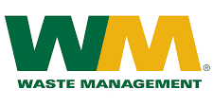
Public-Private Partnerships
Food waste augmentation project that delivers food waste bioslurry to improve co-digestion
2010 – WMNY expresses interest in co-digesting bioslurry from collected source separated organics (SSOs)
Driving factors
  Contaminants and variability of inbound material
  Source separated organics (SSO) processed offsite
  Centralized Organic Recycling system (CORe)
    Full scale operation in CA
  OneNYC Zero waste to landfill by 2030
Bio-methane cleaning project for export as renewable natural gas (RNG)
2009 – NGrid and NYCDEP meet to discuss collaboration opportunities for GHG reductions
Driving factors
  OneNYC – NYC’s commitment to sustainability and reducing GHG emissions
  80 X 50
    40 X 30
Peak production
  Heat 2,500 homes
  Reduce CO2e by 16,000 tons/yr

Slide 43


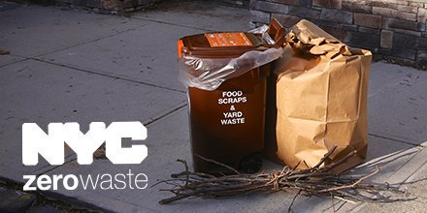



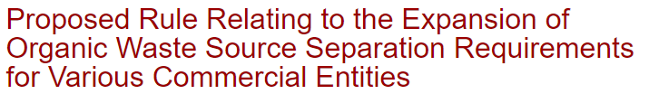
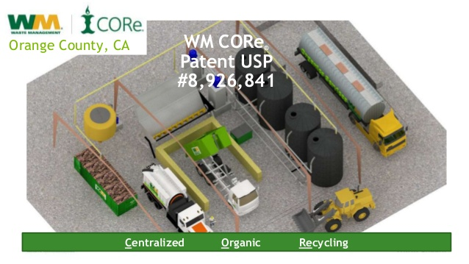
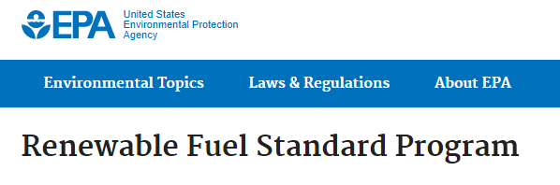
Legislative, Regulatory, and Policy
NYC Public Design Commission

Slide 44
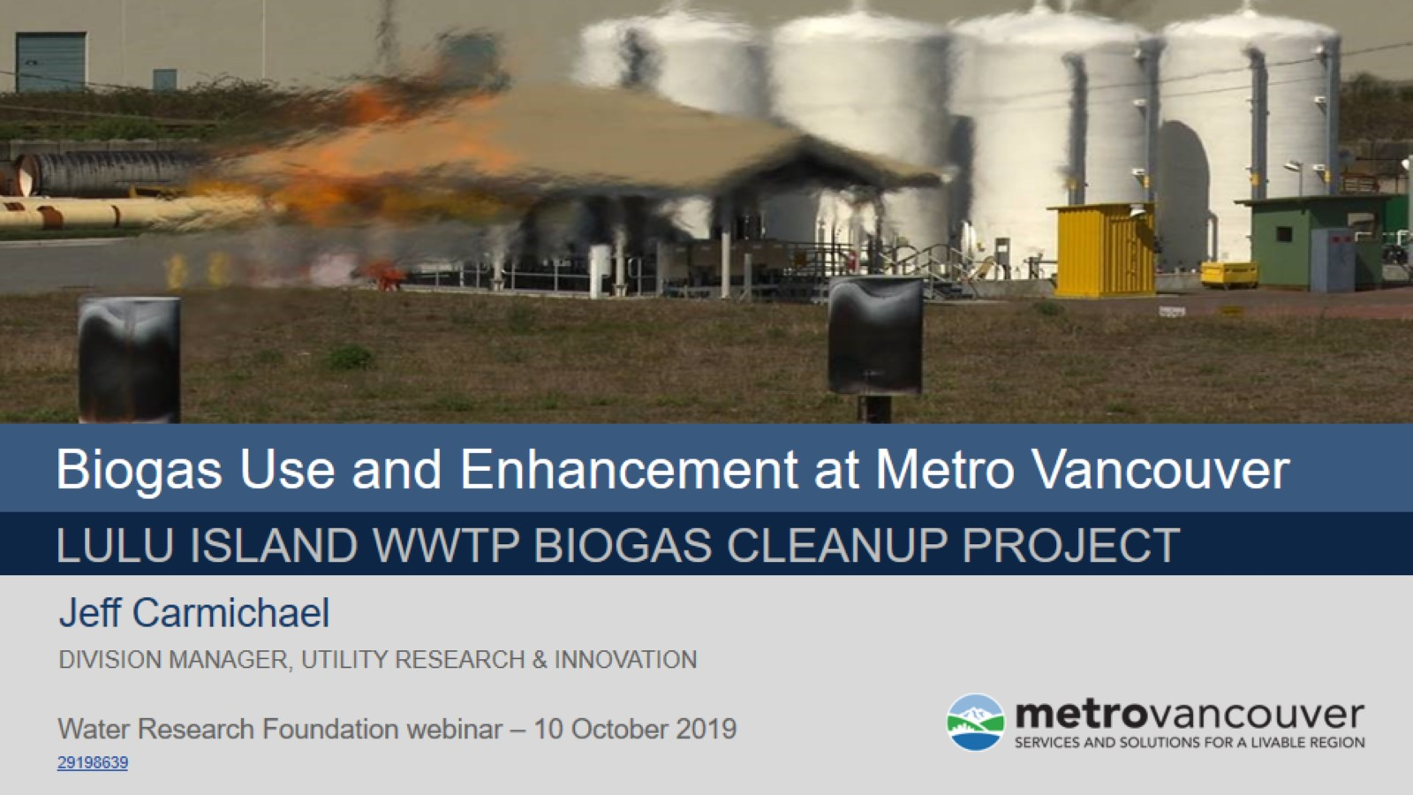

Slide 45
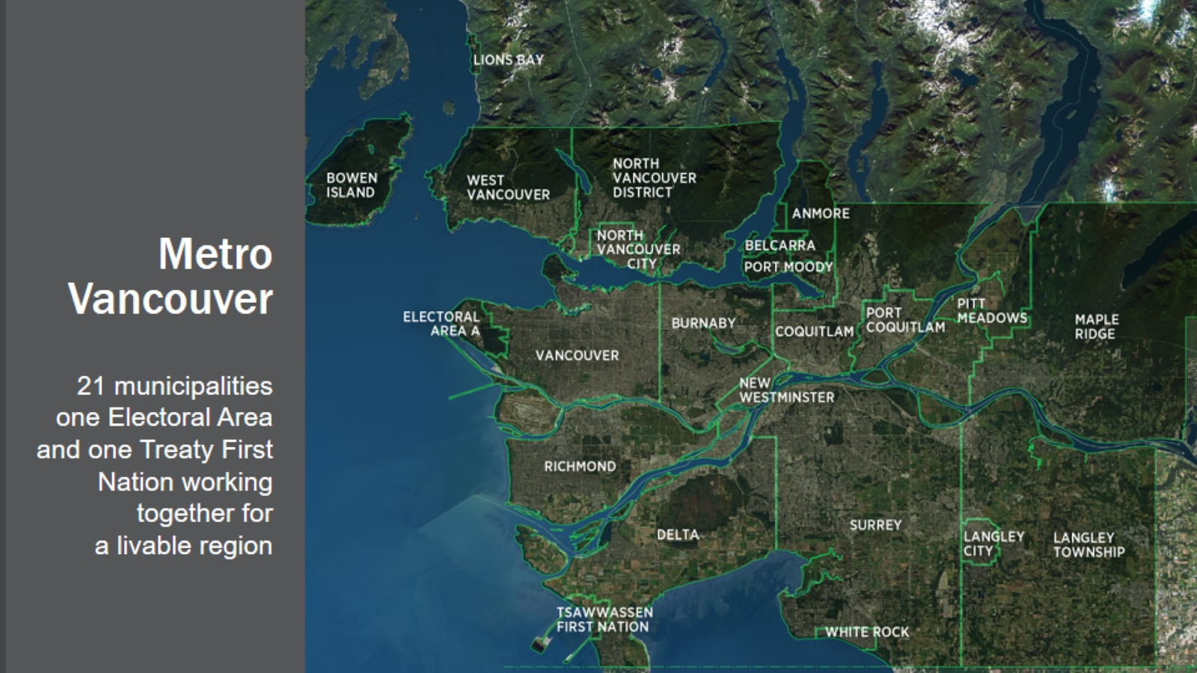

Slide 46
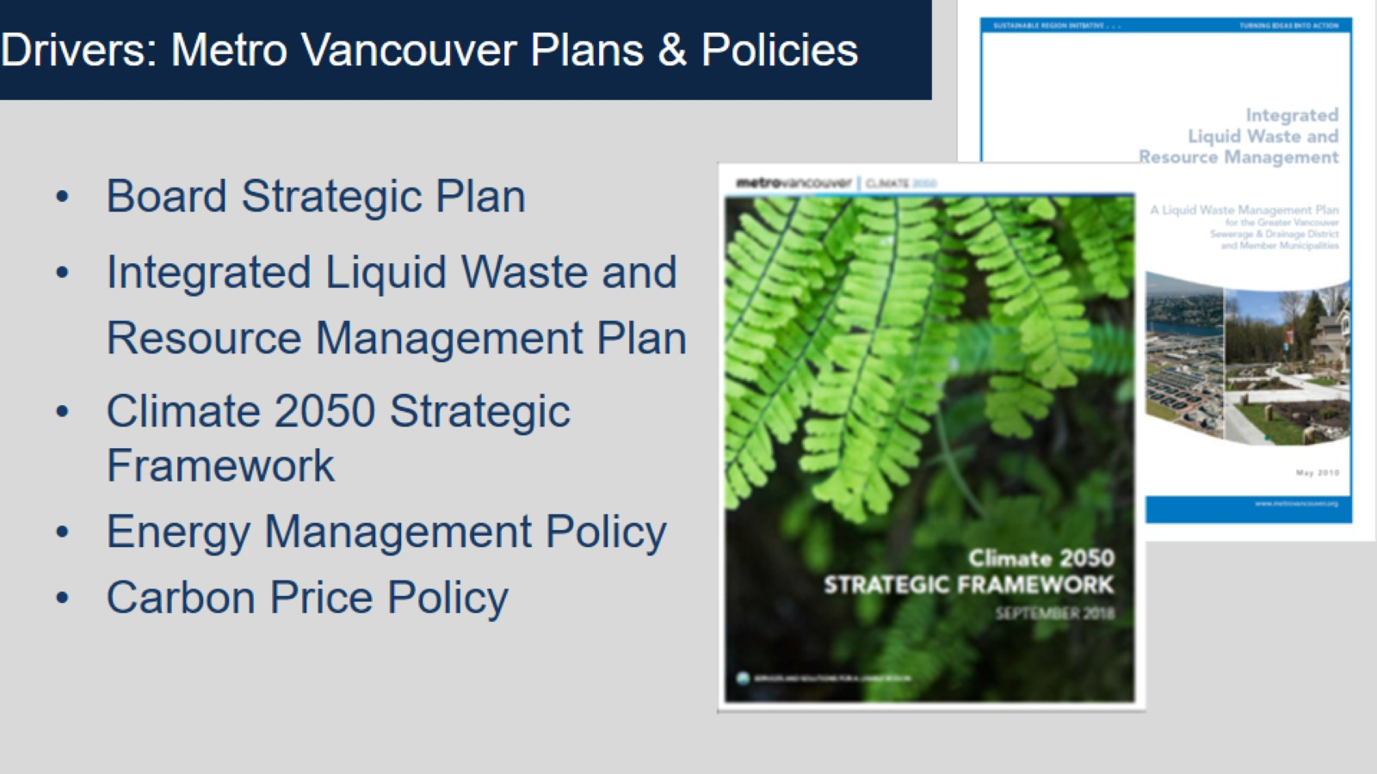

Slide 47
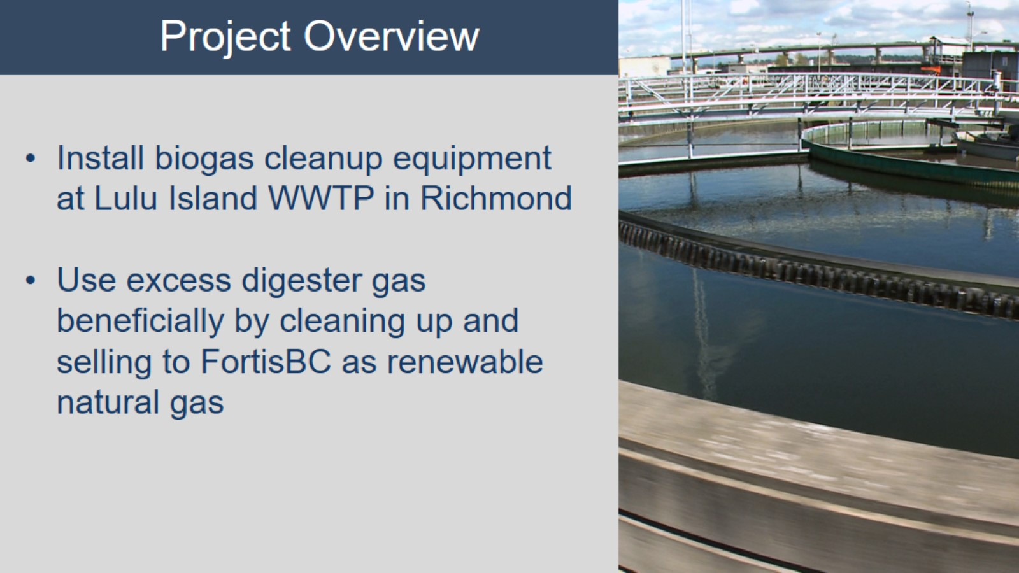

Slide 48
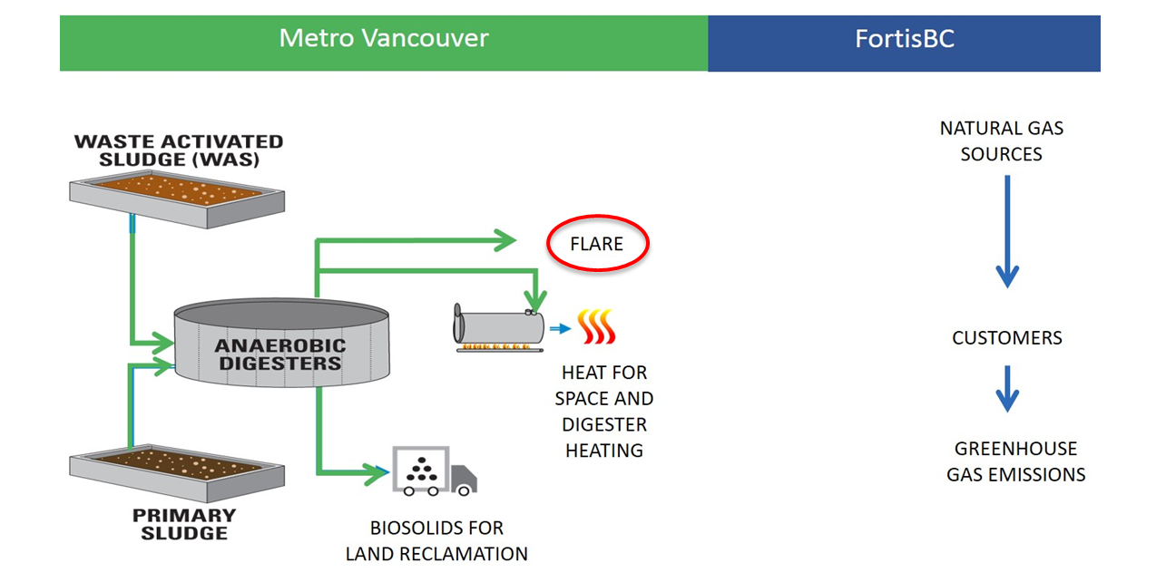
Project Schematic: Existing

Slide 49
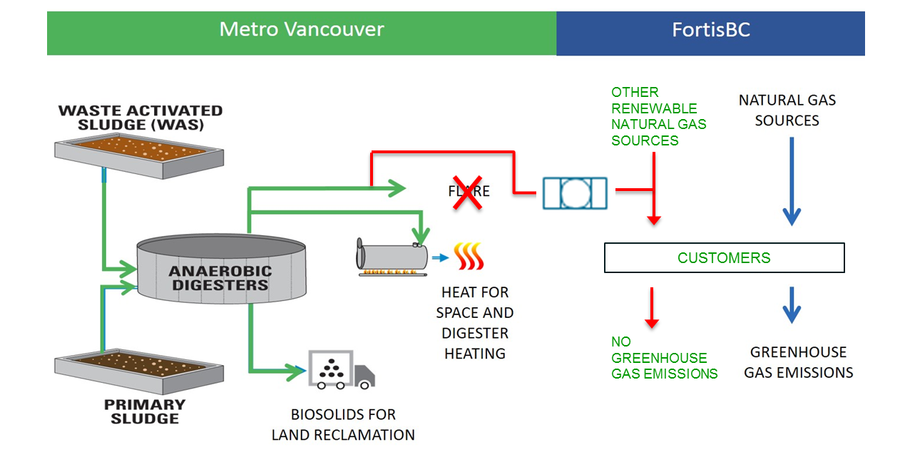
Project Schematic: New

Slide 50
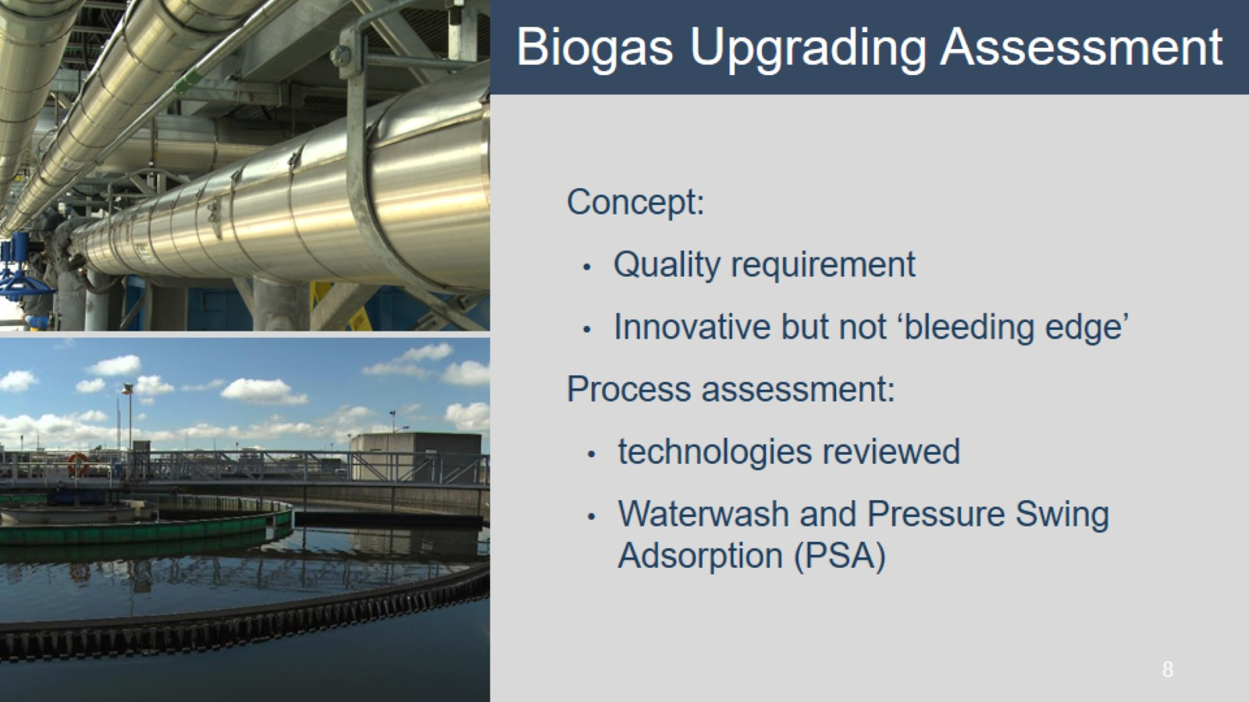

Slide 51


Slide 52


Slide 53


Slide 54

Summary of success factors and risks in implementing
Renewable and DER projects (Chapter 9).
Economic Feasibility
Technical Feasibility
Leadership
Clear and Realistic Expectation
Cooperation Between Stakeholders
Notes:
Across all DER types the thematic analysis of two of the open-ended questions asked in the survey was cross referenced with themes identified in the case studies and stakeholder interviews. The questions analyzed were: 1) “Please describe the key factors that help water and wastewater utilities successfully implement DER” and 2) “Please describe any potential failures and key risks in implementing DER projects.” Chapter 9 presents a detailed discussion of the findings – highlighted here

Slide 55
Success Factors and Risks
Success Factor | Policy and Regulatory Consideration | Risk or Potential Failure
Economic Feasibility (Chapter 5)
Financial Incentives provide strong business case energy supply demand drive investment | Funding or subsidy Energy market/rate of return | Unstable funding or subsidy sources long rate of return on investment energy market fluctuations change potential energy revenue returns
Technical feasibility (Case Studies)
Location and resources (e.g. waste streams) suitable to DER projects Demonstration projects exist proving technology | Control of system Infrastructure | Inability to control input streams Proven technologies do not transfer to local sites
Notes:
Across all DER types the thematic analysis of two of the open-ended questions asked in the survey was cross referenced with themes identified in the case studies and stakeholder interviews. The questions analyzed were: 1) “Please describe the key factors that help water and wastewater utilities successfully implement DER” and 2) “Please describe any potential failures and key risks in implementing DER projects.” Chapter 9 presents a detailed discussion of the findings – highlighted here

Slide 56
Success Factors and Risks
Success Factor | Policy and Regulatory Consideration | Risk or Potential Failure
Leadership (Survey and Case Studies)
Clear mandate to invest in clean energy and carbon reduction programs Board and executives aim to showcase sustainable practice | Governing structures | Change of state government Change in government policy
Cooperation (Case Studies)
Case study experiences confirm cooperation between public utility commission, water/energy utilities needed | Participation of Key Players | Fail to get full participation of the key players Failure to engage 3rd party provider

Slide 57
Policy and Regulation Review
Regulatory Background and DER Markets (Chapter 5)
Major Regulatory Activities (Chapter 6)
Policy Arrangements (Chapter 7)
Frameworks for DER Developments (Chapter 8)
Policy and Regulatory Opportunities
(Chapter 10)

Slide 58
Enabling Policies (Chapter 10)
Broad Renewable Policies
  Ensuring the Economic Feasibility and Stability of Capital Investments
  Addressing Technical Feasibility of DER Projects
  Promoting Clear and Realistic Expectations and Leadership
  Cooperation between Stakeholders - Building Consensus, Collaboration,
  and Understanding
  Cooperation Between Stakeholders
Biogas Policy Activities
Notes:
The political, regulatory and economic environment governing DER projects is a complex myriad of intersecting rules, incentives, and goals that differ greatly by state and region. The activities described below suggest options for improving policy stability that apply, in differing degrees, across the USA. While this report discussed various regulatory and economic instruments that apply to many water and wastewater utilities, identifying and examining the current political and regulatory environment within a utility’s jurisdiction is still a necessary step that should be taken in preparing a DER plan. After which, the activities described below may assist in minimizing the challenges, risks, and costs faced by water and wastewater utilities.

Slide 59
Economic Feasibility
Net metering
opportunity
Review feed-in-tariff policies and net metering rules when beginning
Be Aware of Low interest loans/state/federal loan guarantees
  Micro Grid financing options
Options real-time pricing where or establishing real-time pricing
non-market benefits of water and wastewater utility specific resources (thermal and biogas) should be accounted and identified
Energy
Time of Day
Utility Energy Demand
DER Energy Production
Notes:
Be aware of and identify feed-in-tariff policies and net metering rules when beginning DER project planning and evaluation
Be Aware of Low interest loans – state/federal loan guarantees
For instance, the Connecticut “Act Concerning the Use of Micro-grid Grants and Loans for Certain Distributed Energy Generation Projects and Long-Term Contracts for Certain Class I Generation Projects”
Investigate options to use real-time pricing where available and review options for establishing real-time pricing and delivery as an incentive to develop their DER potential
The British Columbia net metering program for residential and commercial customers provide wholesale compensation for generating units up to 100 kW in capacity that use a clean or renewable resource. Credits are given for energy provided that exceeds consumption on an annual basis.
Further the non-market benefits of water and wastewater utility specific resources (thermal and biogas) should be accounted and identified.

Slide 60
Technical Feasibility
Consider lifetime energy performance along with full lifecycle costs
Assess on-site power potential
  Example: NREL tools
Assess non-traditional renewable energy projects such as floating solar, fuel cells
Review Interconnection rules and building code opportunities
  Colorado PUC’s AB 802 - Energy Efficiency companion to SB 350
Notes:
Consider lifetime energy performance along with full lifecycle costs
Assess on-site power potential
Example: NREL tools
Assess non-traditional renewable energy projects such as floating solar, fuel cells
Review Interconnection rules and building code opportunities
New Orleans City Council net-metering rules, similar to rules adopted by the Louisiana Public Service Commission (PSC) in November 2005
Colorado PUC’s AB 802 - Energy Efficiency companion to SB 350 that requires Colorado PUC to authorize new energy efficiency and conservation programs that "measure overall energy usage reduction" to inform "modifications to existing buildings."

Slide 61
Leadership and Clear Expectations
Develop Frameworks for DER development
  NREL framework for solar investments
Review state-by-state permitting requirements and rules affecting DER
Mandates for Renewable Energy
  The San Antonio City Public Service - Renewable Portfolio 20% by 2020
  California Senate Bill 350 30% by 2030
review and discuss DER opportunities with local planners.
Notes:
Frameworks for DER development – industry policy and guidelines in the form of a framework for water and wastewater utility DER projects is required and a structured process.
Utilizing frameworks like the NREL framework for solar investments can clarify the steps involved in assessing, quantifying, financing and managing DER.
Water and wastewater should review state-by-state permitting requirements and rules affecting DER
Mandates for Renewable Energy
The San Antonio City Public Service - Renewable Portfolio Goal to meet 20 percent of its electrical peak demand with renewable energy by 2020
California Senate Bill 350 which commits California to reduce GHG emissions by 30 percent by 2030 and increase to 50 percent
Water and wastewater utilities should review and discuss DER opportunities with local planners.

Slide 62

“Cooperation Between Stakeholders”
Where are the options to provide information to public officials on the benefit of DER from water and wastewater resources
Fostering relationships with regional energy generation utilities
Water and wastewater utilities will need to be proactive with their efforts to engage their counterpart energy utility
Sustainable Development Goals 6 & 7
Notes:
This research has found that strong collaboration between the water and wastewater utilities, their local energy providers, local governments, and the public has led to successful DER projects. This research also found that collaboration is also one of the more significant barriers to DER projects. The following summarize activities for building consensus, collaboration and understanding before and during the lifespan of a DER project.
Water and wastewater utilities, in multiple jurisdictions, should look to options to provide information to public officials on the benefit of DER from water and wastewater resources.
Fostering relationships with regional energy generation utilities may encourage energy utilities to want to purchase gas/electricity from water and wastewater systems.
Water and wastewater utilities will need to be proactive with their efforts to engage their counterpart energy utility as was observed in the case study profiles for Metro Vancouver, British Columbia and Boulder, Colorado.

Slide 63
Biogas Opportunities
Review policies that requires or encourage diversion of organics
  The Vermont waste program no waste by 2020
Look to regional organic feedstock from agriculture and food producers
Enable natural gas companies take cleaned biogas
Review renewable energy incentives for opportunities to offset costs associated with biogas projects
Image © Metro Vancouver
Notes:
Water and wastewater utilities should review policies that requires or encourage diversion of organics into wastewater streams.
The Vermont waste program that specifies that by 2020, all food scraps, including those from households, must be diverted from the waste stream with no exemption for distance
Water and wastewater utilities could look to regional organic feedstock from agriculture and food producers to gain access to additional sources of organic material
Policies that enable natural gas companies take biogas cleaned and delivered to their standards could enable DER projects
For instance, the City of Portland - beneficial use of biogas standard recognizes the 600 million cubic feet of digester gas (biogas) generated at the Columbia Boulevard WWTP as a renewable alternative to natural gas.
Water and wastewater utilities should review renewable energy incentives for opportunities to offset costs associated with biogas projects.

Slide 64
National Policies and Actions
A clearinghouse of successful policies and of successful projects
High-level endorsement by industry bodies inspire action around DER
Awareness and support from state elected policy officials
Reduce regulatory requirements for biogas use as transportation fuel
w/ww utilities have access to national energy markets
National level efforts/workshop on policy/regulation alignment

Slide 65
Contributions and meaning for utilities
Collectively a solid stepping stone for utilities to move from talk, or single DER to planning and implementing one or more DER system.
Guidance to utilities, related stakeholders, and policy makers.
Strong high-level information pointing towards future needs, resources (NREL tools), early options evaluation and location-specific information.
Outlines utility and industry experiences, with attention to expected major Renewable Energy opportunities, support for options evaluation.
Case studies illustrate the implementation of DER projects, demonstrating real-world solution, challenges and regulations and other factors of greatest influence.
Lessons learned by other utilities, and related risks will help utilities and could guide policy to focus on key issues.
A thorough glossary to help communications across stakeholders.
More is needed….

Slide 66
References
Kenway, S., Conrad, S. Jawad, M. Gledhill, J, Bravo, R, Strazzabosco, A, and Howe, C, 2019, Opportunities and Barriers for Distributed/Renewable Energy Resource Development at Water and Wastewater Utilities. Denver: CO, Water Research Foundation. Project # 4625. WRF Link. (Note: First register (free) then download).
Conrad, S. A., S. J. Kenway, and M. Jawad. 2017. Water and Electric Utility Integrated Planning. Project #4469. Denver, Colo.: Water Research Foundation.
Strazzabosco, A. Kenway, S.J, Lant, P 2019. Solar PV adoption in wastewater treatment plants: A review of practice in California. Journal of Environmental Management. 248. Link

Slide 67
Questions?

Slide 68
Thank You
Comments or questions, please contact:
Dhanasekar@waterrf.org
For more information, visit
www.waterrf.org

